Slide 1


Slide 2
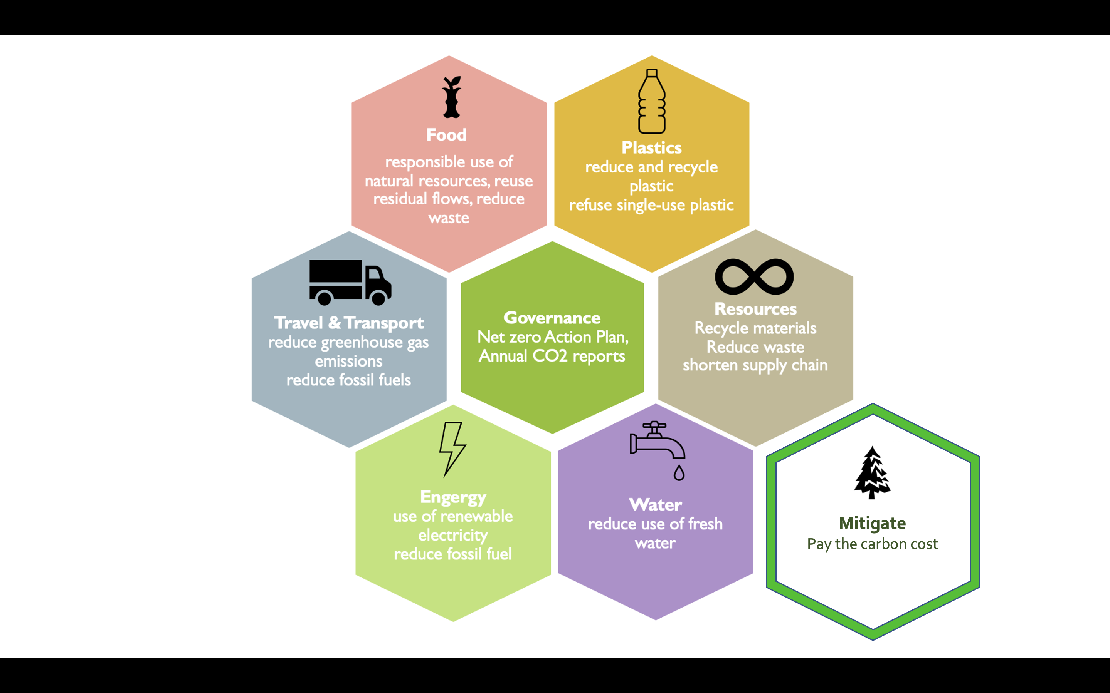

Slide 3
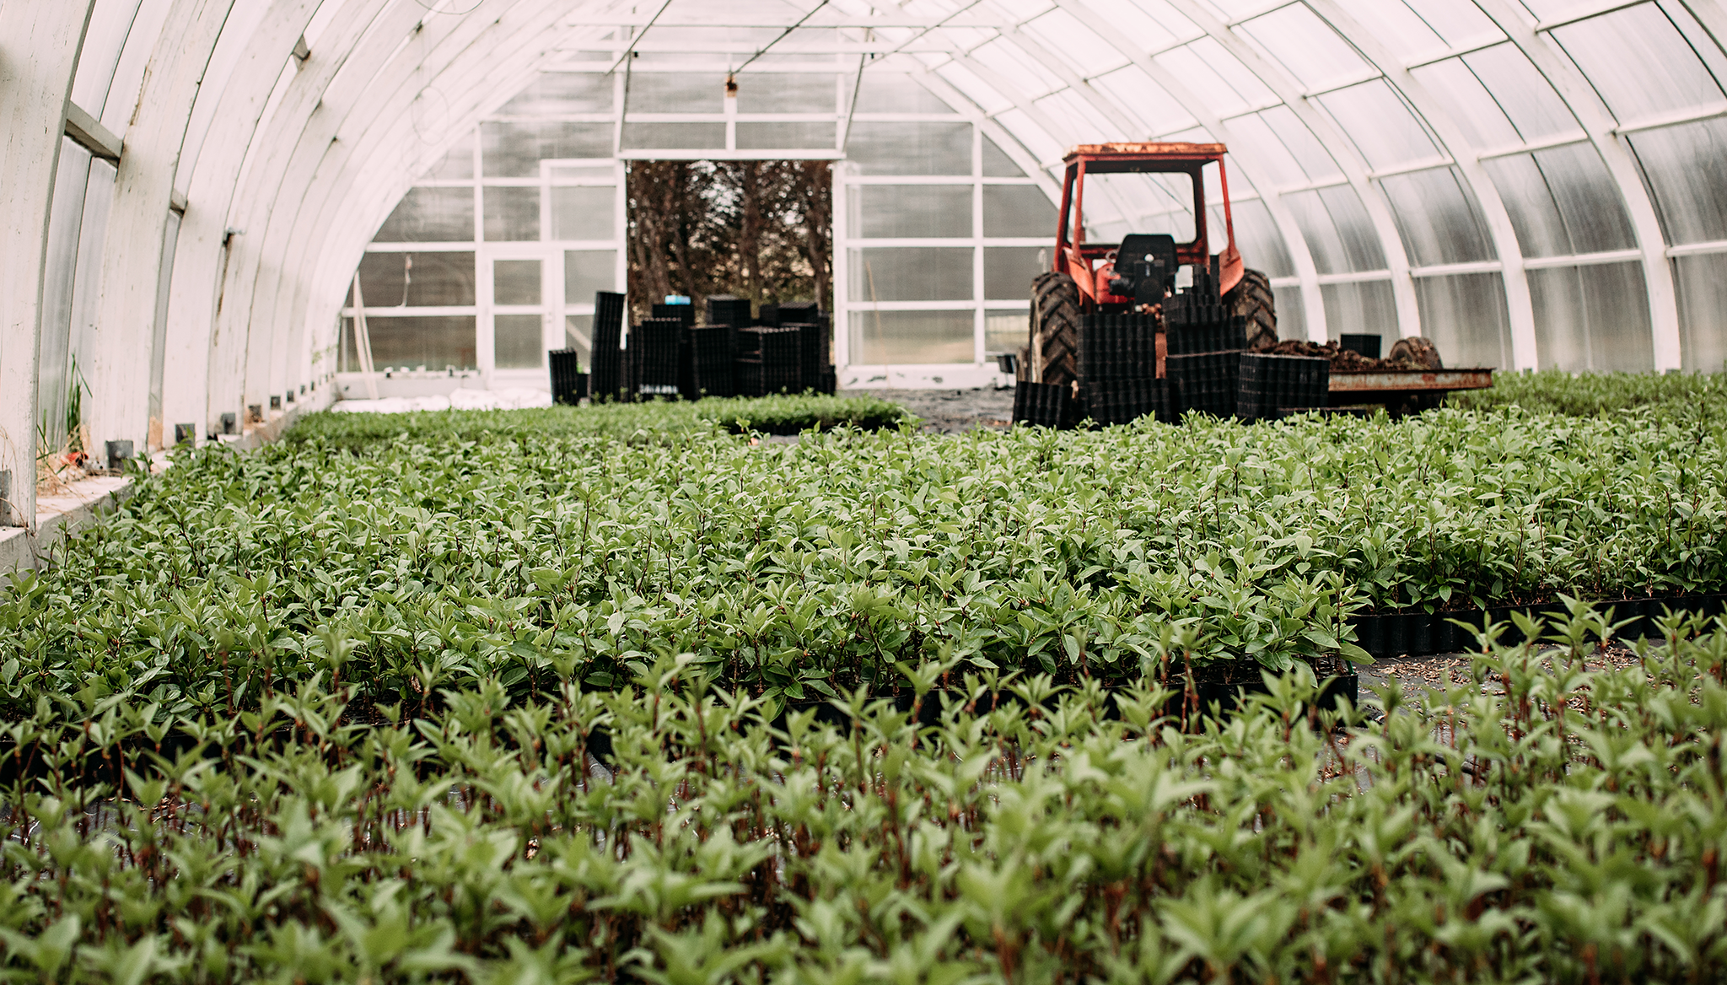




Slide 4
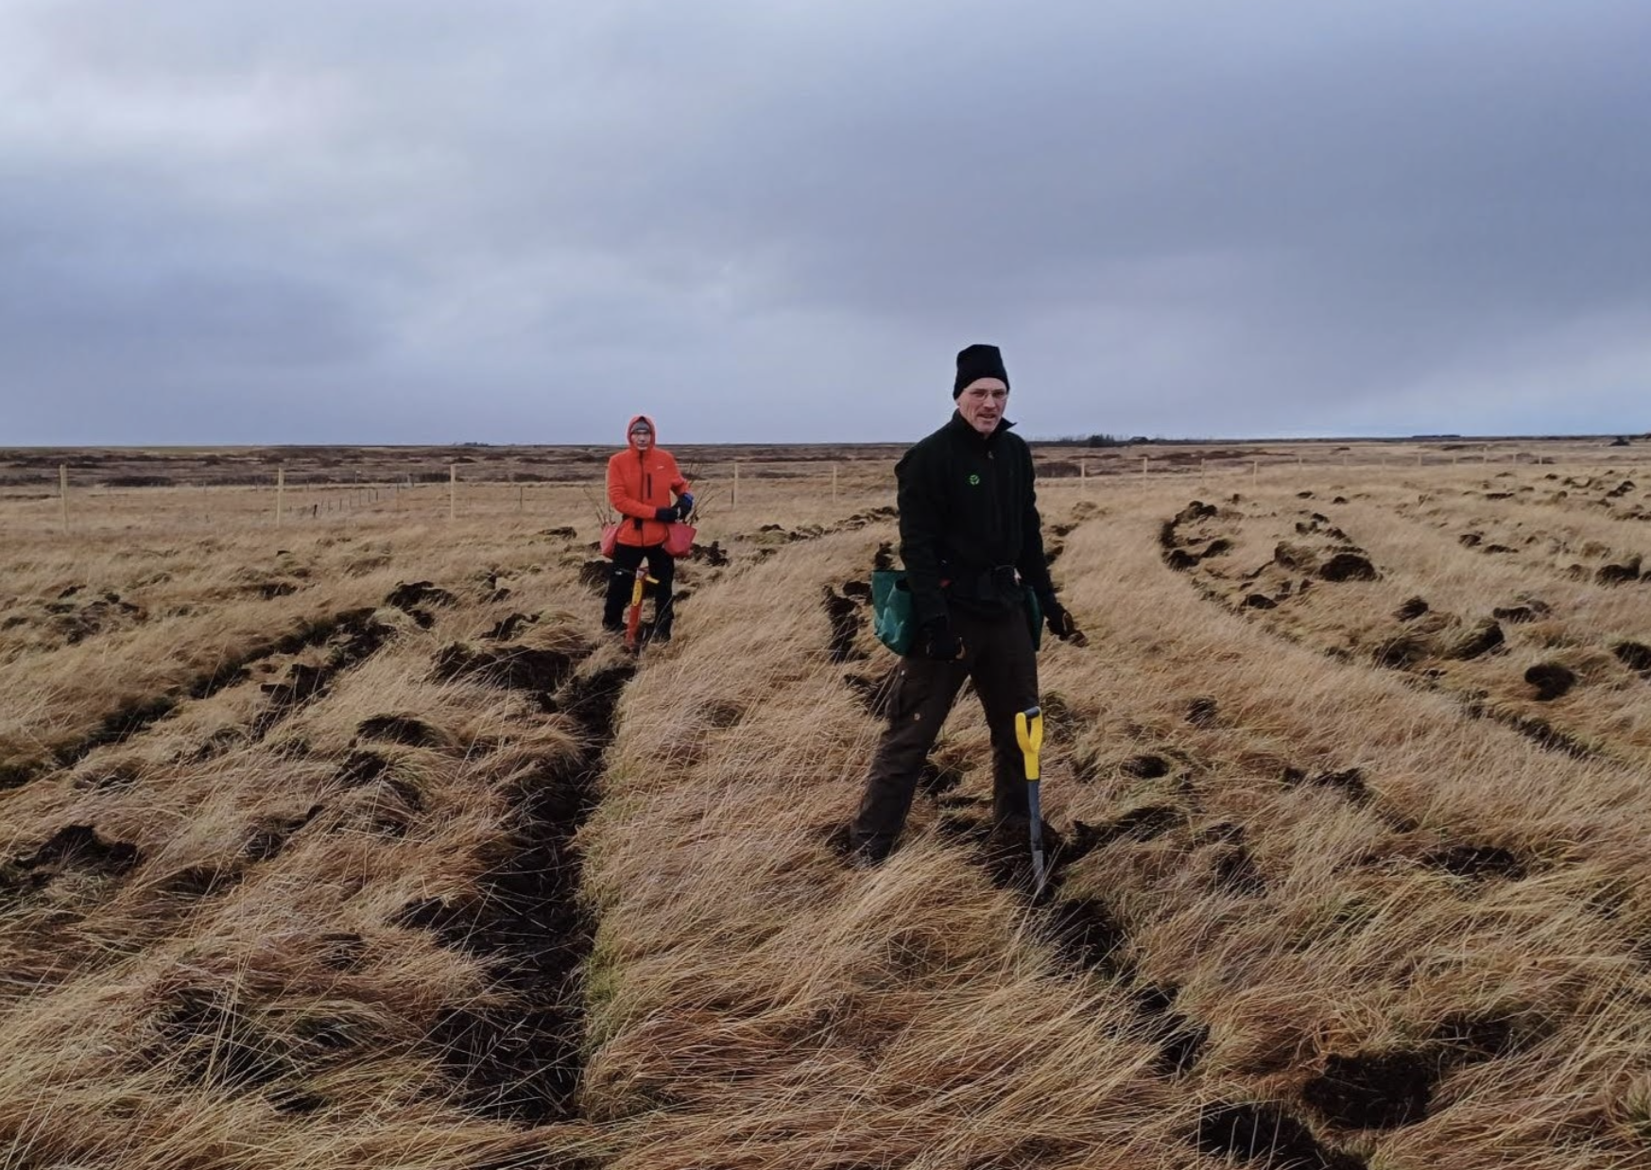
How?
carbon levy on each full booking
voluntary donation of € 2
(or a multiple) via your ticketsystem
a fixed amount to offset travel movements

Slide 5







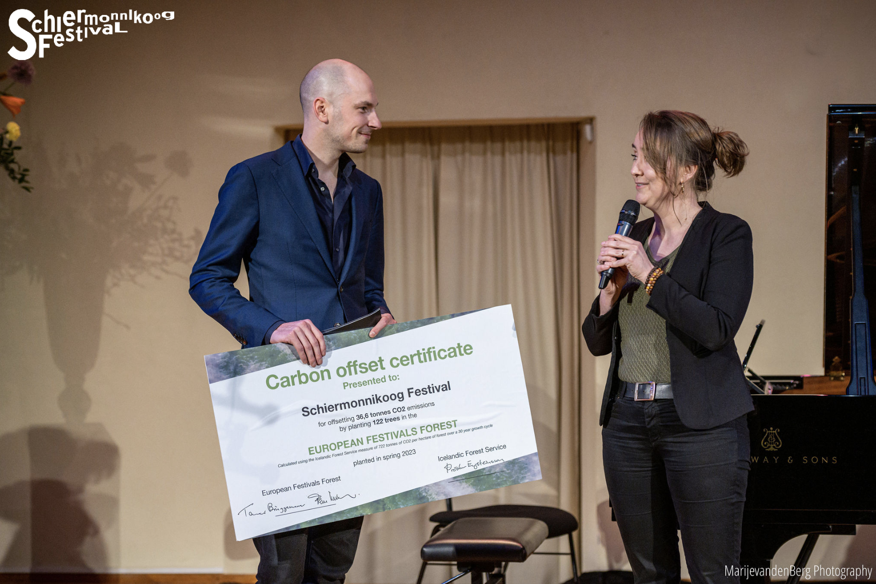









Slide 6

