Slide 1
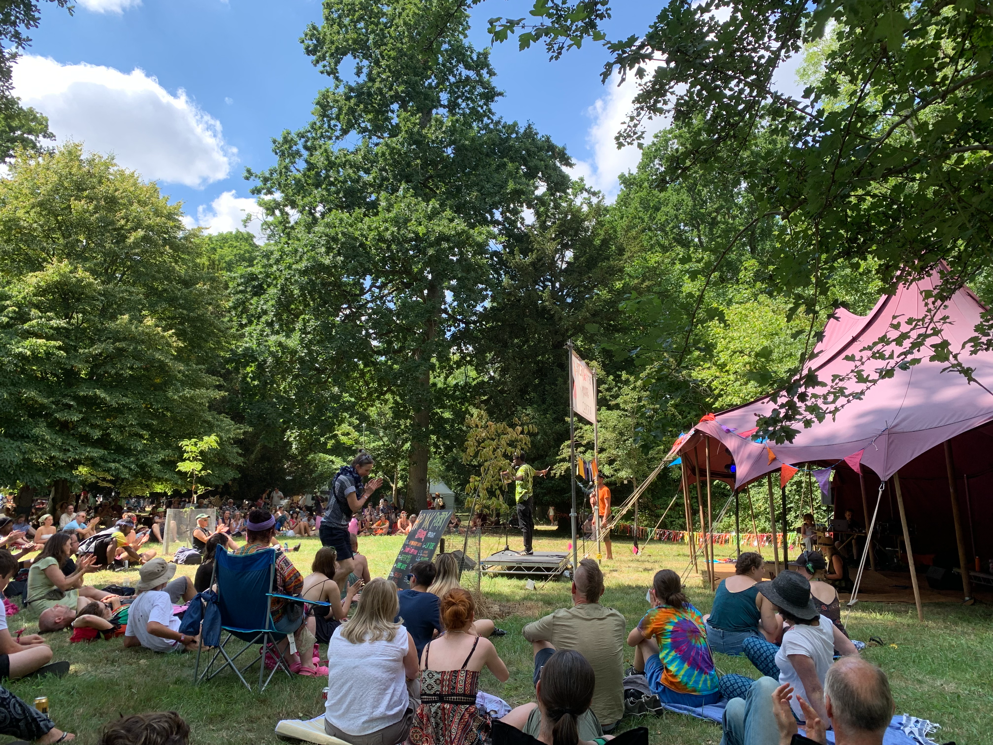
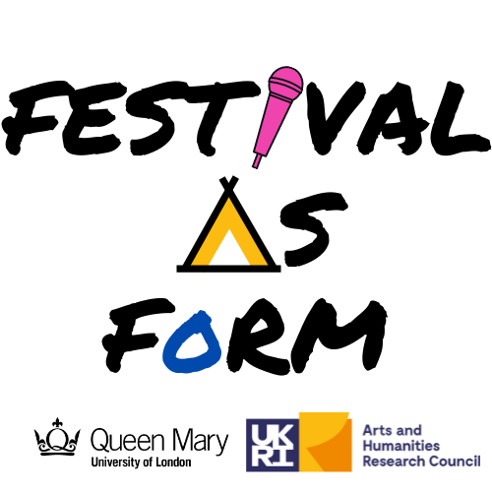
Poetry and the Festival
Notes:
In 2022-23 we researched poetry at UK festivals called The Festival as Form. We asked participants who were interested in the poetry events to photograph anything which captured their festival experience, and 2 weeks afterwards, we interviewed about it. Over the last 15 years, poets and writers have been increasingly given stage time at non-literary festivals, where their performances are for non-traditional audiences and framed by the music, costumes, family and comedy events. It’s part of a larger shift that’s been dubbed ‘the festivalization of cultural production’; Our research set out to understand how this new setting might be altering what poets did. We made a short film with them about what festivals as a setting have done. But as you will see, when it came to interviewing the participants, we got rather more than we bargained for.

Slide 2
10% got involved with new charities or social causes
33% considered change of career / uprated social commitment
25% faced up to vulnerability and life-transitions
25% discovered sympathies towards social ‘others’ whom they had in the past been fearful or ignorant of
15% found it ’transformational’: every festival encounter signalled a new sense of self, purpose and future
Notes:
Those closing quotes are just a small sample. Half a million words of interview later, what we found is that people set their poetry stories inside much longer narratives about how the festival was calling them to change: both change encouraged by the festival and/or changes recognised because of the festival. By change, they did not mean generalised feelings of well-being. Nor did they mean the intense but temporary experiences of ‘cathartic escape’ from repressive normality. Nor did they mean the kind of cosmic experience people report at Burning Man. What we heard instead was that the festival experience had been helping them see longer-term changes needed in regular life.
Just under 10 percent reported direct new involvement with charities at the festival, something social marketeers have already picked up on. But more than third reported that the festival had made them want to change career, given them ideas for new roles within their current work or had renewed existing commitments to green and community causes. A quarter said that the festival had allowed them to face a current life-transition where they felt vulnerable; for instance, coming out in public, the loss of intimate relationships, or the death of parents. A quarter reported that events and conversations with strangers had helped them extend sympathies towards social ‘others’ (sexual and ethnic minorities) whom they had, in the past, been fearful, dismissive or ignorant of. Fifteen percent found their festival experience transformational; everything that had happened had spoken to a new sense of self, purpose and future opening up before them.

Slide 3
What kinds of stories are we talking about?
Contemplating change of career from GP to prison worker
Transformational experience: reconciliation and dialogue with emotionally-absent mother; experienced deep self-understanding following end of coercive marriage
Practiced mindfulness and wanted to take peaceful feeling back into regular life
Found new resources for Ph.D research; realised new purpose and meaning in what she is doing
Notes:
These percentages do not add up to 100, because some people experienced more than one of these types of change. But to give you an idea of the complexity of people’s lives, here are some capsule summaries.

Slide 4
Festival mobility scooter enabled new feeling of participation as disabled person; strong new friendship group; joined social movement
Encounter with refugees exposed unsuspected prejudice; encouraged to keep writing letters to MPs
Learned more about foodbanks and decided to volunteer
Transformational experience: experienced uncanny synchronicities, inspired to build new printing technology, change jobs and relocate.
Notes:
I have deliberately not given you all the most dramatic stories: this is is just a sample of the different levels that festivals get to people. What stands out to us is that people don’t go to event A, have a nice time, go to event B, realise they want to change something, and then go back to event C and have a nice time. The feeling of change coming happens at certain moments but it picks up and builds on all the separate encounters; with strangers in the queue for the falafel bar, in the view of a sunrise over a sea of tents, in the acts and the sets, in the experience of going to the wrong event and then finding it was the one you unconsciously needed to hear.

Slide 5
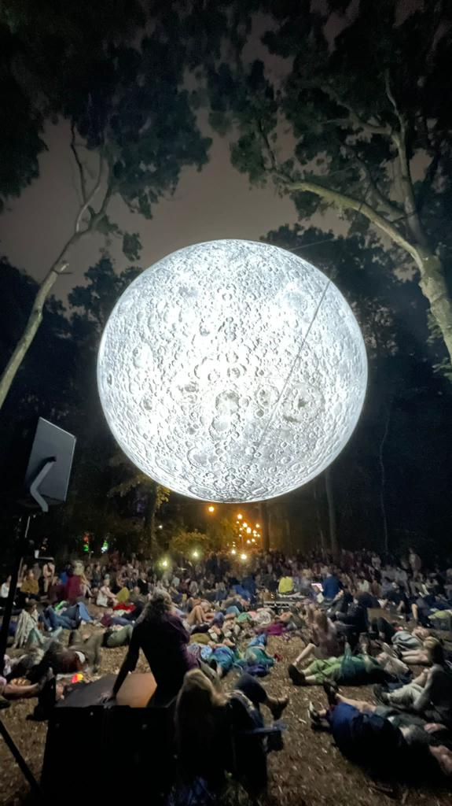
Notes:
It was this overall, 24-hour, unpredictable experience which was allowing respondents to recognise buried inner feelings, and to reconsider their lives. Festivals seem to make people feel change coming, and that it is possible. And the poetry is part of that. Discussing this photo, one participant described the poetry stage as a small-scale version of her whole festival experience of discovering ‘affiliative’ connections with strangers and with herself:

Slide 6
the poet kind of links you to the other people in the audience, but also to them, but also to yourself. It’s a… defying, kind of, a breaking down of a miasmic skin that’s suddenly missing, and you kind of fast-forward into a more authentic experience of your emotions.
Notes:
the poet kind of links you to the other people in the audience, but also to them, but also to yourself. It’s a… defying, kind of, a breaking down of a miasmic skin that’s suddenly missing, and you kind of fast-forward into a more authentic experience of your emotions.
But the other thing that stood out to us is was that, although people’s overall experiences were largely joyful, many had to cross emotional barriers. Prejudices had been exposed, fears revealed and family rifts faced up to. These personal and difficult changes have not often been noticed in the research.

Slide 7
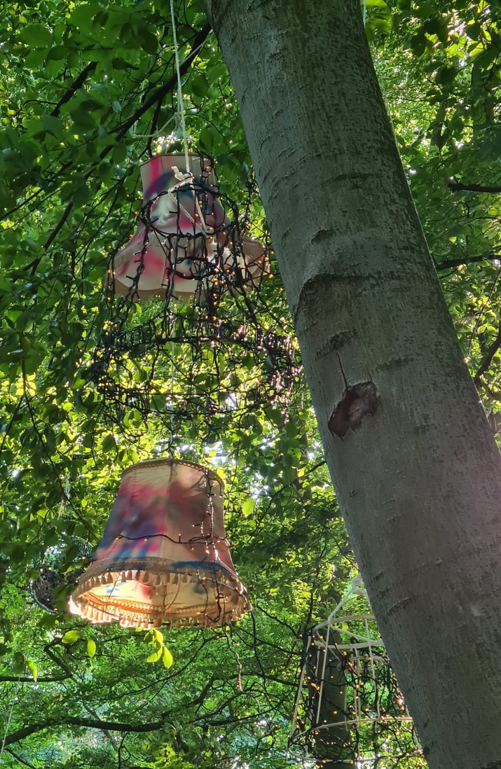
What I meant from that is that, you know, I’m a middle-aged man, so things are as they are, aren’t they? So you, you have certain expectations. So you want trains to arrive on time, and you want, you know, want the lights to come on when you switch on the switch… and you get affronted when people or situations don't conform to your own expectations. And quite a lot of time, things are either right or wrong, and I think, lampshades in trees, you know, why have you got lampshades in trees? That's ridiculous, it’s, it's not what should happen, really.
Notes:
This was a photo from a man of a particular festival stage involving an outside / inside feel – under the trees were beds and upturned sofas, and hanging from the trees were lampshades. The décor started a train of thought. He captioned it saying ‘lampshades in trees… challenges us to live in a less binary way’. When we asked in an interview what he meant, he said this.

Slide 8
And I think it just made me think - just lying back in the, in the chairs, you know, looking up at these trees, and seeing the lampshade swinging and think – and you just think, why shouldn't you have lampshades in trees, you know? And I think from that just stems a whole load of stuff, that says, actually look for the unexpected in the everyday.
Notes:
As the interview progressed, though, it emerged that lampshades in trees stood for other kinds of ‘affront’:

Slide 9
And I think, to my shame, I feel that that was especially true of the whole LGBT thing, which, you know, I'm desperately trying to not feel uncomfortable with, you know, two men holding hands… whereas most people would find that affronting, you know, and be offended by that, in what the lampshades and the trees said to me was actually, let's make that normal. Let's have, in our everyday life, let's have more lampshades in more trees, you know.
Notes:
It took a while to get to this point, and what struck me is the sense of internal shame that has to be faced here. I could give many other examples of people being able to own things they were fearful of – challenging events, difficult speakers, unwelcome feelings. Festivals seemed to be giving people the time, the space and the atmosphere to adjust. As I’ve said, this hasn’t really been picked up in festival tourism research before. But it harmonises very well with what anthropologist David Picard thinks is now the core purpose of festivals worldwide.

Slide 10
The mediation of life-crisis . . .Often very short and transitional life crises are provoked by situations of social interaction, or by the individual trespassing of spatial or temporal limits or boundaries… someone dying, coming of age, falling in love, being ill, being jobless etc. Such crises challenge, in a more or less dramatic way, the ways in which an individual conceives and perceives his or her being in the world, but also how he or she is perceived by others.
Picard and Robinson, Festivals, Tourism and Social Change (2006)
Notes:
By mediation, he means: talking it over with yourself, seeing it in new lights, adapting, adjusting your inner narrative. By life-crisis, he means all the situations here. Festivals provide not only temporary joy, but opportunities for dynamic stabilisation and reorientation for people experiencing ‘life crises’. But, as P and R stress, these life crises are not just personal, but intersect with race, with the environment, with global change.

Slide 11
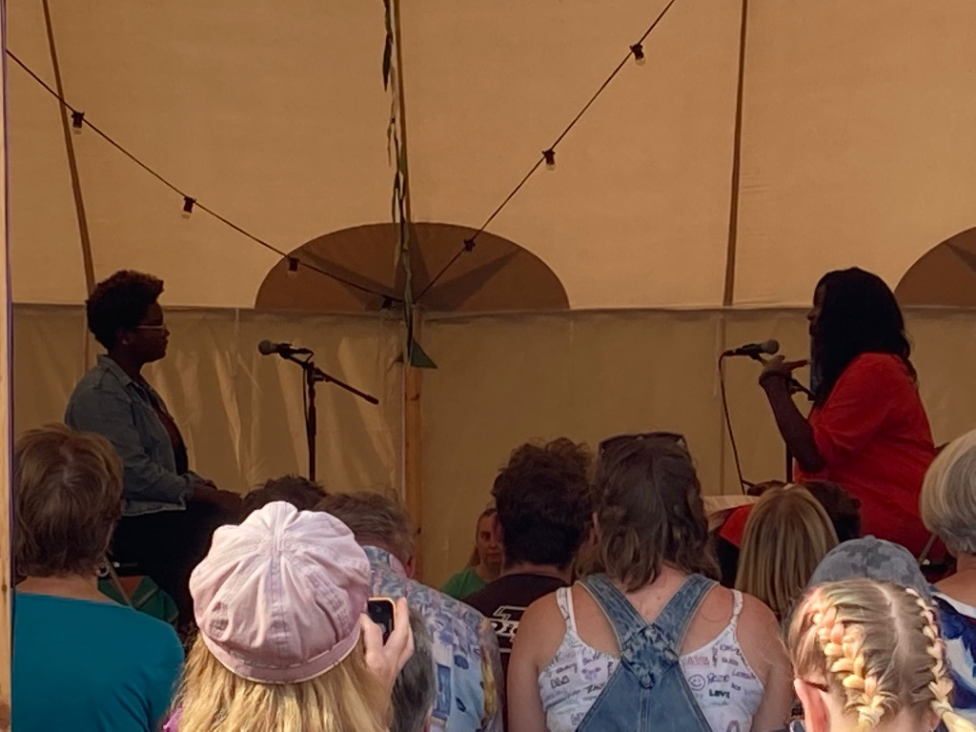
Notes:
Another photographer who had funded her attendance by part-time café volunteering was asked about what she would take back to daily life. At first she mentioned the joyful team spirit and the attitude to reducing food waste, before correcting herself. No, what she really wanted to remember and continue relates to what she’s photographed here, an event with Renie Eddo-Lodge:

Slide 12
But I think actually the stuff around racial justice, you know, col-, decolonisation, that inclusivity, you know. And I think also the self-expression from the poetry. I think, you know, you can feel, listening to the people talking about suicide on the mental health side, and then those poets having that sense of bravery, I suppose, to have that self-expression, and that being kind of like a form of healing – I’ve definitely connected with that. . . almost like a bit of a self-healing process for myself.
Notes:
The word ‘inclusivity’ here, meaning a new understanding of the experience of refugees and people of colour, leads her into admiration for certain poets’ honesty in making unwelcome feelings public, and then to recall her own ‘self-healing’. The festival has allowed her to connect sympathy for excluded others with recognition of unwelcome / disavowed feelings within, and to achieve a measure of reconnection or inclusion with them both, so that the personal and social / global dimensions of ‘life-crisis’ overlap. She was someone who went home with a new idea of what she wanted to do at work, and having done quite a bit of grieving for a relationship that went badly wrong during lockdown.

Slide 13
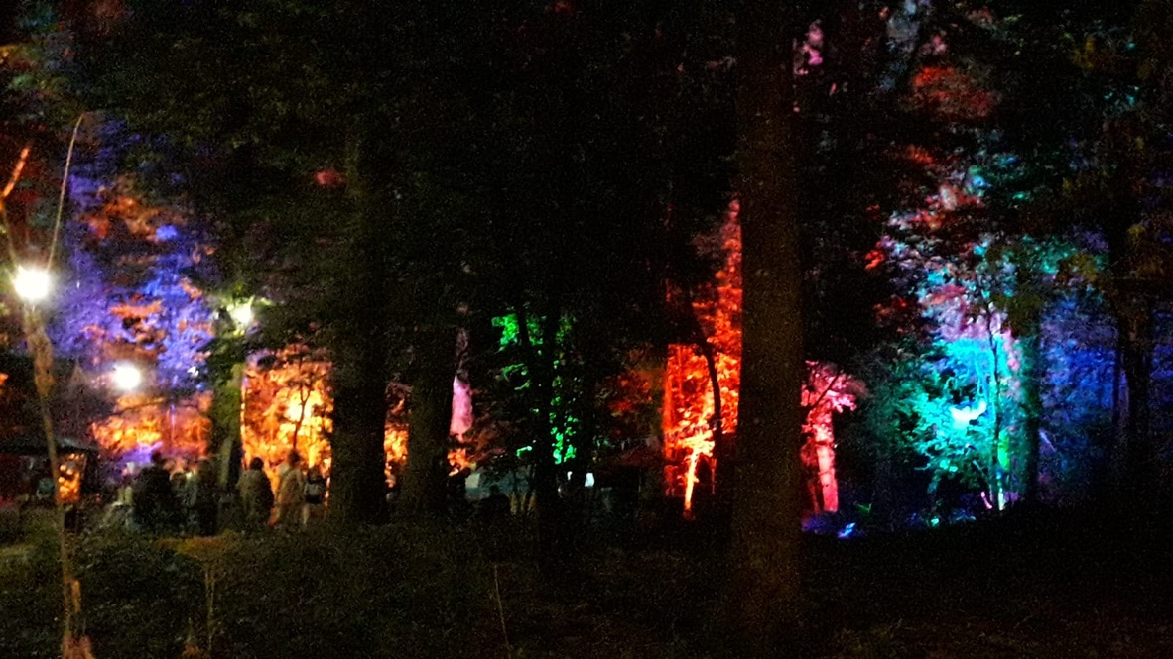
Notes:
But this feeling of boundaries going also has consequences for access. Here is a photo taken by a participant who was talking about the colour and abundance of the festival site. ‘I didn't actually go and explore, but I just thought the colours were lovely’. Our interviewer then said, ‘Oh yes, I went there. It was a gin bar. A very expensive gin bar’. And this provoked then another train of submerged thought, to do with colour and money.

Slide 14
I think it is a bit of a, a criticism of WOMAD and other festivals that it's not... I mean, you could see that it's not very diverse.
I think the cost of it is- is a, is a bar. You know, and, and that's actually- and that also... rules out, umm, you know, people without access to resources, you know, from all sorts of- from every ethnicity. Umm.... but you know, I- I imagine... I mean it must be very expensive to put on. . . But given that it is, a- a global thing and the performers, yeah, so the performers are much more diverse than the audience.
Notes:
The lowered-boundaries-feel also meant people noticed who was not there. They wanted to tell us about great work from festival access teams around mobility, disability and neurodivergence, but like this person, it meant people were aware of the boundaries around the festival too. We observed poets calling that out, and actually making poems from it. We should also add that the poetry stages discussed how hard it was to get diversity; mainstream music festivals take poetry as an optional extra, meaning budgets are decided late, meaning poets of colour are booked up and their fan clubs don’t come, meaning less diversity at the festival.
And yet we found it was consistently the poetry that gathered all kinds of people’s general festival ambience and gave people the language to think and feel the changes coming. What our research captures is the range and depth of the feelings and situations that people bring into the festival and its poetry. People came as fun-seeking consumers and as self-improvers, but also as those who carry feelings of being excluded, defiant, anxious or grieving, and this is where the poetry more often found them – because that’s what’s poetry’s job. I’m going to close with a couple of postcards that people left us after particular poetry shows.

Slide 15
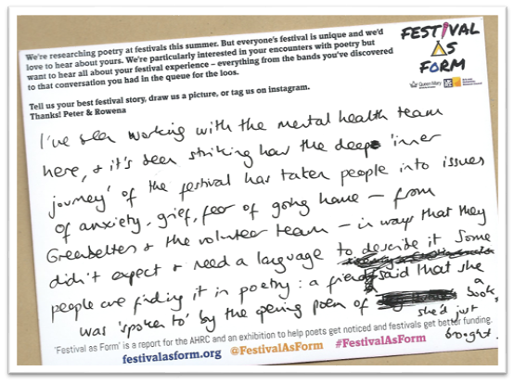
Notes:
This first was sent to us by an anonymous member of the Greenbelt festival’s mental health team after a poetry event

Slide 16
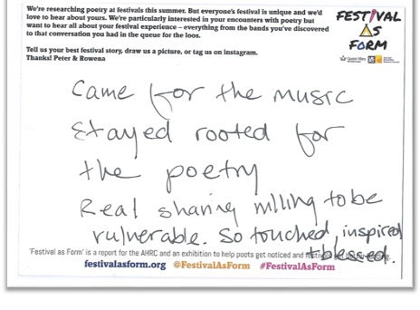
Notes:
And this second was from a music festival.

Slide 19
Festival audiences are experiencing an overlapping series of thin – but not collapsed – boundaries
physically (tents, shared tables, crowds, toilets)
socially (unexpected conversations with strangers and stars, opportunities for participants to make or become part of the art)
socio-geographically (worlds colliding, personal witness from global majority and refugees))
Notes:
Why does this happen? I think because people are enabled to think about change because there is a correlation between the physical layout, the social values and the inner change. People are crossing boundaries.

Slide 20
intergenerationally (parents acting like kids and vice versa, Zoomers/ Boomers, child-free adults thinking about children)
schematically (events morph into each other, scheduling goes to pot, the chancy and the chosen overlap)
genderedly (costume cross-dressing, safe space for LGBTQ+ encounter)

Slide 21
temporally (out of day/night schedule, large-scale repeats in time, memories return, non-human scale of time in nature, stars, climate)
emotionally (intimacy, unexpected empathy, crises, grief, even re-birth experiences)
Many report a temporary experience of a less ‘buffered’ or less defended life.

