Slide 1
What’s the score?
The role of the Team in the Festival Community

Slide 2
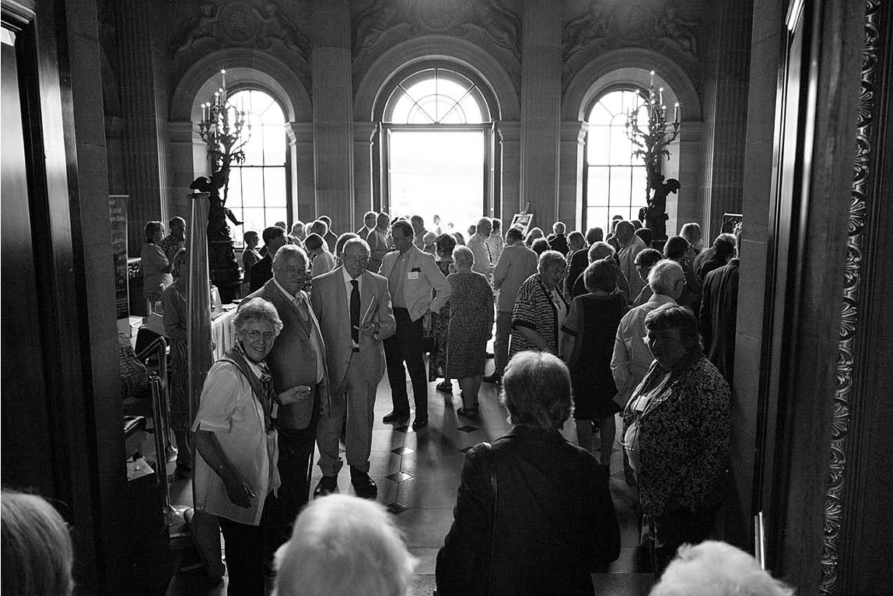
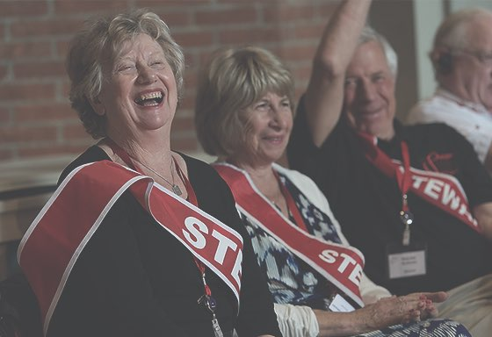
Essential Work

Slide 3
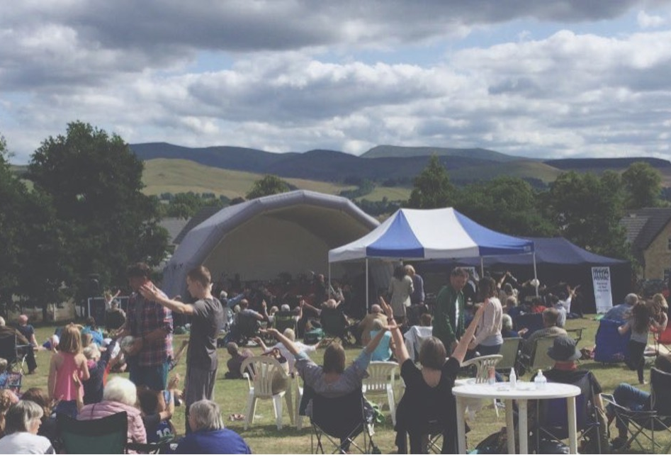
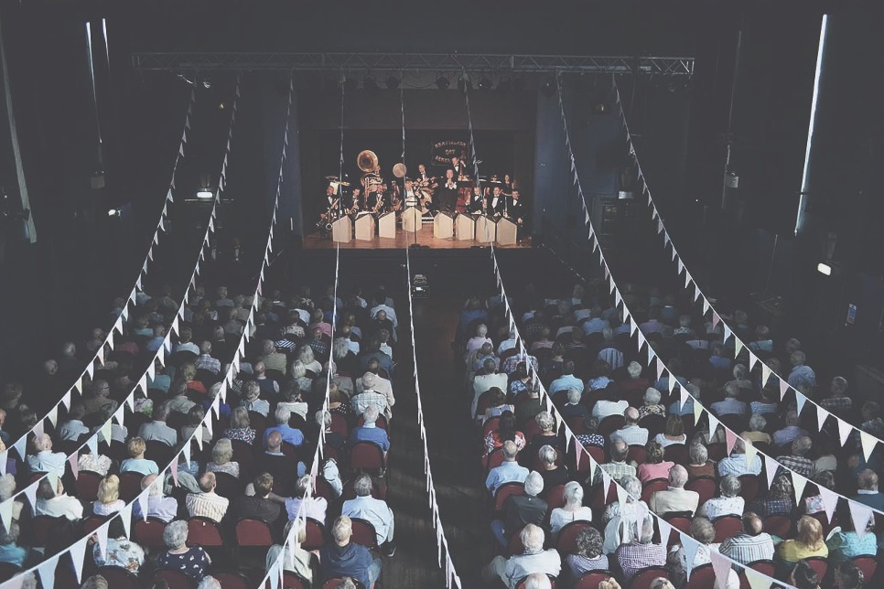
Community

Slide 4
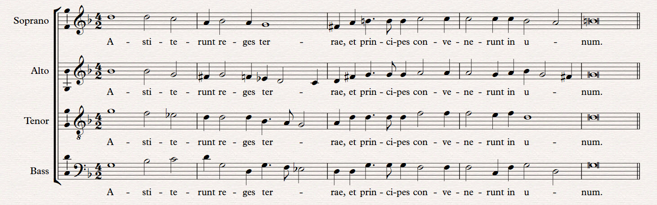
Host community
(Stave, key signature, time signature)
Artistic Director(s)
Audience
Dynamics, tempo, articulation
(Melody)
Artists and presenters
Volunteers and ad hoc team
(Lyrics)
(Harmony)
Core staff team
(Bassline)
The Festival score…

Slide 5
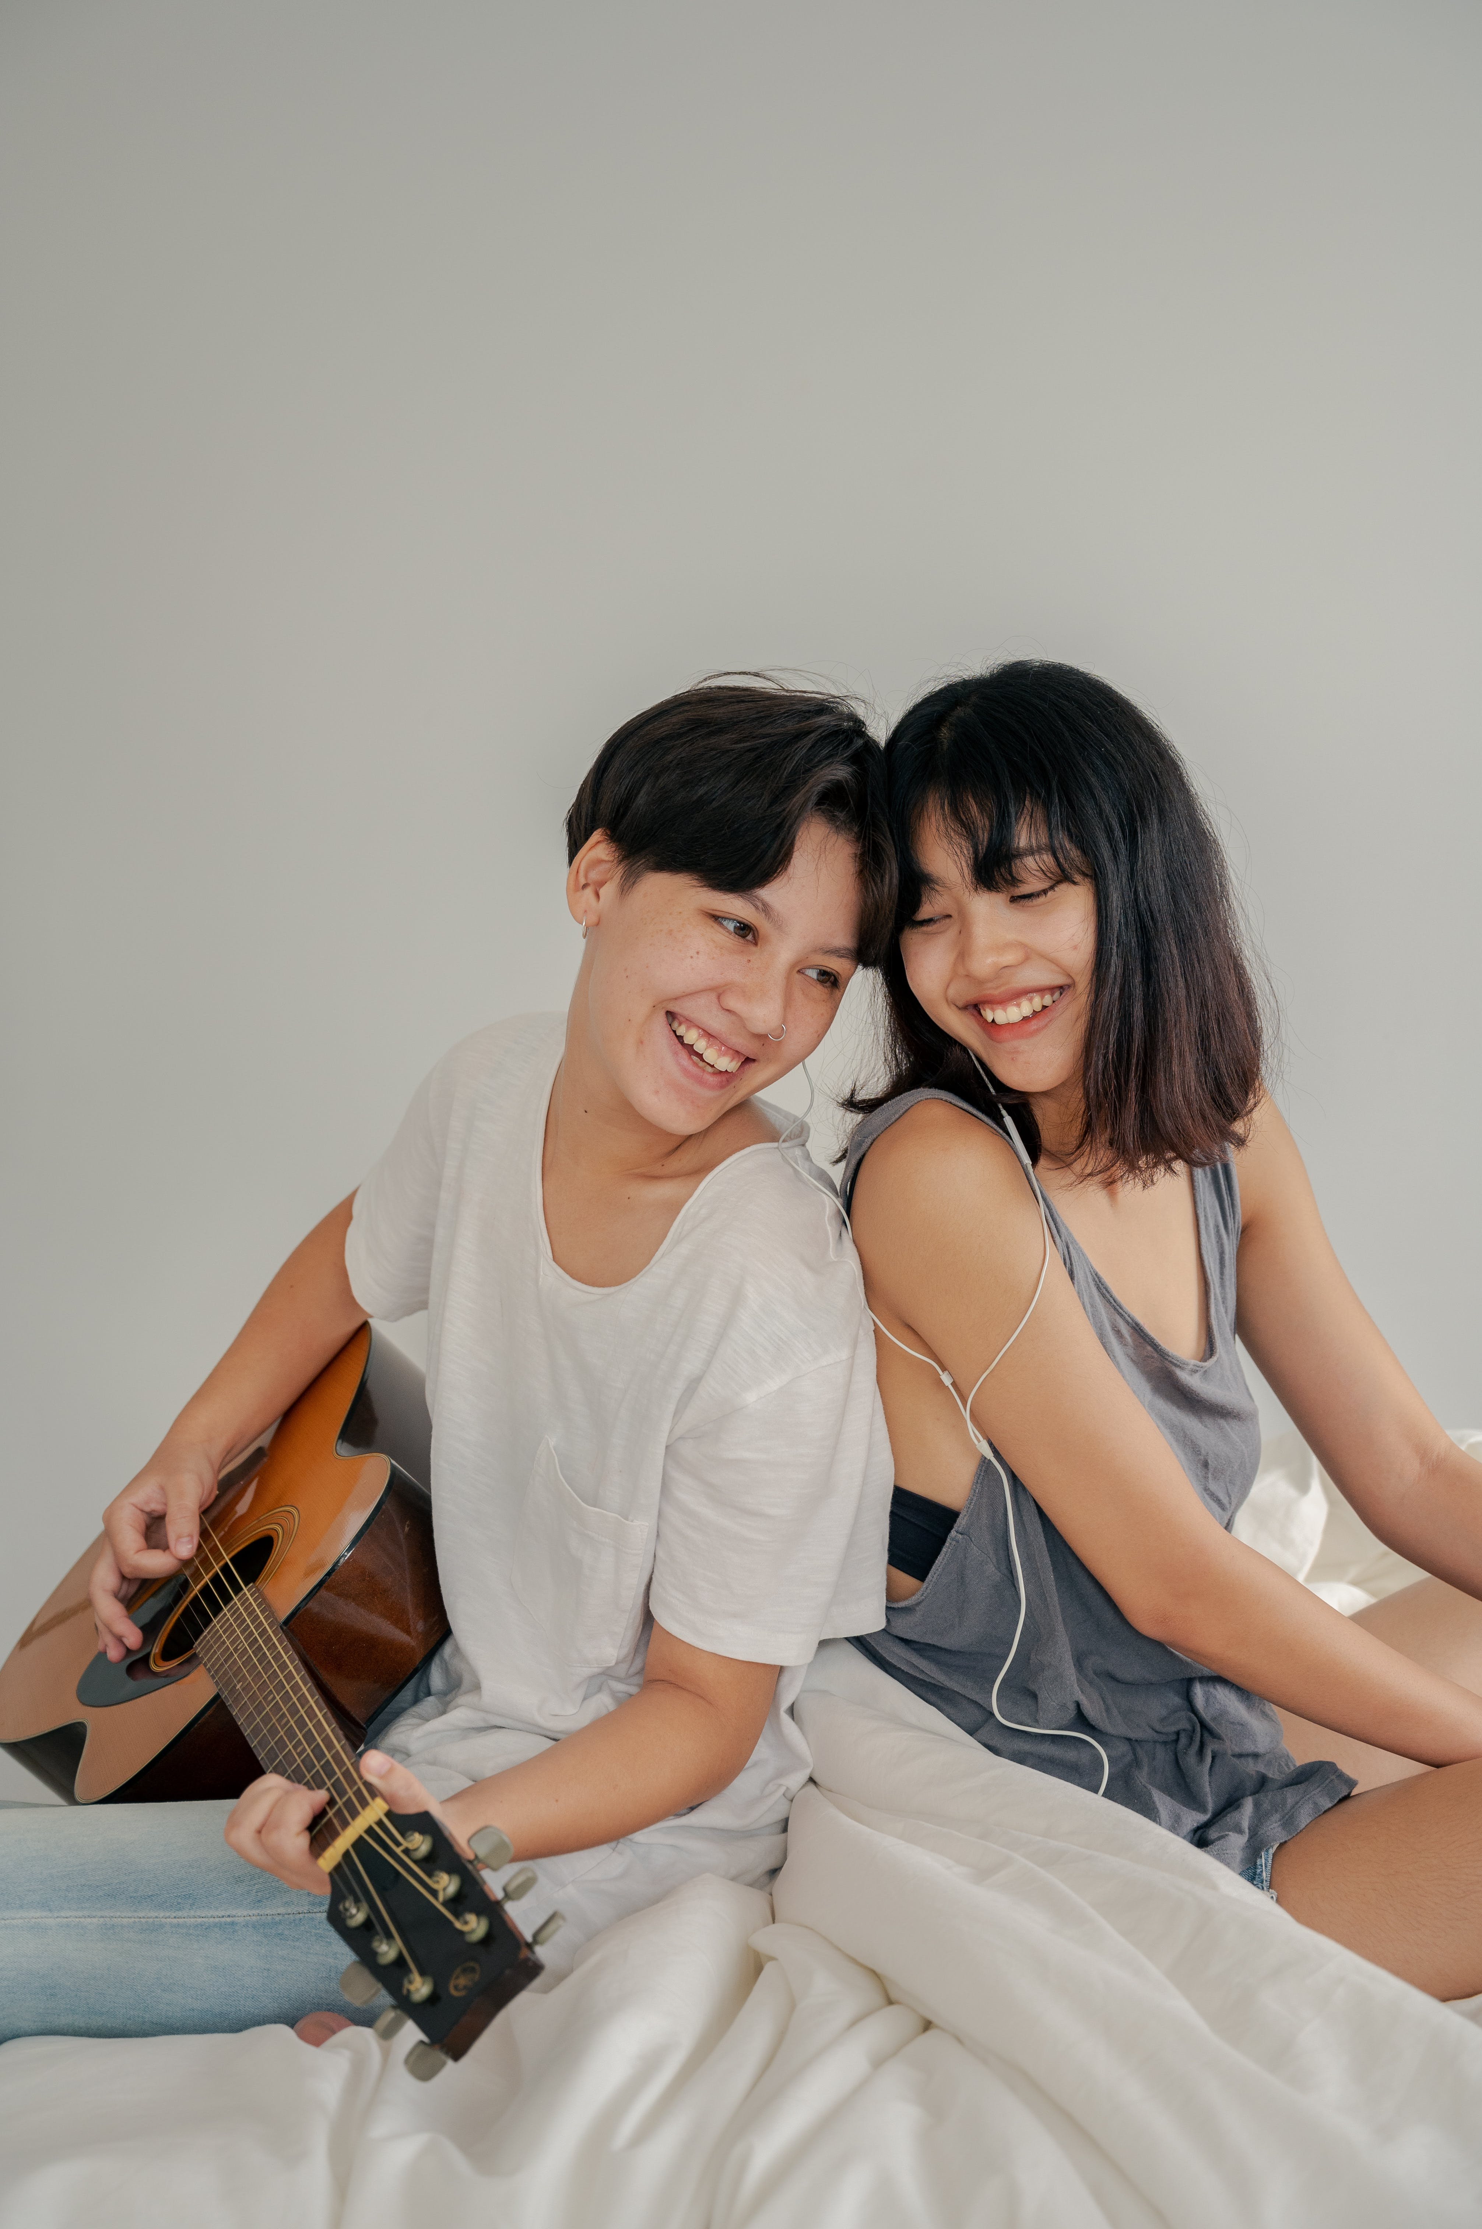
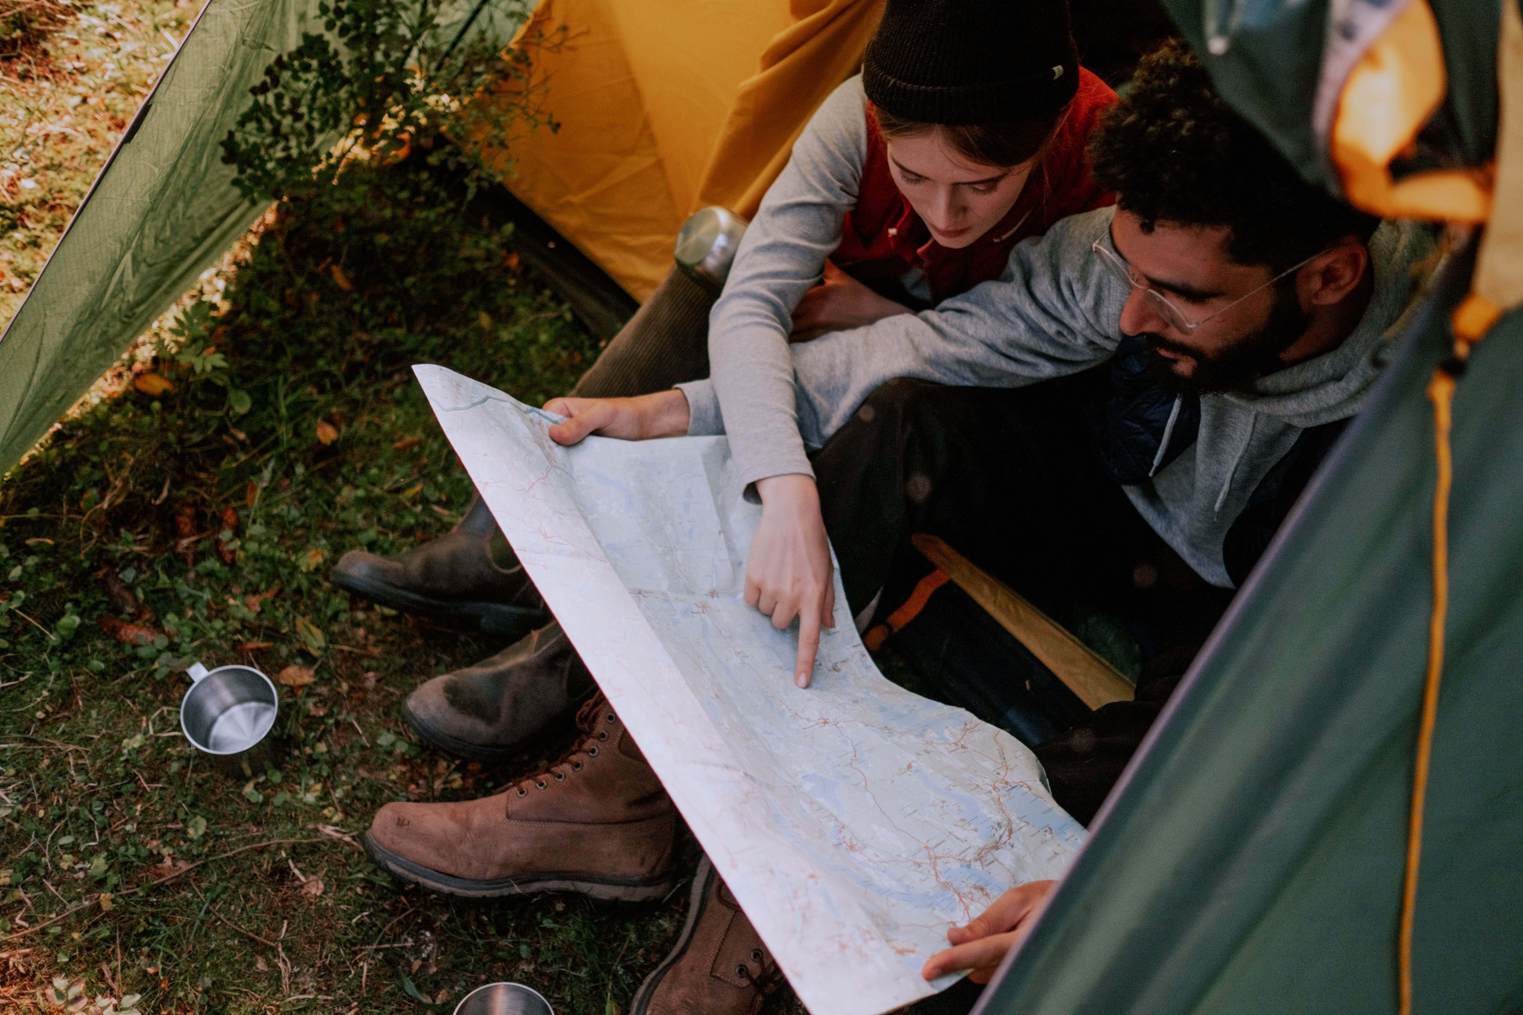
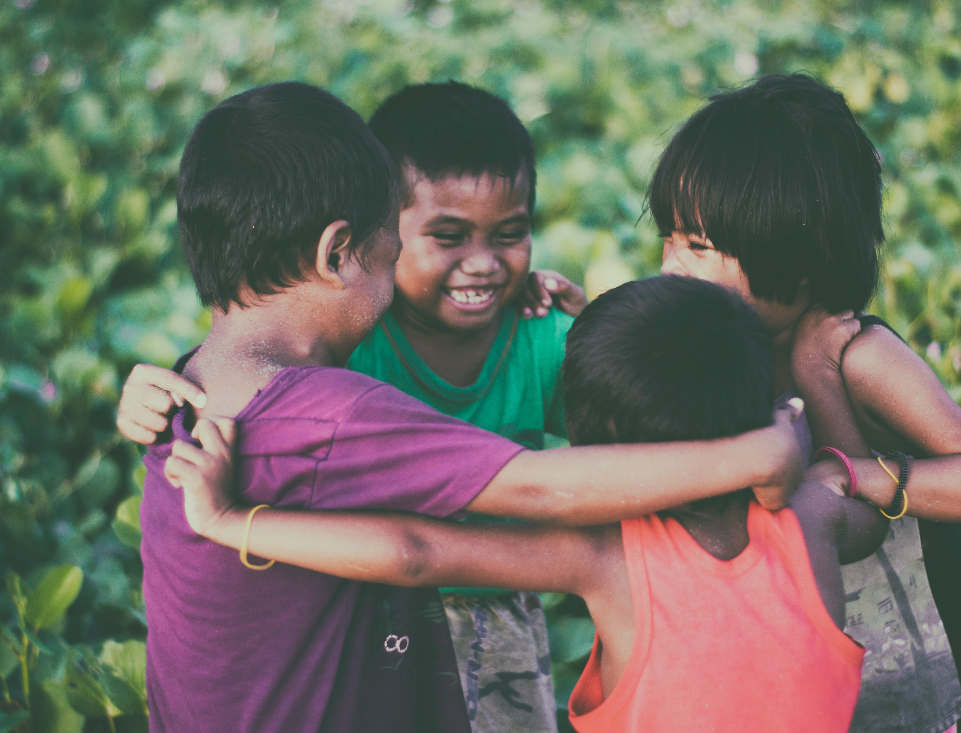
Belonging

Slide 6
‘Belonging’ at work comes when we feel…
Seen for our contributions
Connected to our coworkers
Supported in our work
Proud of our organisation
What does it take to build a culture of belonging? — Harvard Business Review, Julia Taylor Kennedy & Pooja Jain-Link

Slide 7
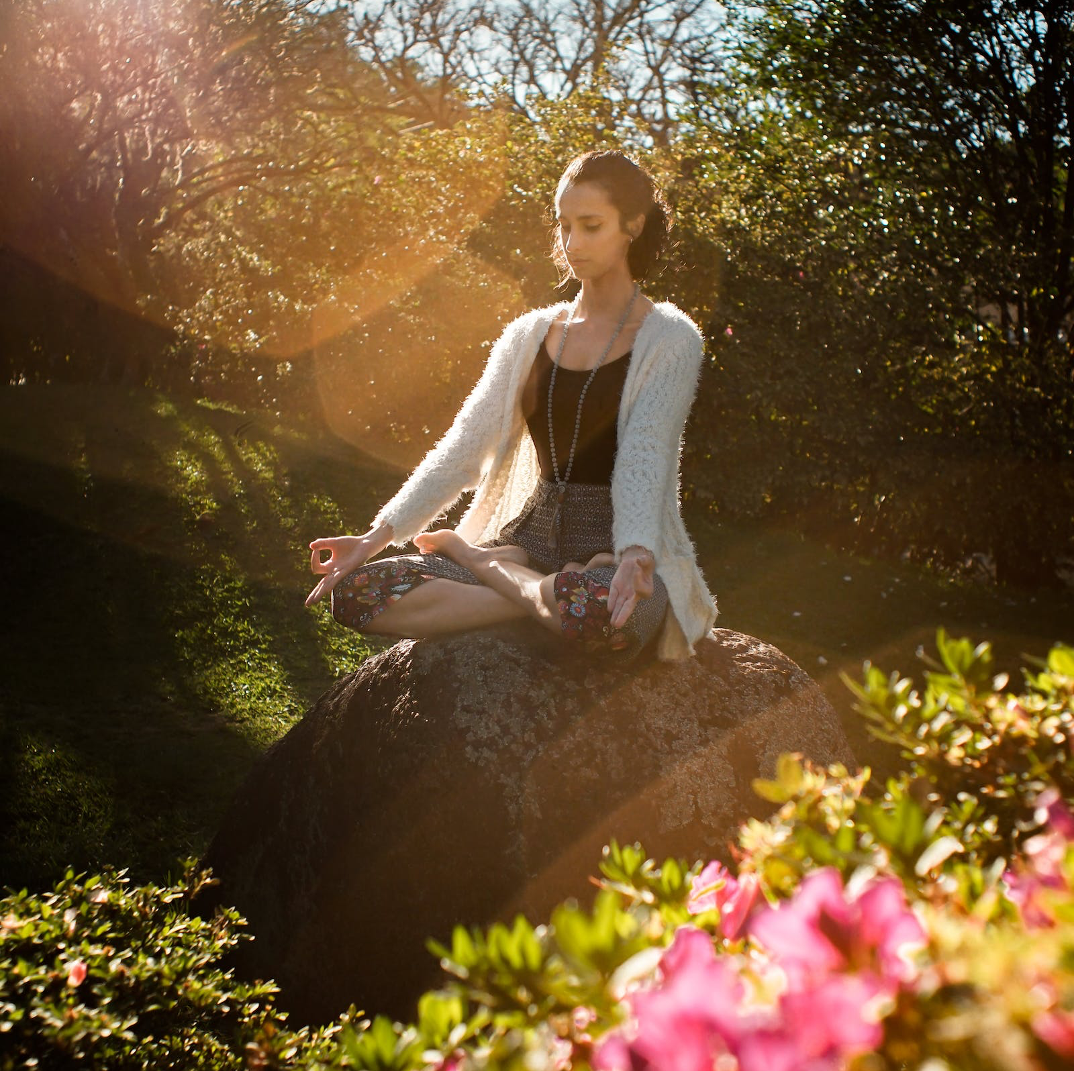
Calm

Slide 8
Impact Players
Unboxing: “Do the job that’s needed”
Taking the initiative: “Step up, step back”
Getting things done: “Finish stronger”
Learning as you go along: “Ask and adjust”
Sharing the load: “Make work light”
Liz Wiseman: Impact Players | How to Take the Lead, Play Bigger, and Multiply your Impact.

Slide 9
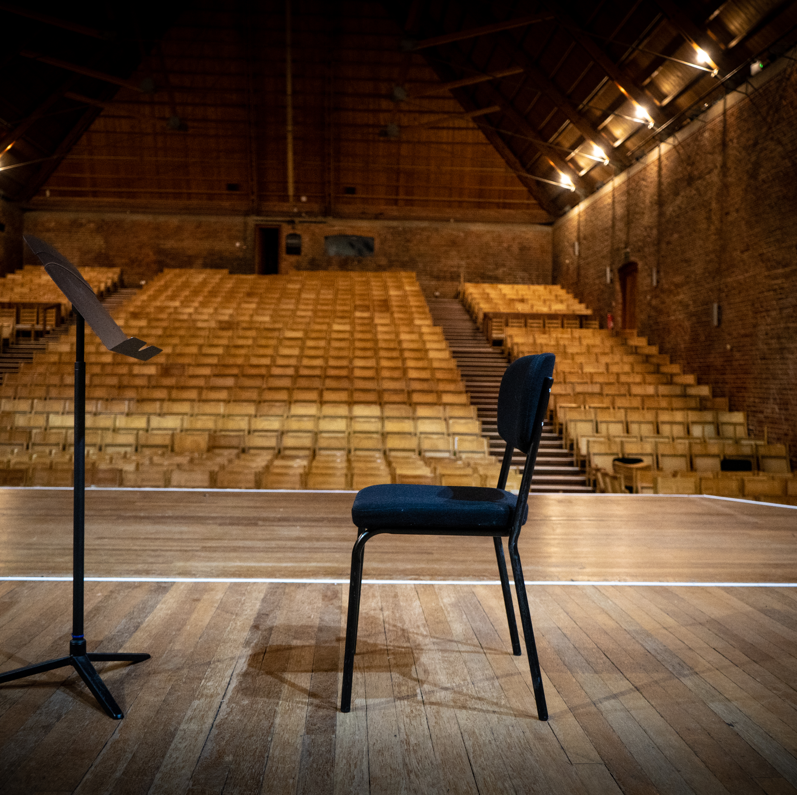
Vision
Imagination

Slide 10
Reproductive imagination
Productive
imagination

Slide 11
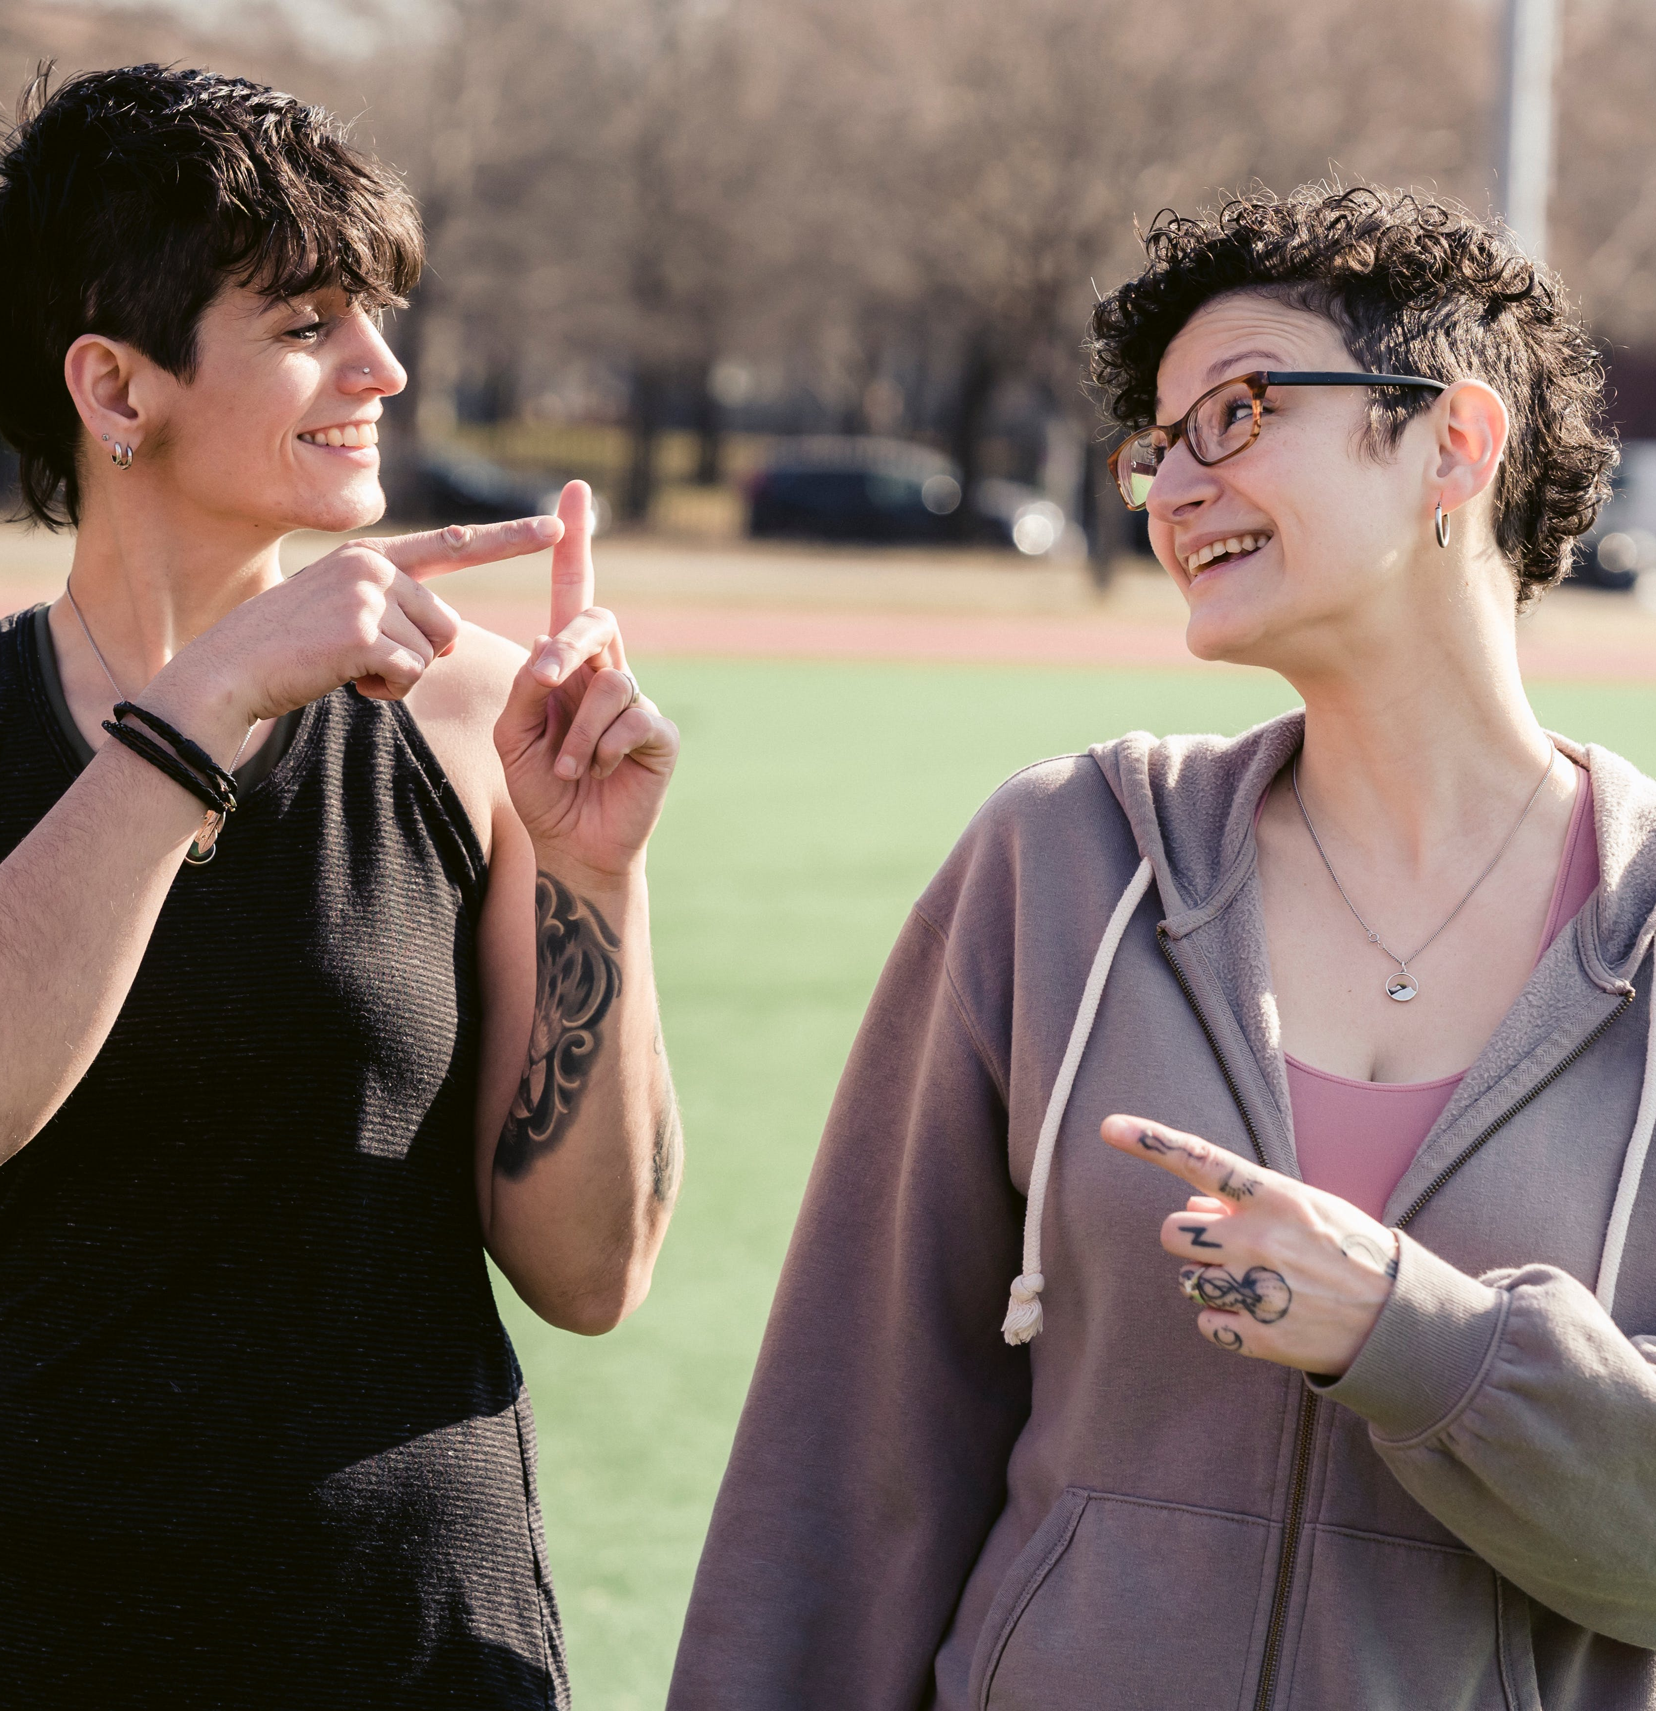
Language
Festival

Slide 12
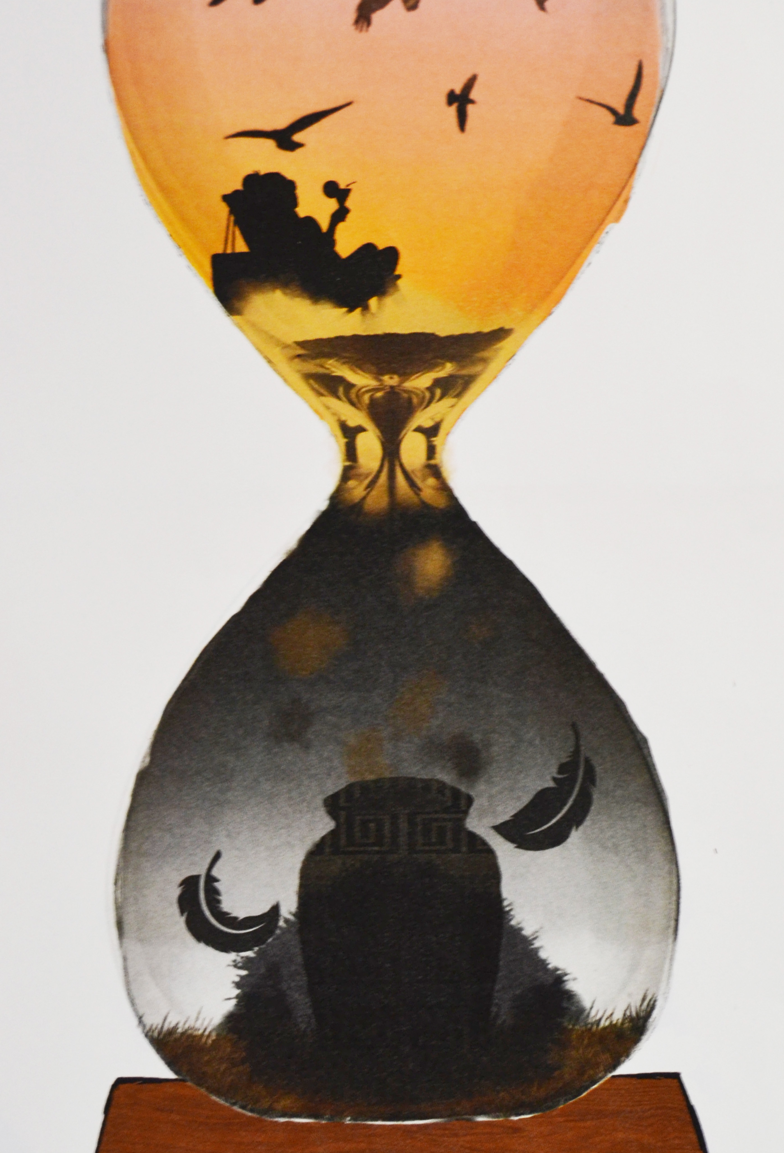
Time out of time
Image: Natasha Ajiboye, winner of Chiltern Arts 2023 Art Competition Under 18s Category

Slide 13
Host community
(Stave, key signature, time signature)
Artistic Director(s)
Audience
Dynamics, tempo, articulation
(Melody)
Artists and presenters
Volunteers and ad hoc team
(Lyrics)
(Harmony)
Core staff team
(Bassline)
The Festival score…

Slide 14
The full score

