Slide 1
Provocation:
The AI Future - challenges and opportunities for festivals
Marieke Navin, Cheltenham Festivals

Slide 2
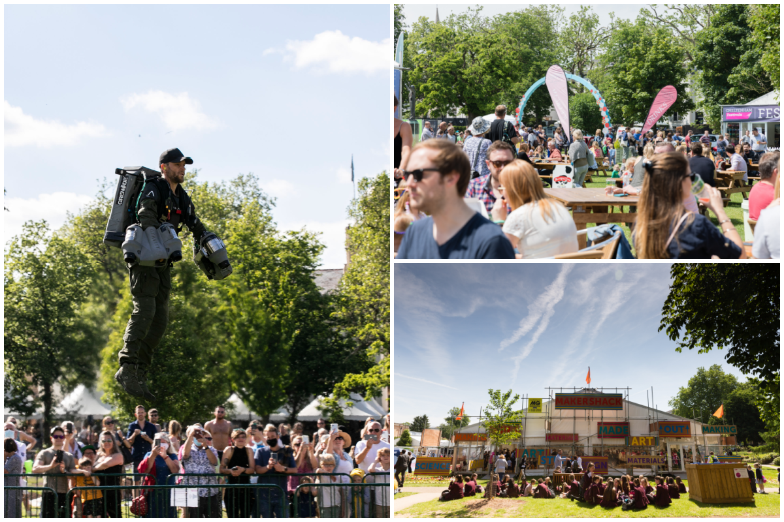

Slide 5
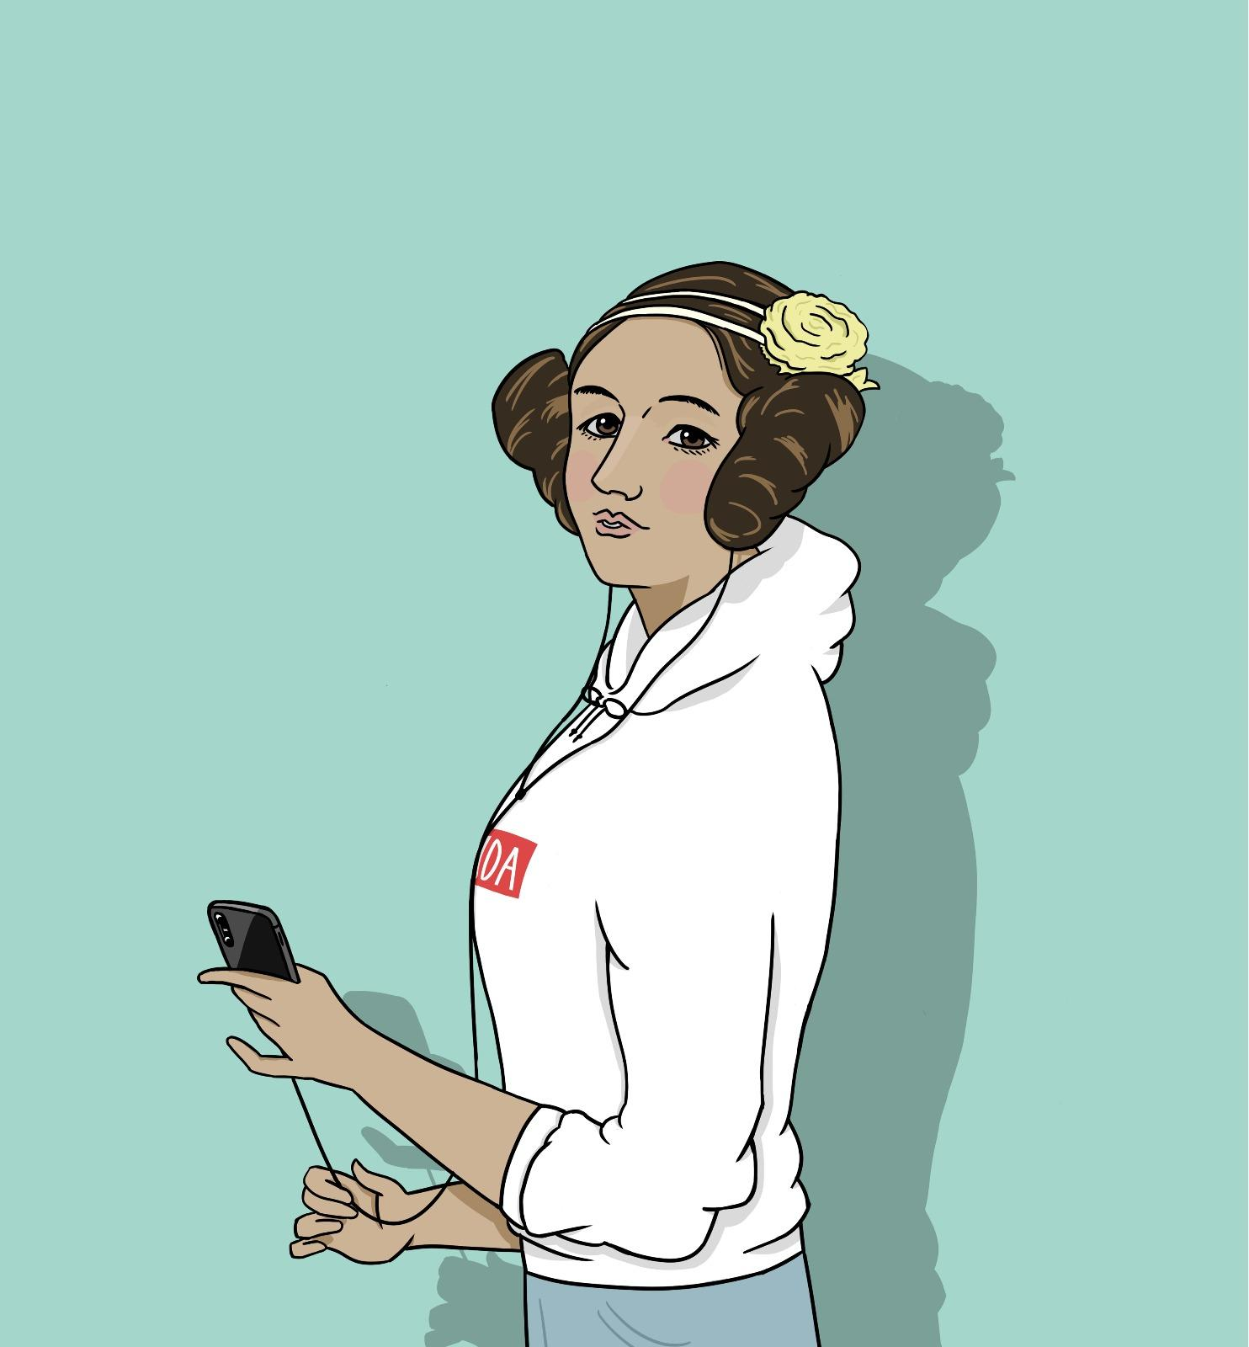
2019: First-ever
AI Guest Curator
Notes:
KERRY

Slide 6
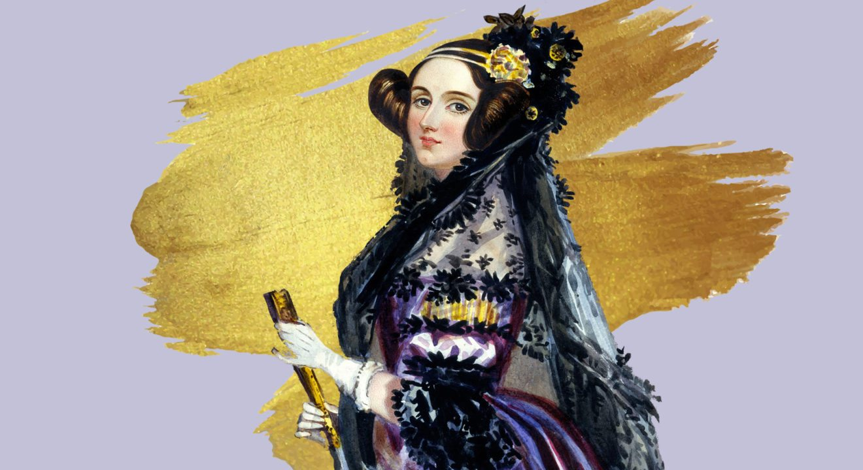
AIDA’S AVATAR
AIDA is named after Ada Lovelace, who published the first computer algorithm.

Slide 10
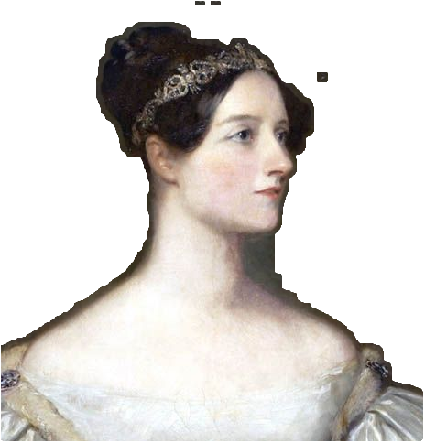
“And then in 2021…

Slide 11
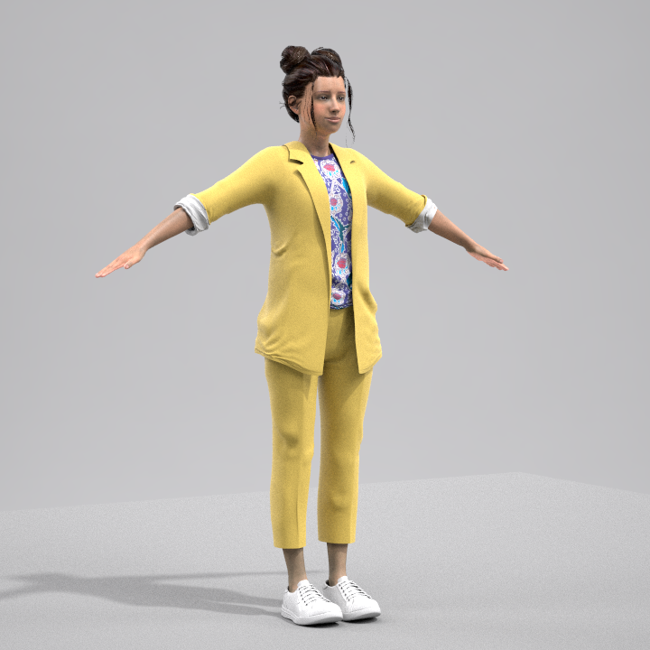
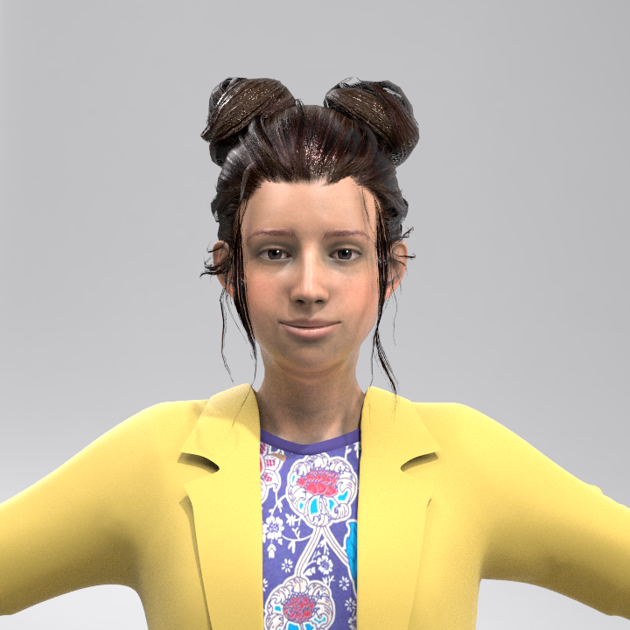
Brought to life as a young, eclectic, energetic activist and social-media science influencer

Slide 12
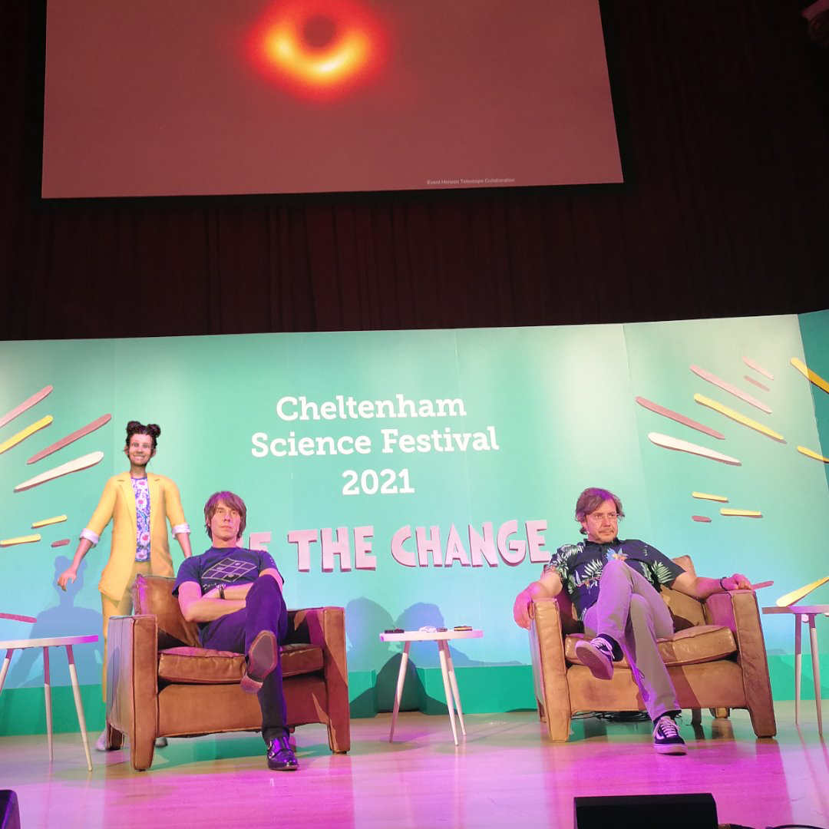
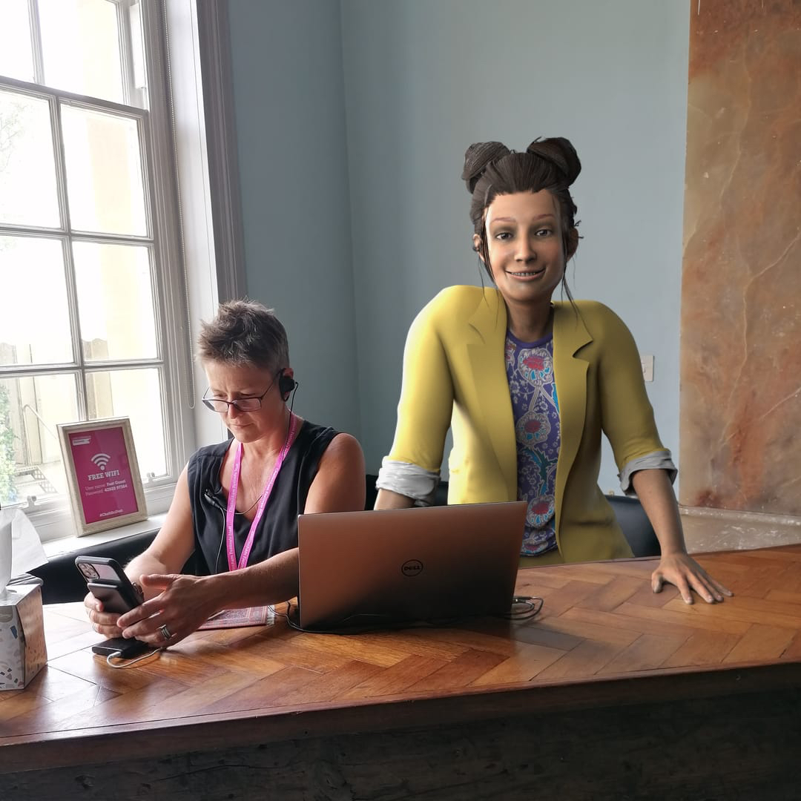
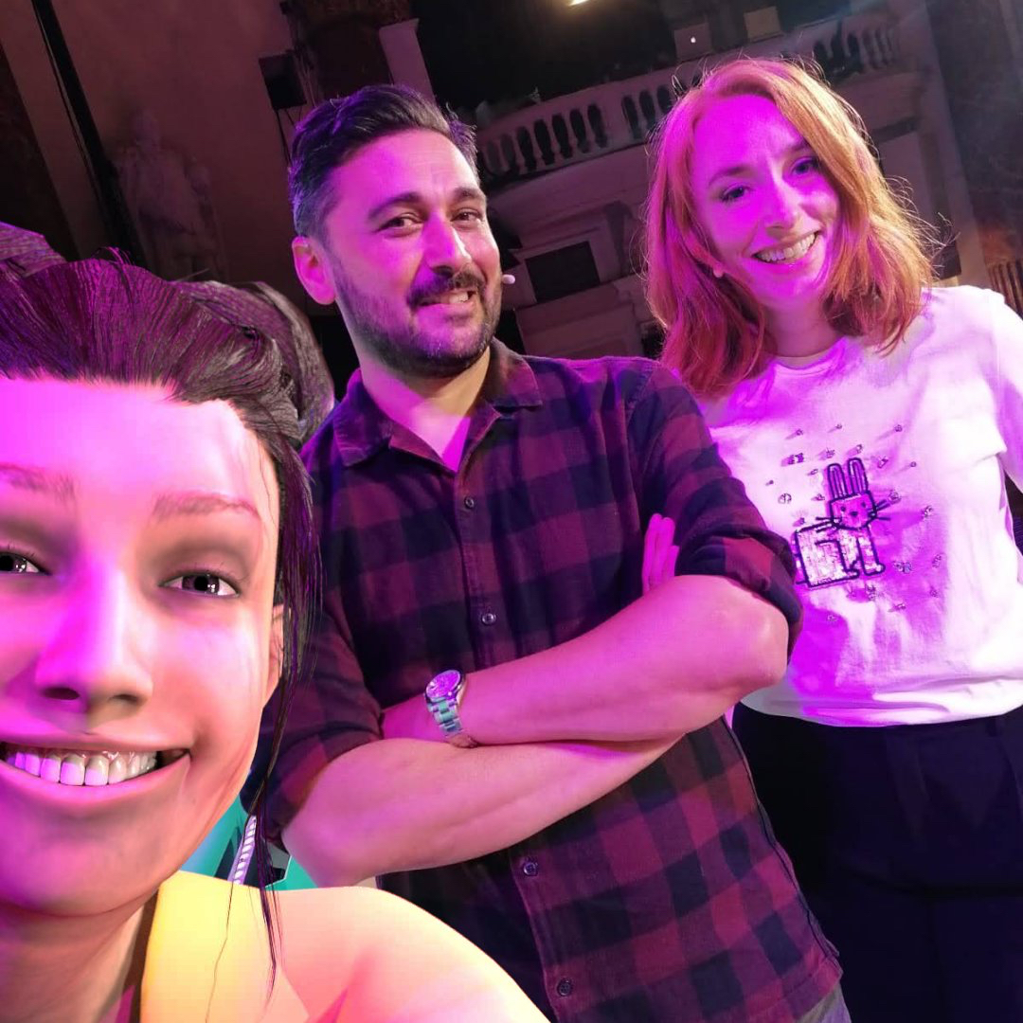
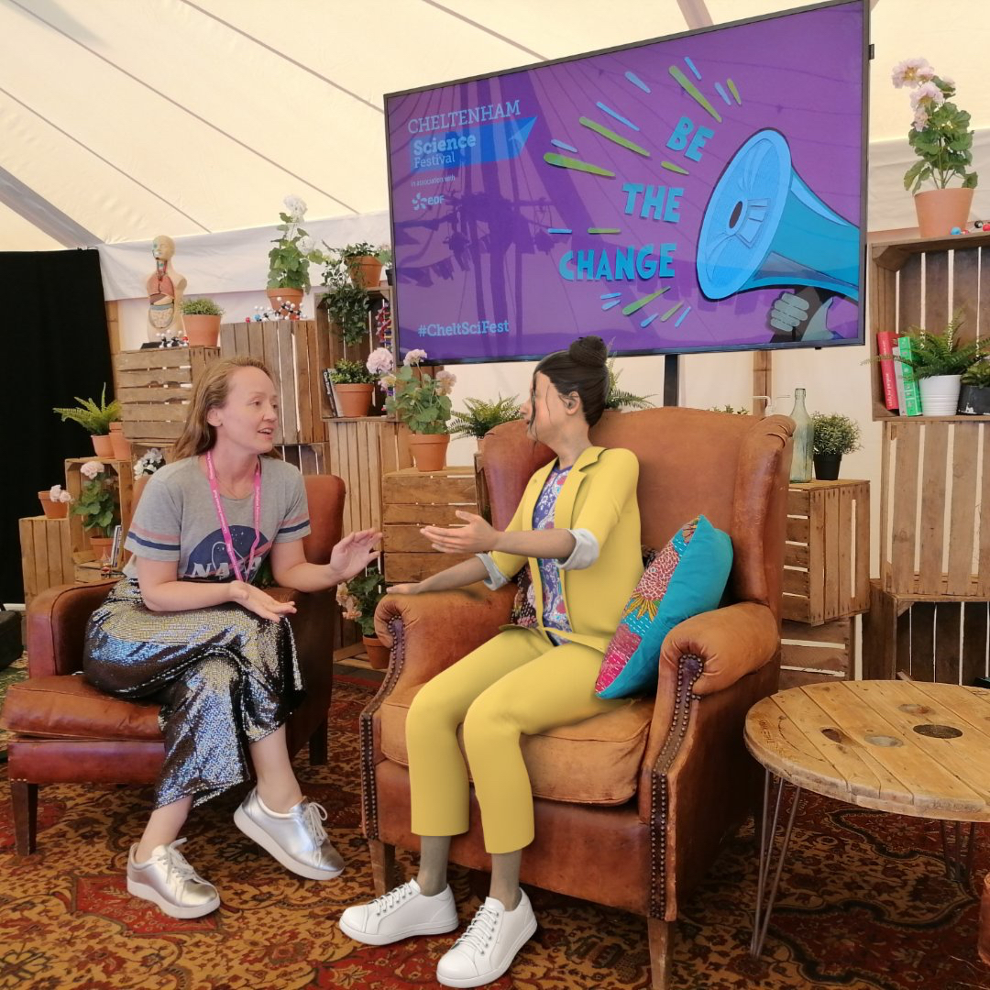

Slide 13
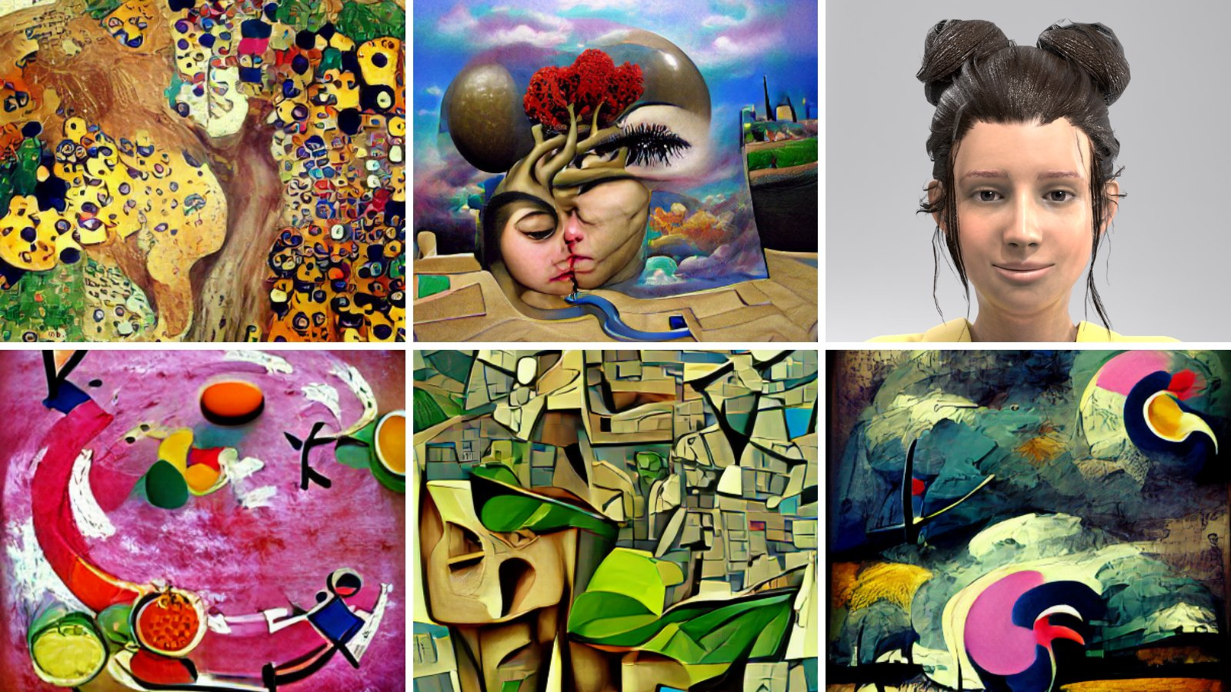

Slide 14
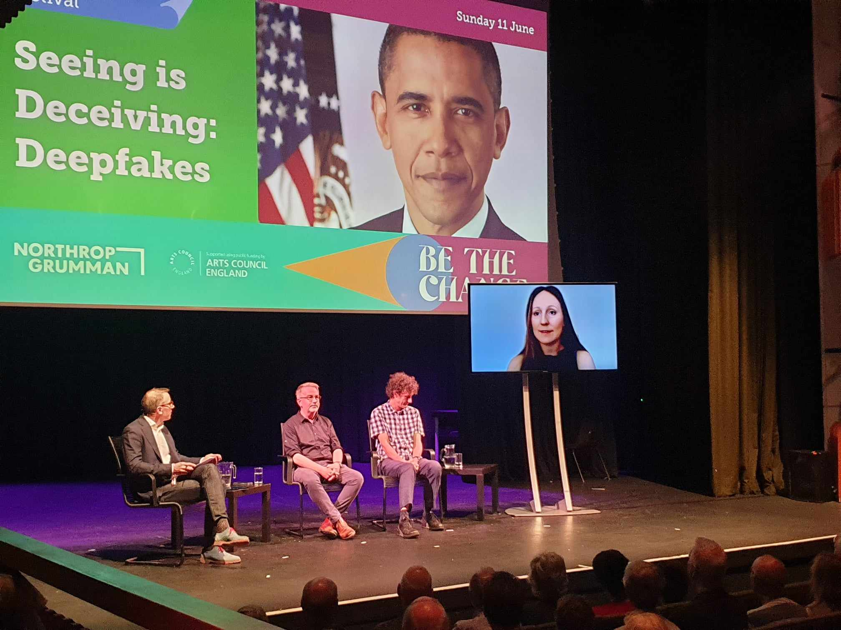

Slide 15
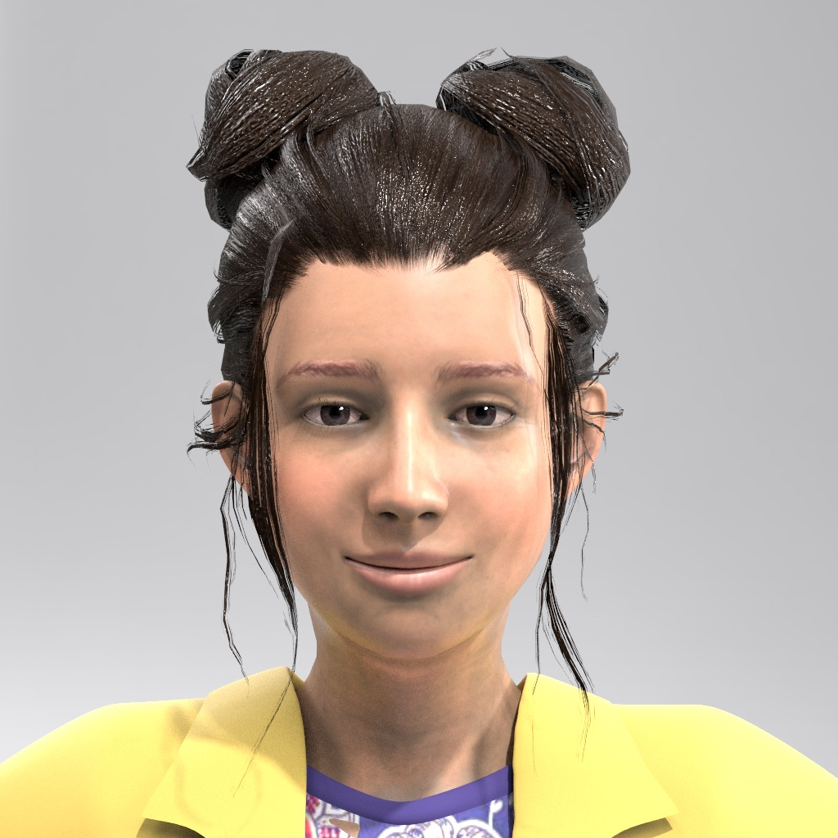
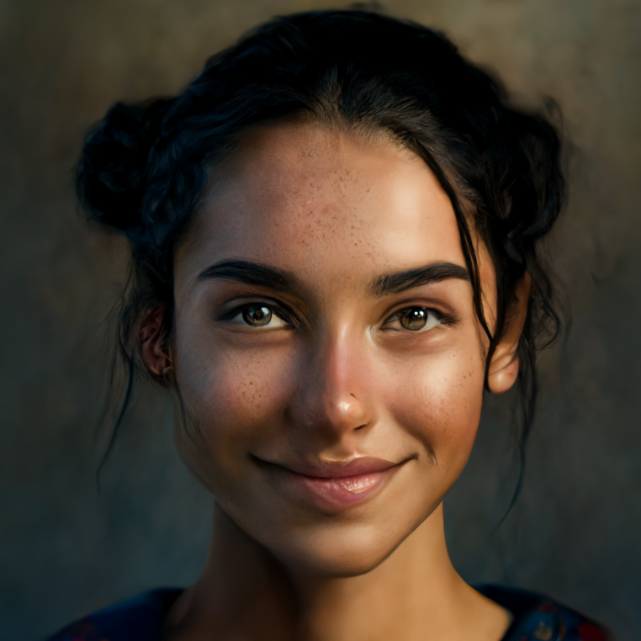
AIDA: AI face of the Fest
AIDA | 2019
AIDA | 2021
AIDA | 2023

