Slide 1
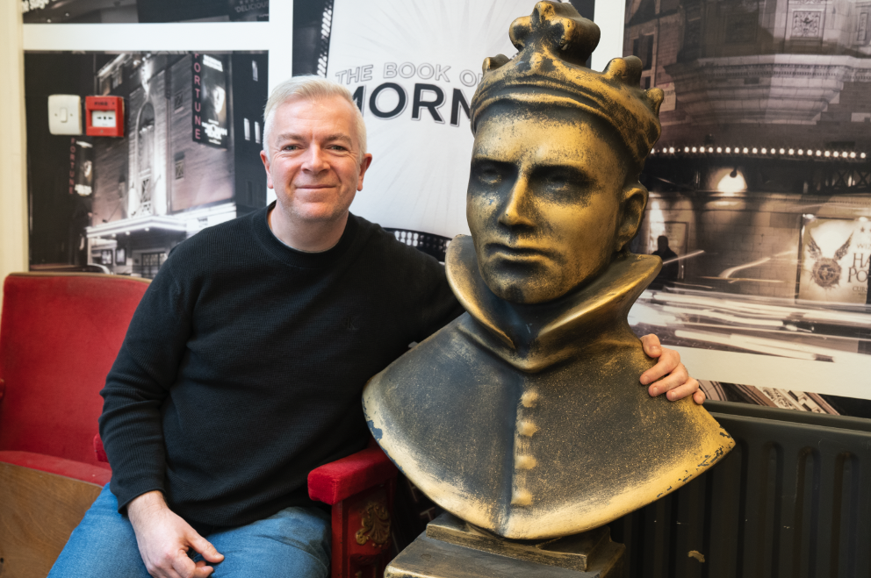
Jamie Snelgrove, Head of Theatre Tokens Society of London Theatre / UK Theatre

Slide 2
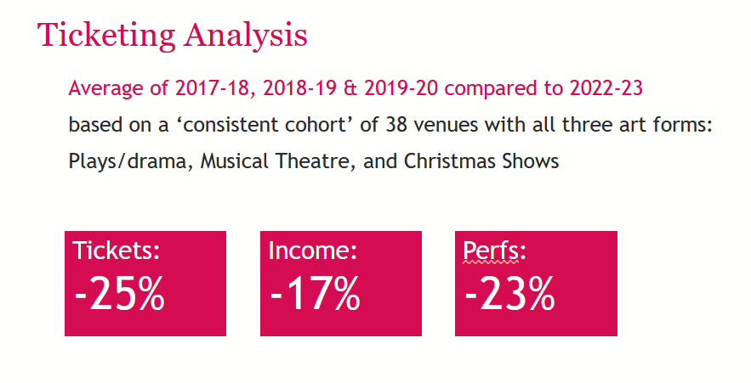
https://theaudienceagency.org/audience-answers

Slide 3
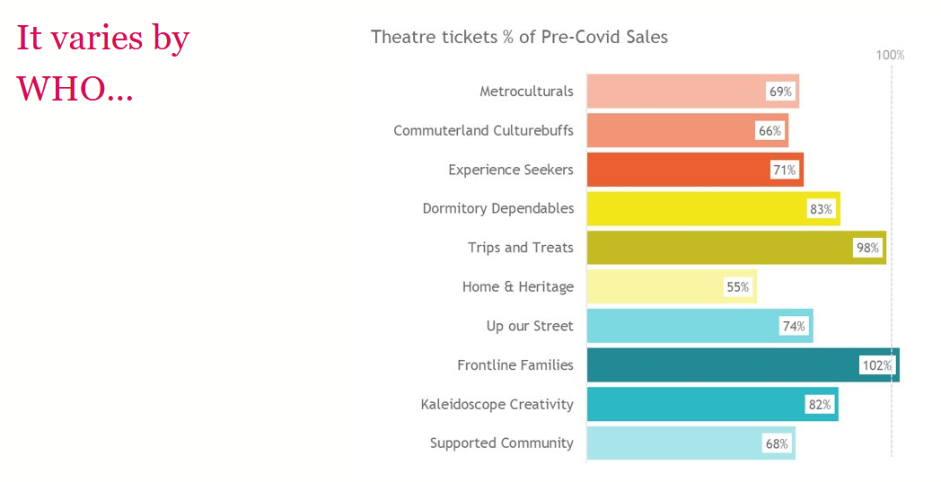

Slide 4
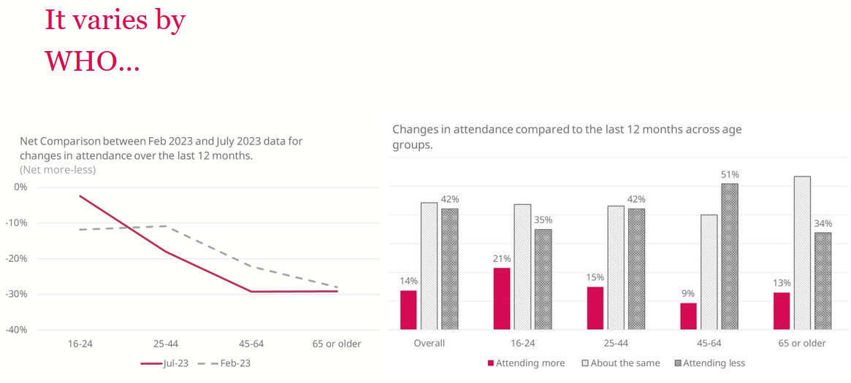

Slide 5
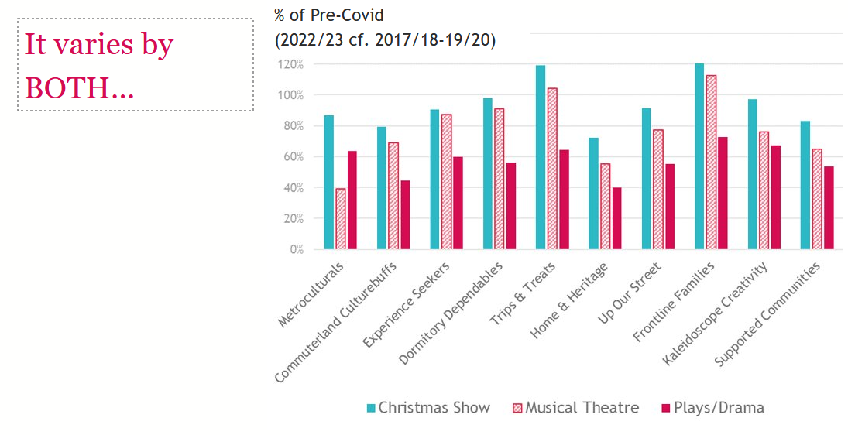

Slide 6
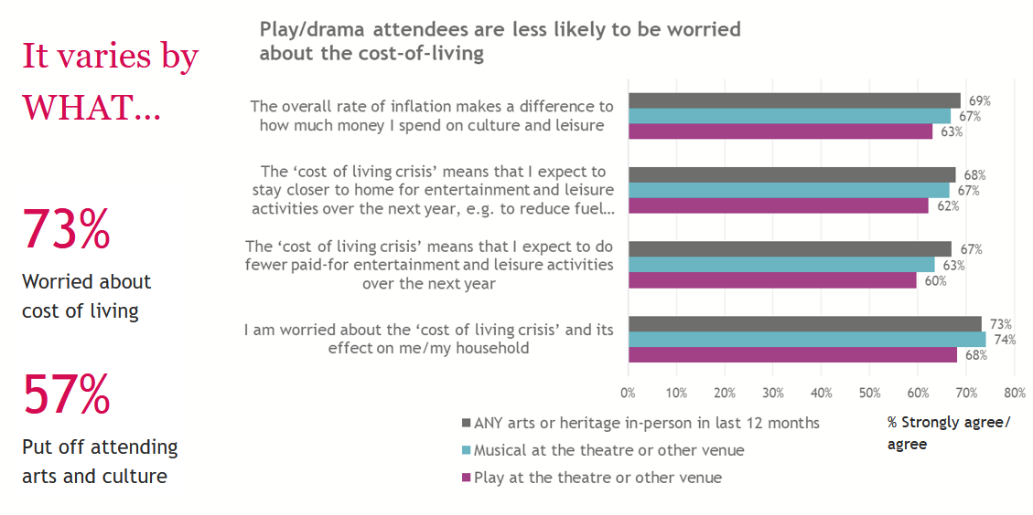

Slide 7
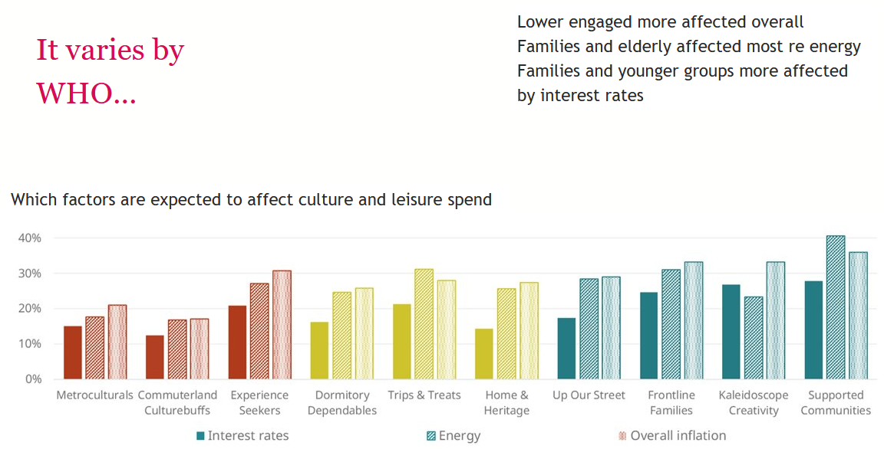

Slide 8
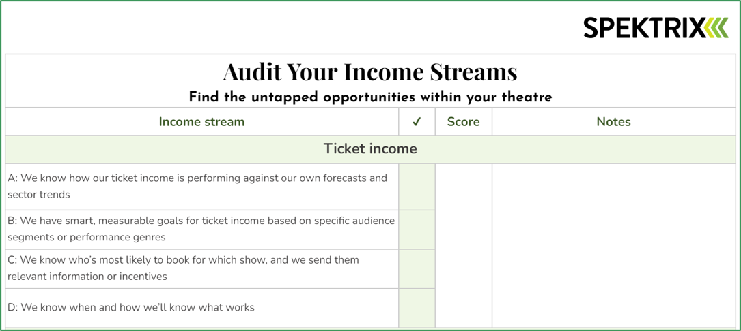

Slide 9
Audit your income streams … Ticket income / Memberships & Subscriptions /Donations & Secondary Spend KNOW YOUR PRIORITIES – clearly define targets KNOW YOUR AUDIENCE - use data from across the journey to understand customer behaviour KNOW WHAT WORKS FOR YOU – setting clear targets for success makes it easier to measure impact

Slide 10
Pay What You ‘Decide’ Pay What You ‘Decide’ support Extra allocation for local residents shakespearenorthplayhouse.co.uk/pwyd/

Slide 11
