Slide 1
Symbol

Slide 2
Notes:
Manchester International Festival (MIF) takes place in the north of England every 2 years since 2007. MIF presents work across a range of art forms, creating new collaborations between different artists and mixing popular and high culture. All of the projects presented at MIF are new commissions; work that has never been seen anywhere else. It’s something that's really exciting about the festival but it can also be a challenge thinking about environmental sustainability – if it’s a project that’s not going to be replicated how do you think about delivering it sustainably and measuring the impact.

Slide 3
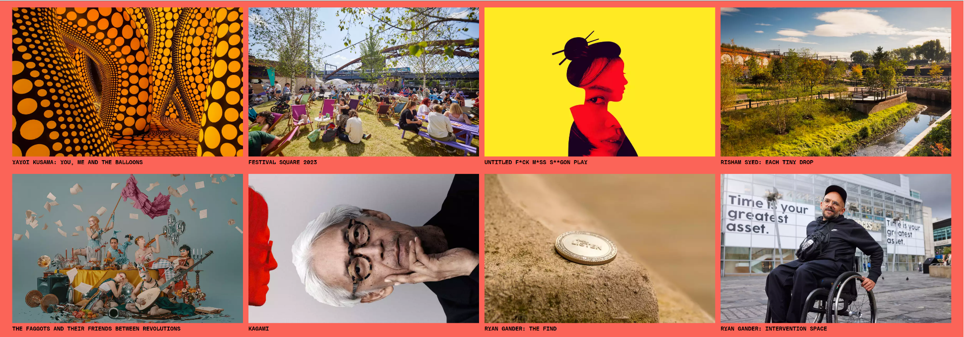
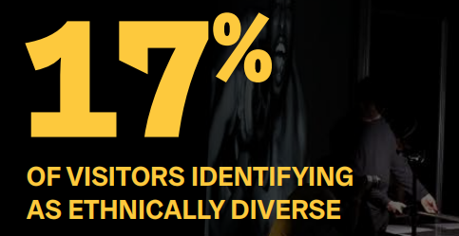
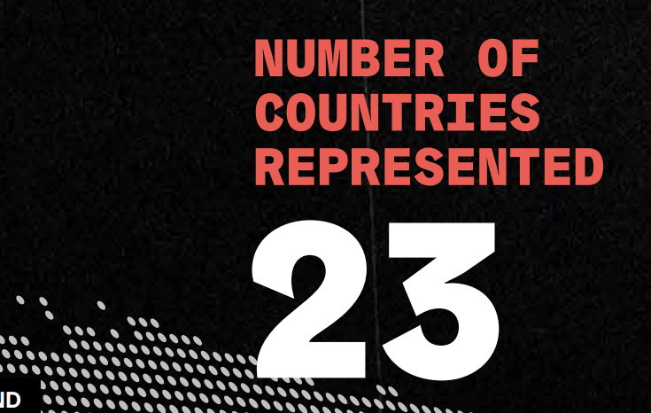
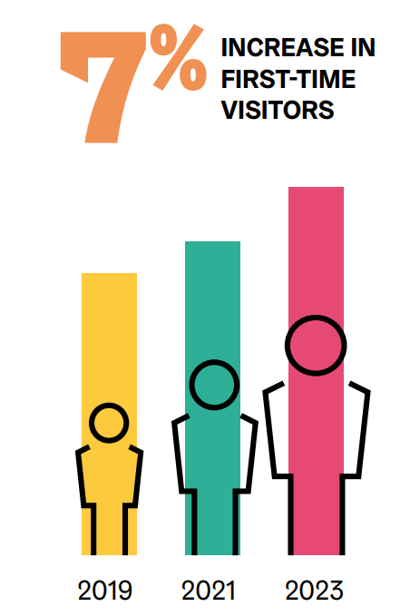
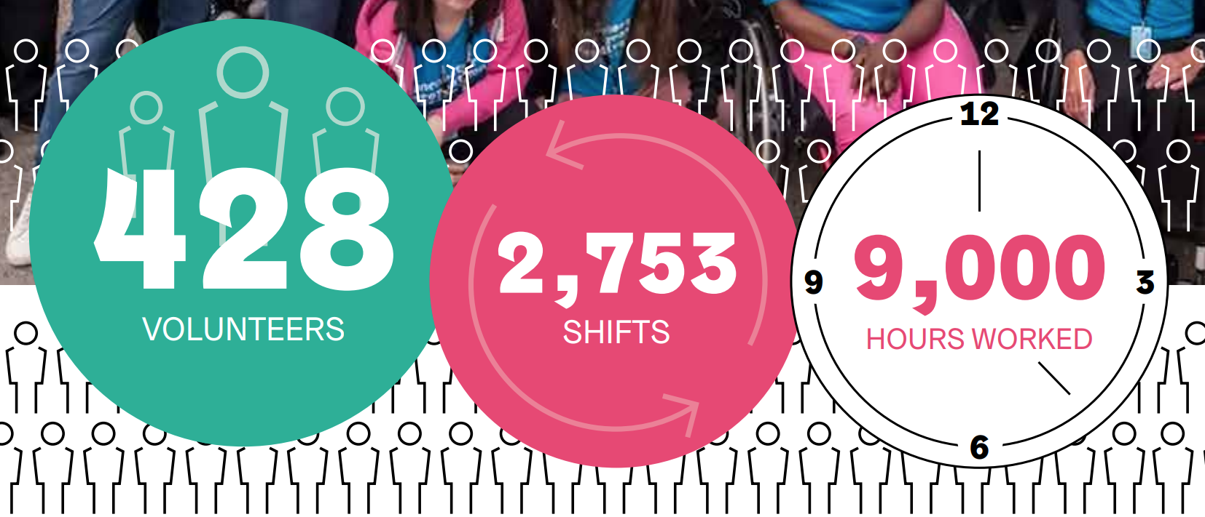
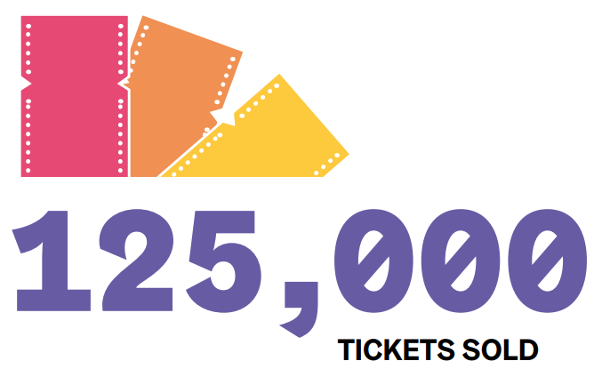
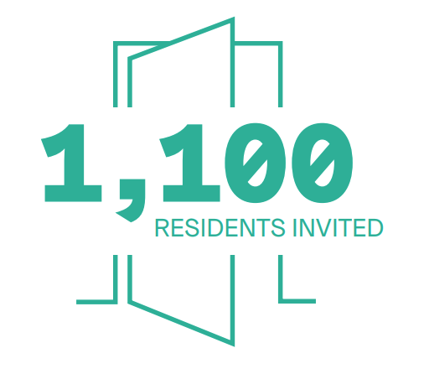
Notes:
With a box office smashing near-125,000 tickets sold for MIF23 shows over £1m was generated in ticket sales, meaning an incredible 125% of our pre-festival income target was achieved.
showcasing the most creative talent from around the globe as well as the magic that is being produced in our own wonderful city. This year’s festival held a special significance for us, being that it was the first time that audiences were able to get a preview of Factory International’s new building, Aviva Studios, which was the perfect location for Yayoi Kusama’s breathtaking You, Me and the Balloons
Work that explores some of the most important issues of our time, from immensely talented and inspirational artists who are really grappling with the big questions and providing new ways of looking at the world (selection of shows on the slide)
We broke box office records with this festival and made it more international than ever, attracting bigger audiences from across the globe as well as locally. Such a grand undertaking requires the best staff, the most dedicated volunteers, the most exciting artists and brings with it the most dedicated and enthusiastic supporters
Over the 18 days of MIF23 the festival welcomed210 journalists from 140 media outlets across the globe; from international publications such as The New York Times (USA), Sueddeutsche Zeitung (Germany), China Daily, Elle Italy, Nippon (Japan), and The Telegraph India
Our rootedness in Manchester and connection with local communities is so important for us
For MIF23, 1,100 residents were invited through neighbourhood organisers and community partnership programmes.
From helping behind the scenes to greeting the public at our events, the 400 or so MIF23 volunteers bring a relentless energy and enthusiasm to everything they do. This diverse team care about the events, the audience and each other, ensuring everything runs as smoothly as possible, learning new skills along the way

