Slide 1
Research support to BAFA and FMB4
Overview
November 2023

Slide 2
About BOP Consulting
World-renowned practice working with cultural organisations, sector bodies, and government
Evidence focused approach supported by exceptional research, data and analytical capabilities
Global reach and networks as convenor of World Cities Culture Forum
Deep expertise in our team of 30 – delivering over 100 projects a year from offices across the UK & China

Slide 3
We bring global insight from our portfolio of research and strategy projects
Selected projects
Economic impact
Research and evaluation
Masterplanning and asset development
Data partner for UNESCO on its most recent Global Reports
Concept and impact framework for Creative Enterprise Zones for the Mayor of London
Infrastructure Planning for West Kowloon Cultural District and M+, Hong Kong
Strategy and Action Plan for The East London Fashion District for the GLA
Film Education Strategy for the UK for the BFI
Tencent: Culture Masterplan for New Campus in Shenzhen
Planning for a new National Collection of Land Art for HS2
Handbook on the Creative Industries for the Inter-American Development Bank
Business Planning for the Smithsonian’s first non-US museum
Olympic Park Arts and Culture Strategy for LLDC
Impact Assessments and forecasts for Edinburgh Festivals, Royal Highland Show, Pitlochry Festival Theatre, Cheltenham Festivals, Leeds 2023 and Bradford 2025
Major study into festival skills across Gulf region
Design Economy 2022 for Design Council: Economic impact of design, design skills and design cluster across the UK
Impact of Ireland’s Live Entertainment sector for Ticketmaster

Slide 4
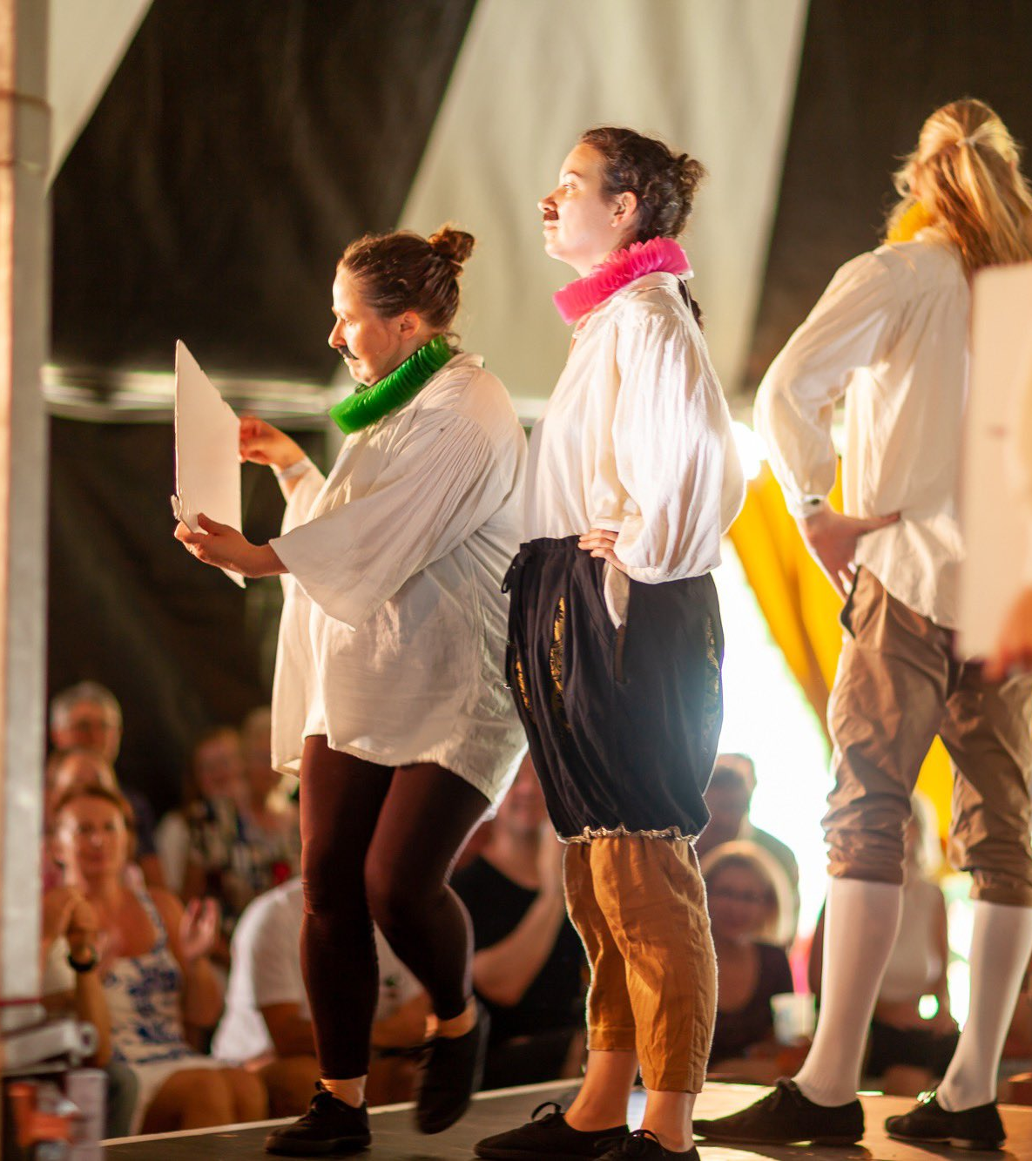
We have clear aims for this research
Through this project, we will … | We intend for this research to enable greater … | Title
1 | Define the sector | Create a robust definition for “arts festivals”, enabling categorisation, location, and scale
2 | Engage with the sector | Statistically robust survey of UK festivals to understand the current state of play
3 | Determine the footprint of the sector | Report on the sector’s scale, evolution, capacity and development
4 | Develop methodologies to support the sector | Create easily replicable methodologies for future iterations of FMB

Slide 5
This research will add value to the arts festivals sector
We intend for this research to enable … | We intend for this research to enable greater … | Title
1 | Understanding of the sector’s current state | FMB3 was 15 years ago and a lot has changed since then – what do we now mean by arts festivals? And how are they performing?
2 | Advocacy for the sector | Generating high quality data-driven insights into arts festivals across the UK to help advocate for the sector with major funders
3 | Greater support for festivals’ development | Identifying key points of commonality that can drive the agenda forward for arts festivals in the current cultural landscape
4 | Improvement of sector decision-making | Creating a joined-up approach to speaking about the challenges and opportunities for the sector and informing BAFA’s work

Slide 6
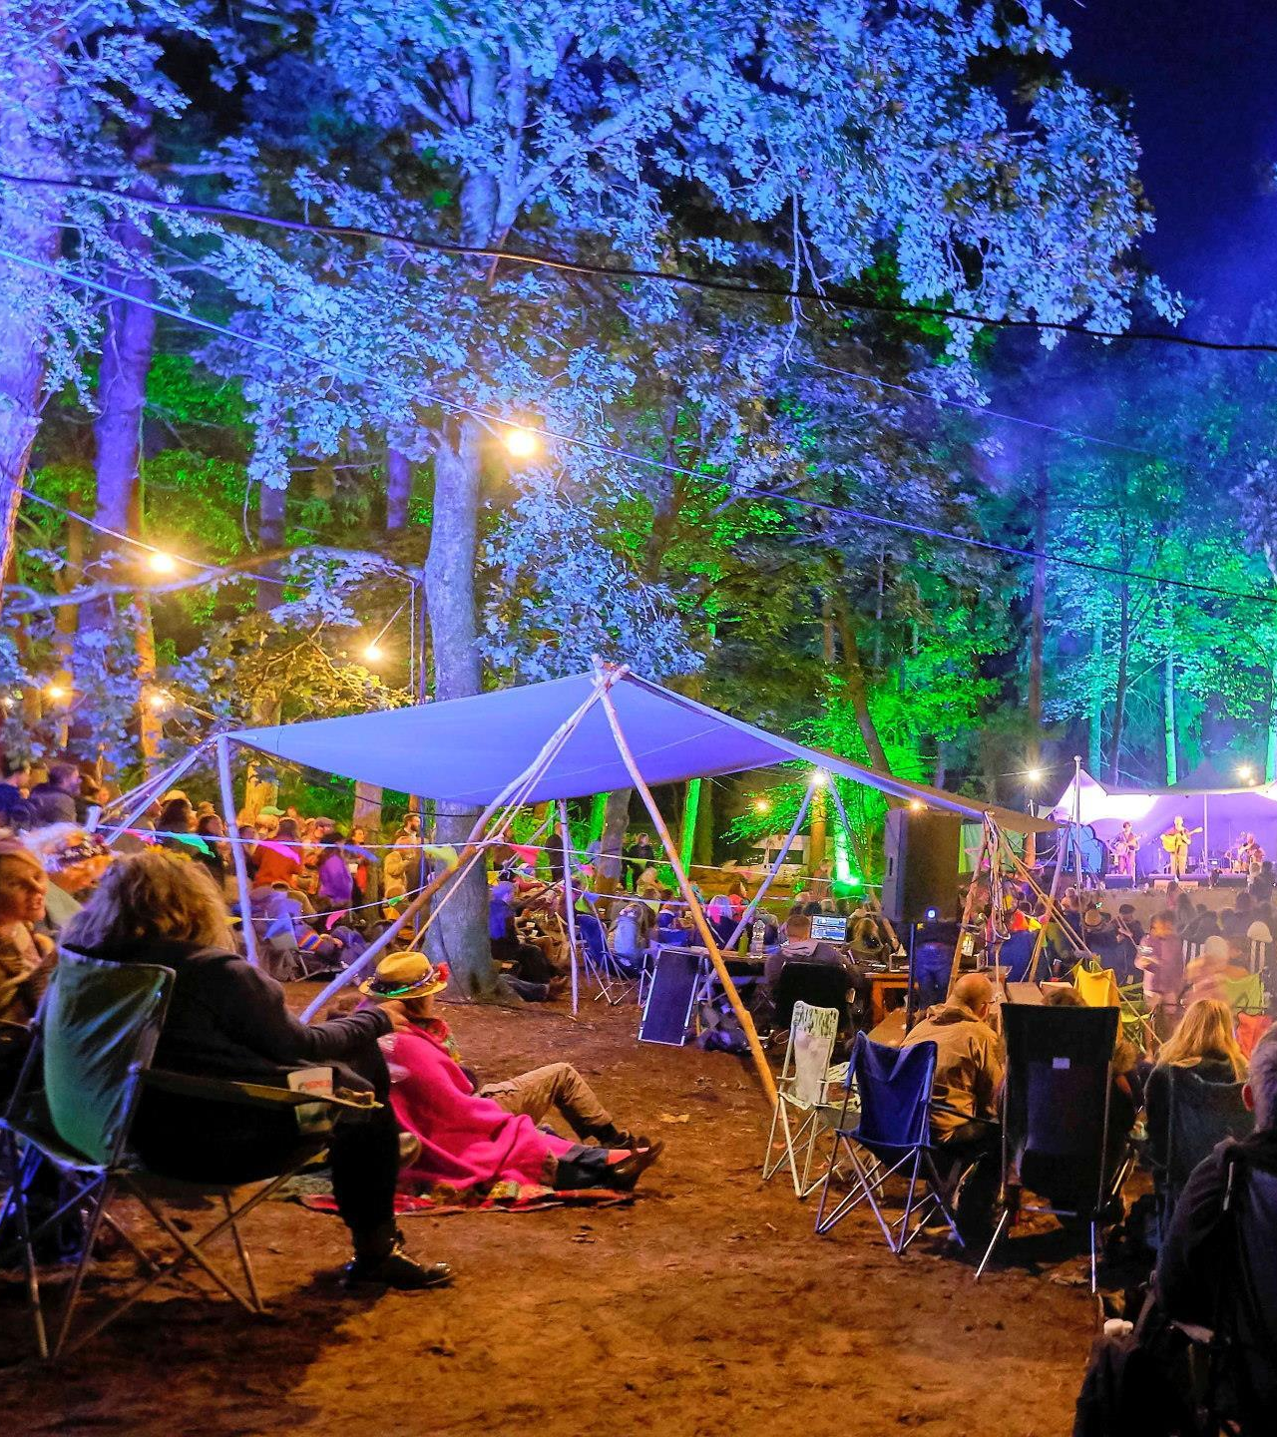
We will need to overcome challenges
These include… | We intend for this research to enable greater … | Title
1 | Definition | How should we define arts festivals?
2 | Participation | Will we secure participation from arts festivals?
3 | Representativeness | Sufficient participation to be representative of the underlying population?
4 | Survey | Agreeing questions – in a way that delivers research aims and is manageable for arts festivals

Slide 7
Definition
To what extent does this remain a relevant definition given recent changes?
Digital / remote activities
Growth of multi-arts camping festivals
Do festivals recognise themselves in this definition?
Where should a definition come from?
Sector authorities
International bodies
 | “…short-term scheduled events where the programme includes performances and/or exhibitions featuring single or multiple art forms. Many arts festivals include opportunities for audiences to participate directly in programmed activities, although this is not always the case”
 | Festivals Mean Business 3 (2008), adapted from Long & Owen (2006), The Arts Festival Sector in Yorkshire, Arts Council England
The advisory board will play a key role in solidifying the definition

Slide 8
Participation
Engaging a robust and representative sample from festivals across the UK is vital to the success of this research.
2 | Initiate further sector scoping via:
 | Direct outreach to memberships and wider newsletter subscribers by these organisations
 | Indirect outreach through social media and third party forwarding
 | Leveraging advisory group members wider networks and contacts
1 | Engage members of known major membership bodies
 | BAFA – currently has around c.50 festival members, including organisations that run multiple festivals
 | Association of Festival Organisers – over 250 members, although there may be multiple members from single festivals
 | Association of Independent Festivals (AIF) – 78 festival members
We also welcome any additional suggestions you may have of trade bodies not covered and alternative approaches to maximise responses

Slide 9
Representativeness
Arts festival sector
Survey sample
 | This research aims to present a picture of the sector, via a representative part of the whole. In trying to make the sample as representative of the total sector as possible, the first thing that you need to know is the shape and make-up of the sector – both in terms of definition and size.
+ additional data sources as needed

Slide 10
We will be supported in meeting these challenges
 | 1 | Management group |  | 2 | Advisory group |  | 3 | Partners
 | BOP Consulting – Jonathan Todd, Rhiannon Davies BAFA – Fiona Goh, Aline Imray, Naomi Taylor (BCU) and board representatives |  |  | Association of Festival Organisers (AFO) - Steve Heap Association of Independent Festivals (AIF) - John Rostron Black Lives in Music – Roger Wilson DHA Communications - Jon Flinn Julie’s Bicycle - Danielle Pipe Outdoor Arts – David Doust Tonic - Lucy Kerbel |  |  | Association of British Orchestras (ABO) Association of Event Management Educators (AEME) Association of Irish Festival Events (AOIFE) Attitude is Everything Birmingham City University (BCU) British Association of Concert Halls (BACH) Creative UK European Festivals Association (EFA) Events Industry Forum Jazz Promotion Network (JPN) Making Music

Slide 11
Four stages in detail
1. DEVELOPMENT |  | 2. CIRCULATION |  | 3. ANALYSIS | 4. REPORTING
Survey development
(Input: BAFA & desk research)
Survey live and open for responses
Full survey analysis
Reporting (Input: Survey analysis & other research strands)
Advisory board review and assessment, including of arts festival definition
Direct circulation to BAFA membership and members of other trade bodies
Breakdown analysis of responses based on areas of interest (e.g. nations / size of festival / type of festival).
Executive Summary development & Case study report development
Final sign off from BAFA &
Survey circulation
Indirect circulation to other festivals (social media, newsletters, and third party forwarding)
Findings shared at next year’s conference
February 2024 – March 2024
May 2024 – June 2024 (plus conference)
December 2023 – January 2024
March 2024 – April 2024

Slide 12
Impact framework – for discussion
Inputs
What resources are available to arts festivals?
Arts Council England funding
Other funding to support festivals
Outputs
What are the initial products or services delivered by festivals’ activities?
Audiences
Ticket sales
Outcomes
What changes are expected in the short- to medium-term?
Contribution to the UK economy
Platforms for new work commissions and premieres
Greater education, community and outreach activity
Impacts
What changes are expected in the long-term?
Partnerships
Employment
Revenues
Further funding
Sustainability (economic, social, environmental)
Wellbeing
Community cohesion
Expenditure
Activities
What activities take place across arts festivals?
Programming
Exhibitions
Education, community, and outreach events

Slide 13
Jonathan Todd, Chief Economist
jonathan@bop.co.uk

