Slide 1
Sustainable Events
Helen Harland, Zero Carbon Team

Slide 2
Manchester City Council’s Ambitions, Milestones & Targets
Our first Climate Change Action Plan (CCAP) spans 2020 to 2025
We aim to remain within the set carbon budget of 126,336 tCO₂
Manchester Council’s target is to be zero carbon by 2038
Climate Emergency declared in July 2019

Slide 3
MCC Tools: Sustainable Events – 5 key questions
Energy
Travel
Waste
Food & Drink
Water
Event Impact

Slide 4
MCC Tools: Sustainable Events – 5 key questions
Energy
Reducing power demand from fossil fuels?
Travel
Reducing travel emissions by event participants and audience?
Waste
Waste reduction and recycling targets?
Eliminating avoidable single-use plastics?
Food & Drink
High proportion of low-carbon impact food available?
Food traders not using single-use plastic items?
Water
Mains water use and measuring how much?
Finally: Measuring the carbon footprint of your event? How?
Notes:
Key logistics points:
SUPs: Reusable cups and no other catering SUPs used / sold at owned / funded events and advise other events of this. Do we ask all events to use reusables as standard?
Mains power as much as possible, encourage alternatives to diesel and encourage tracking
Waste management in line with agreed approach (deep dive meeting on events and waste on 8 Dec)
Food & Drink – ensure balance of meat / non-meat, de-prioritise red meat (Sustainable Food Policy in development)
Egs of questions:
What’s the best artificial snow to use?
What's the right type of soup container?
What type of cup is best?

Slide 5
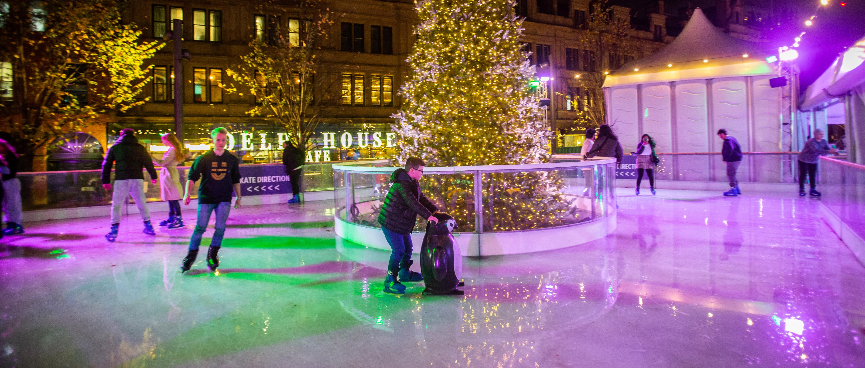
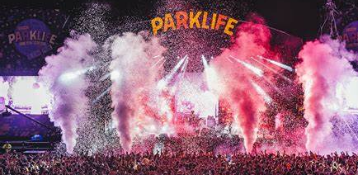
City and event collaboration: Grid power project
Scoping element with 30 event organisers to outline costings and potential carbon savings
Early test case: Skate Manchester
Saving: 50,000 litres of diesel, 90tC02e and cost neutral to organiser

Slide 6
City and event collaboration: Reusable Cup Pilot
Saving: 24,000 cups and half a tonne of plastic waste (3 events)
Potential for reusables (2021 report): 1 million disposable cups could be avoided

Slide 7
Ottilia Ördög
Delivering a more sustainable festival

Slide 8
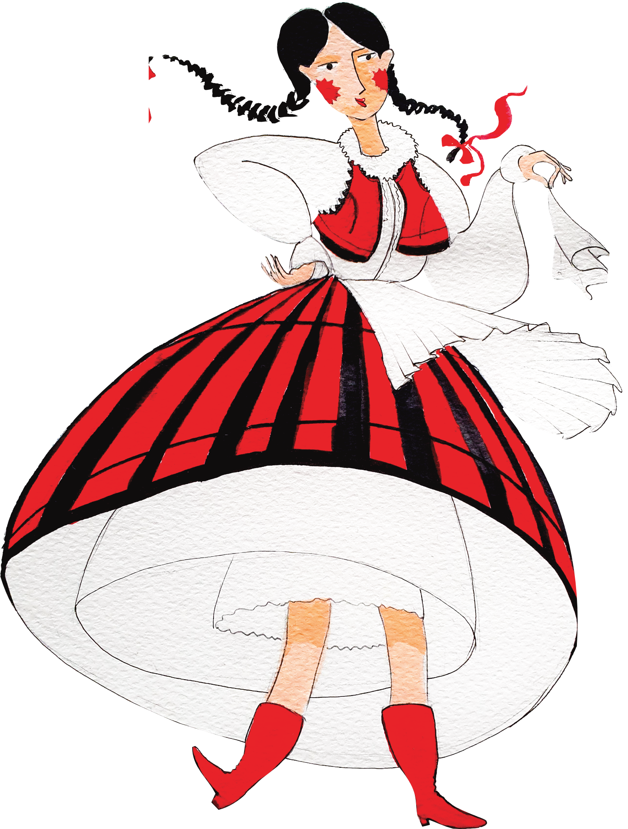
Launched in 2017 – Albert Square – Manchester
International Folk & Culture Festival spotlighting The Carpathian Basin, Eastern Europe and Transylvania
Showcasing musicians, bands, dance groups from Transylvania, Hungary, Romania, Poland, Ukraine, Slovakia, etc.
Welcoming folk dance groups from all over the United Kingdom
Workshops and activities for the whole family,
Go Be backstage
Attracting 20000 people over 3 days
AGF Assessment in 2022

Slide 9
Why Transylvania? Land Beyond the Forest
Born in Transylvania and no I am not Dracula!
King Charles believes Transylvania holds the key for saving the planet
Biggest forest in Europe - In his own words, he was “totally overwhelmed by its unique beauty and its extraordinarily rich heritage”.
Cultural heritage: music, dance, folklore, cuisine

Slide 10
Progress
Waste Reused signage/ banners – make branding sustainable Hire over buy ethos Reusable cups scheme- over 5k disposable cups saved Consider sustainable sourcing – of t-shirts, flyers Waste oil recycled / collected | Food & Drink Server ware – clear guidance in advance and early engagement on what we are using No bottled water for sale Sustainable sourcing – all traders asked to comply with local, seasonal, organic where possible Larger reusable bottles for artists and crew to fill own reusables Direct control over one catering outlet enabled better control – added social / economic benefits Asked all traders to provide vegetarian or vegan option
Energy Mostly mains power (on 100% green tariff) Only one generator used for food stalls | Water Use of mains toilets in nearby building Use of mains drinking water for refillable containers – no leaks
Travel Combined two events – Manchester and London Local groups encouraged to travel by public transport arrival notes sent out – no parking provided Prioritised finding UK-based groups | Other Data collection – started in 2021, developed for 2022 (AGF assessment) – ability to see impacts and priority areas Community element – working with under-represented communities Partnerships : such as The Woodland trust Youth group involved in tree planting (added to stop deforestation message) Website/ Social media – sharing sustainability goals and messages

Slide 11
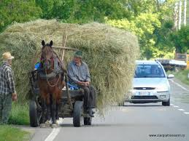
Challenges
Waste
Separation (though energy recovery happens, minimum to landfill)
Audience behaviour
Energy
Not enough mains power on site
Travel
We are showcasing Carpathian Basin/ Eastern Europe so international travel happens
CAPACITY!!!!
We need a designated person to work on sustainability

Slide 12
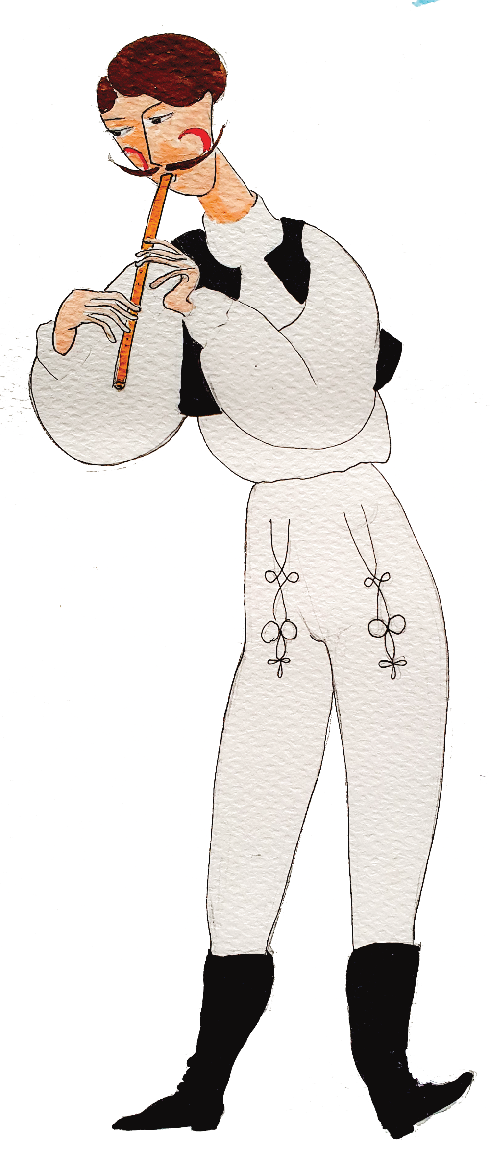
What next?
Currently developing our Sustainability Policy
Sustainability Action Plan
Designated role for a sustainability assistant
Recruiting sustainability volunteers
More partnerships: Conservation, responsible tourism, etc
Ottilia Ördög
ottilia@gobefest.com +44 (0) 7812 107 134
Delivered By

Slide 13
Workshop

Slide 14
What are you doing to reduce impacts from energy, travel, waste, food & drink and water? What are you doing to reduce impacts from festival admin?
Workshop: 5 key questions to delivering more sustainable events
Think about:
What’s going well – what are you proud of?
How do you do things
How do you track your impact?
Challenges
Suppliers you’d recommend

