Slide 1
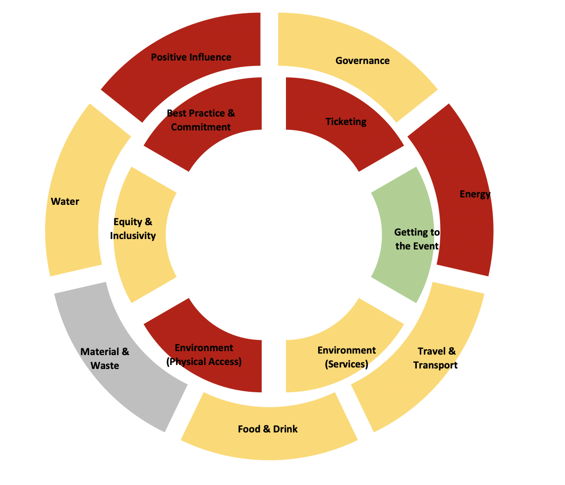
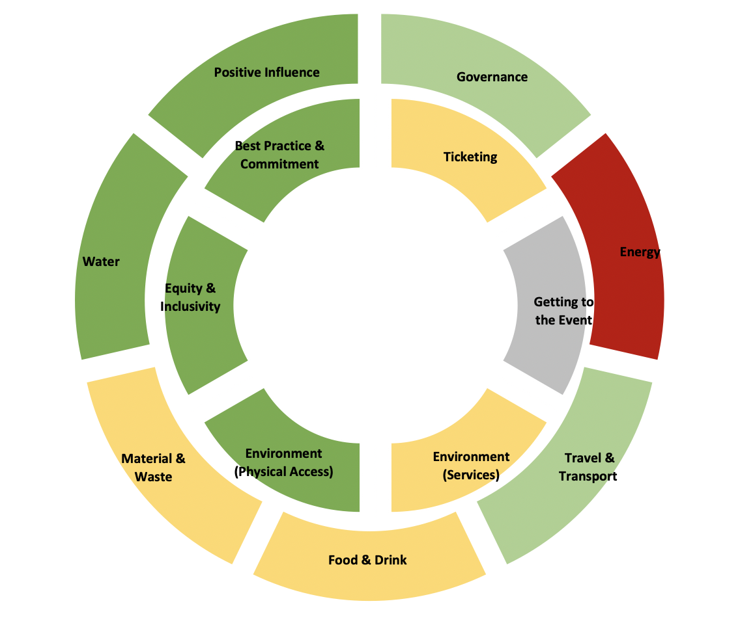
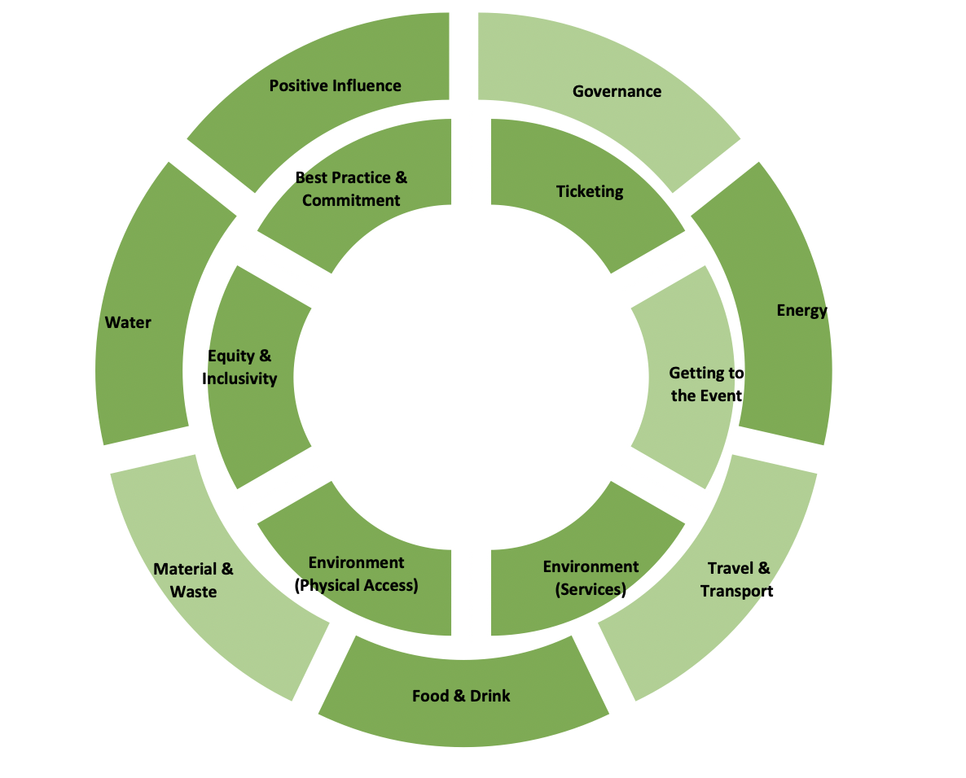
DATE: Donut Advisory Toolkit for Events
Andrew Lansley

Slide 2
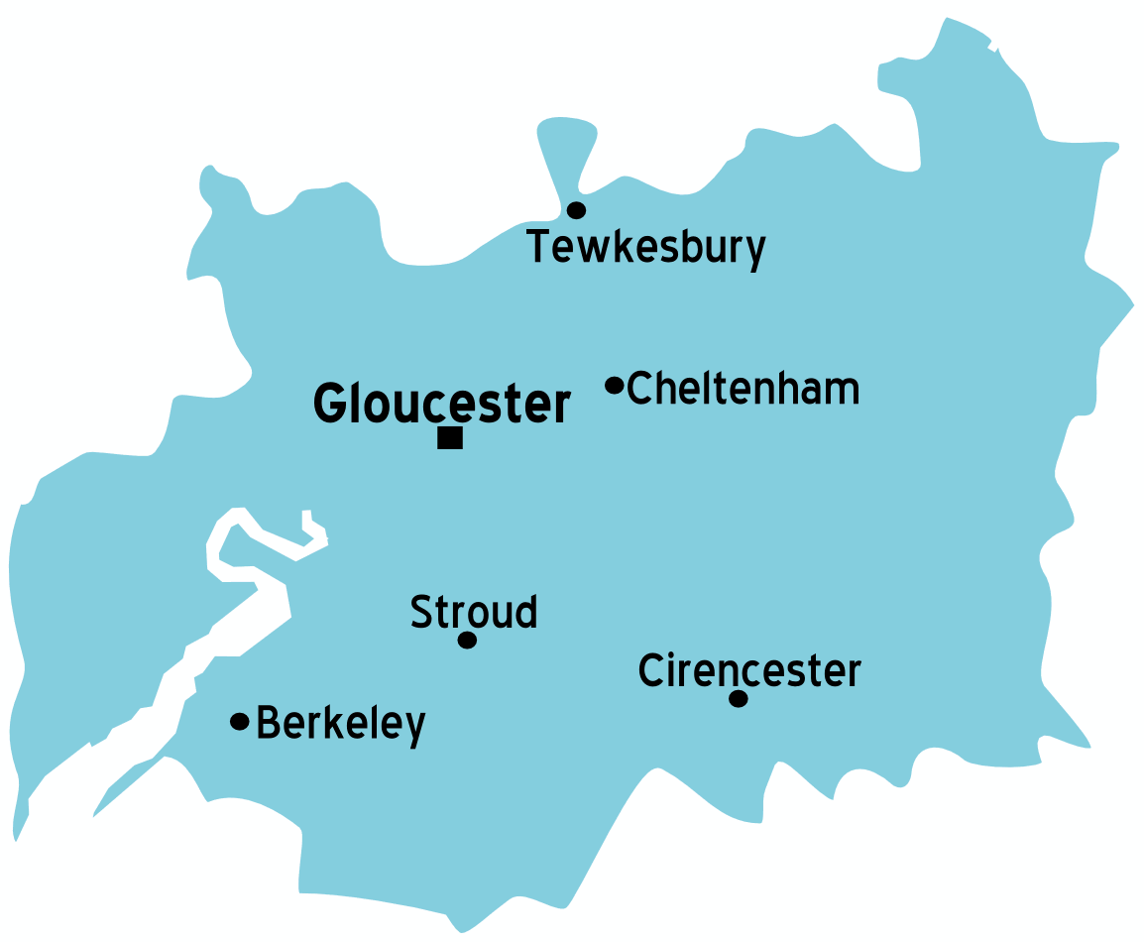
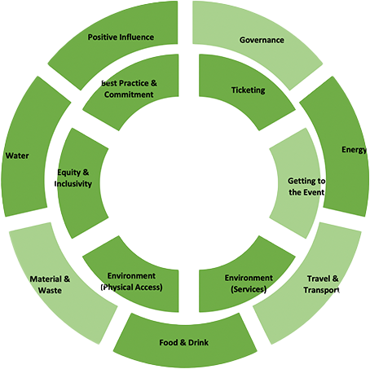
Overview
Advisory networks:
Cheltenham Culture Board
Economic Advisory Group
Sustainability Sub-Group
Local Stakeholders:
The DATE toolkit combines national community driven accessibility and sustainability standards into an assessment and advisory toolkit.
This has been made possible by the highly networked events research and practice ecosystem in Gloucestershire
Action
Research
Innovation
Inclusion
Local ecosystem for events accessibility & sustainability research

Slide 3
What is DATE?
DATE is a simple toolkit that works within the events commissioning process to deliver:
An assessment of an event’s accessibility and sustainability profile
Information for events’ group/SAG/staff
Support for the event organizers
Aggregated data for analysis
The tool has been purposely designed to be:
Accessible to all
Easily integrated into any LA context
Accurate, inexpensive and adaptable

Slide 4
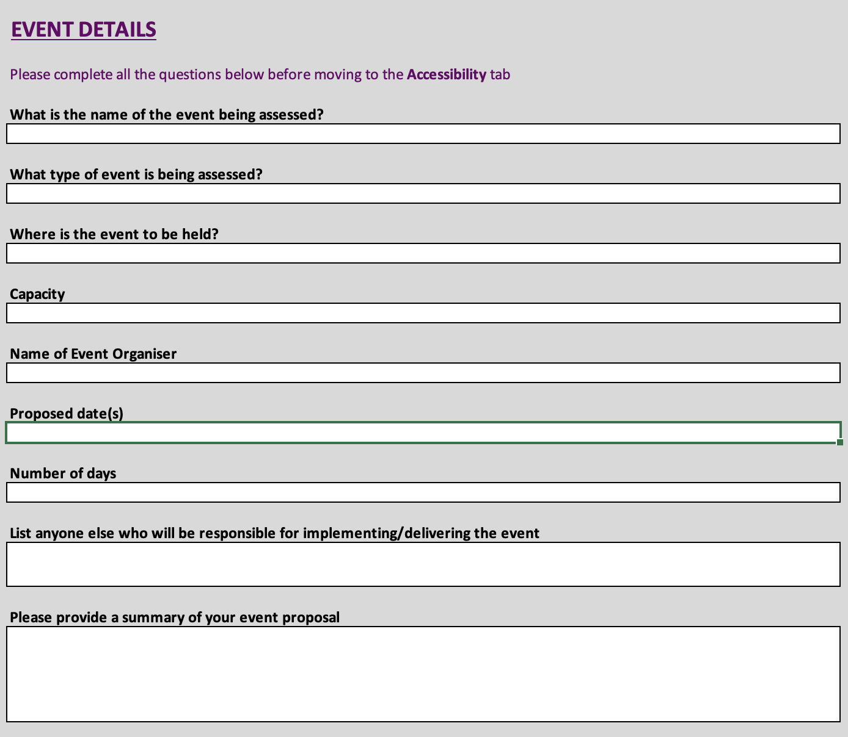
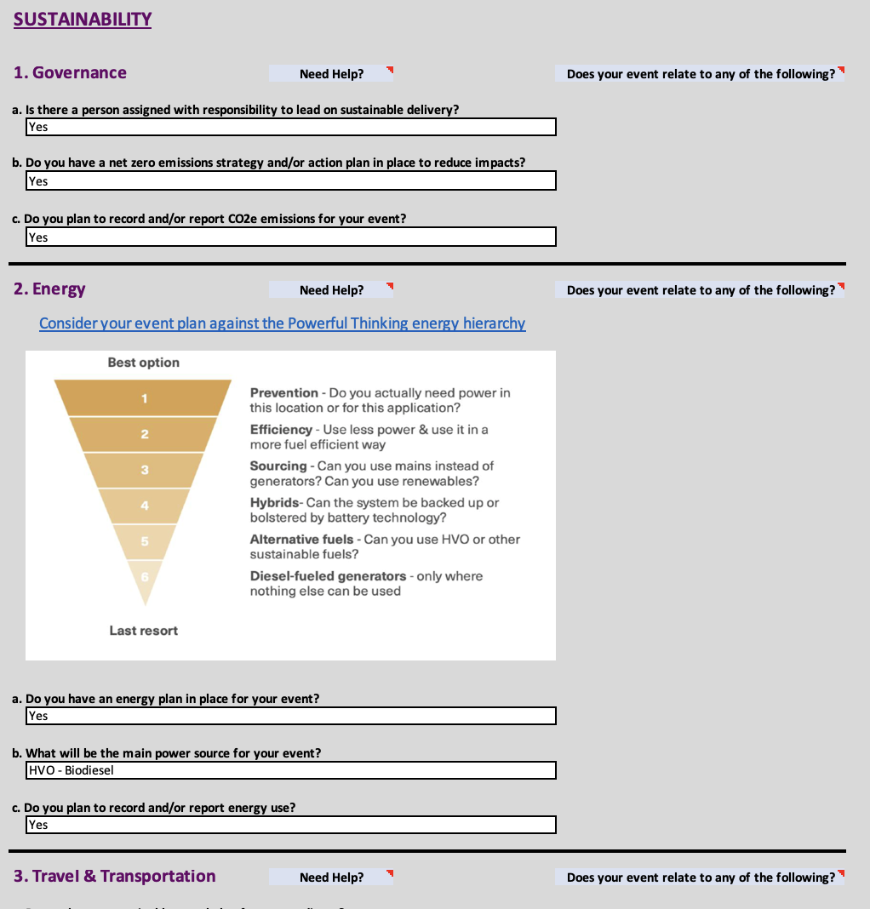
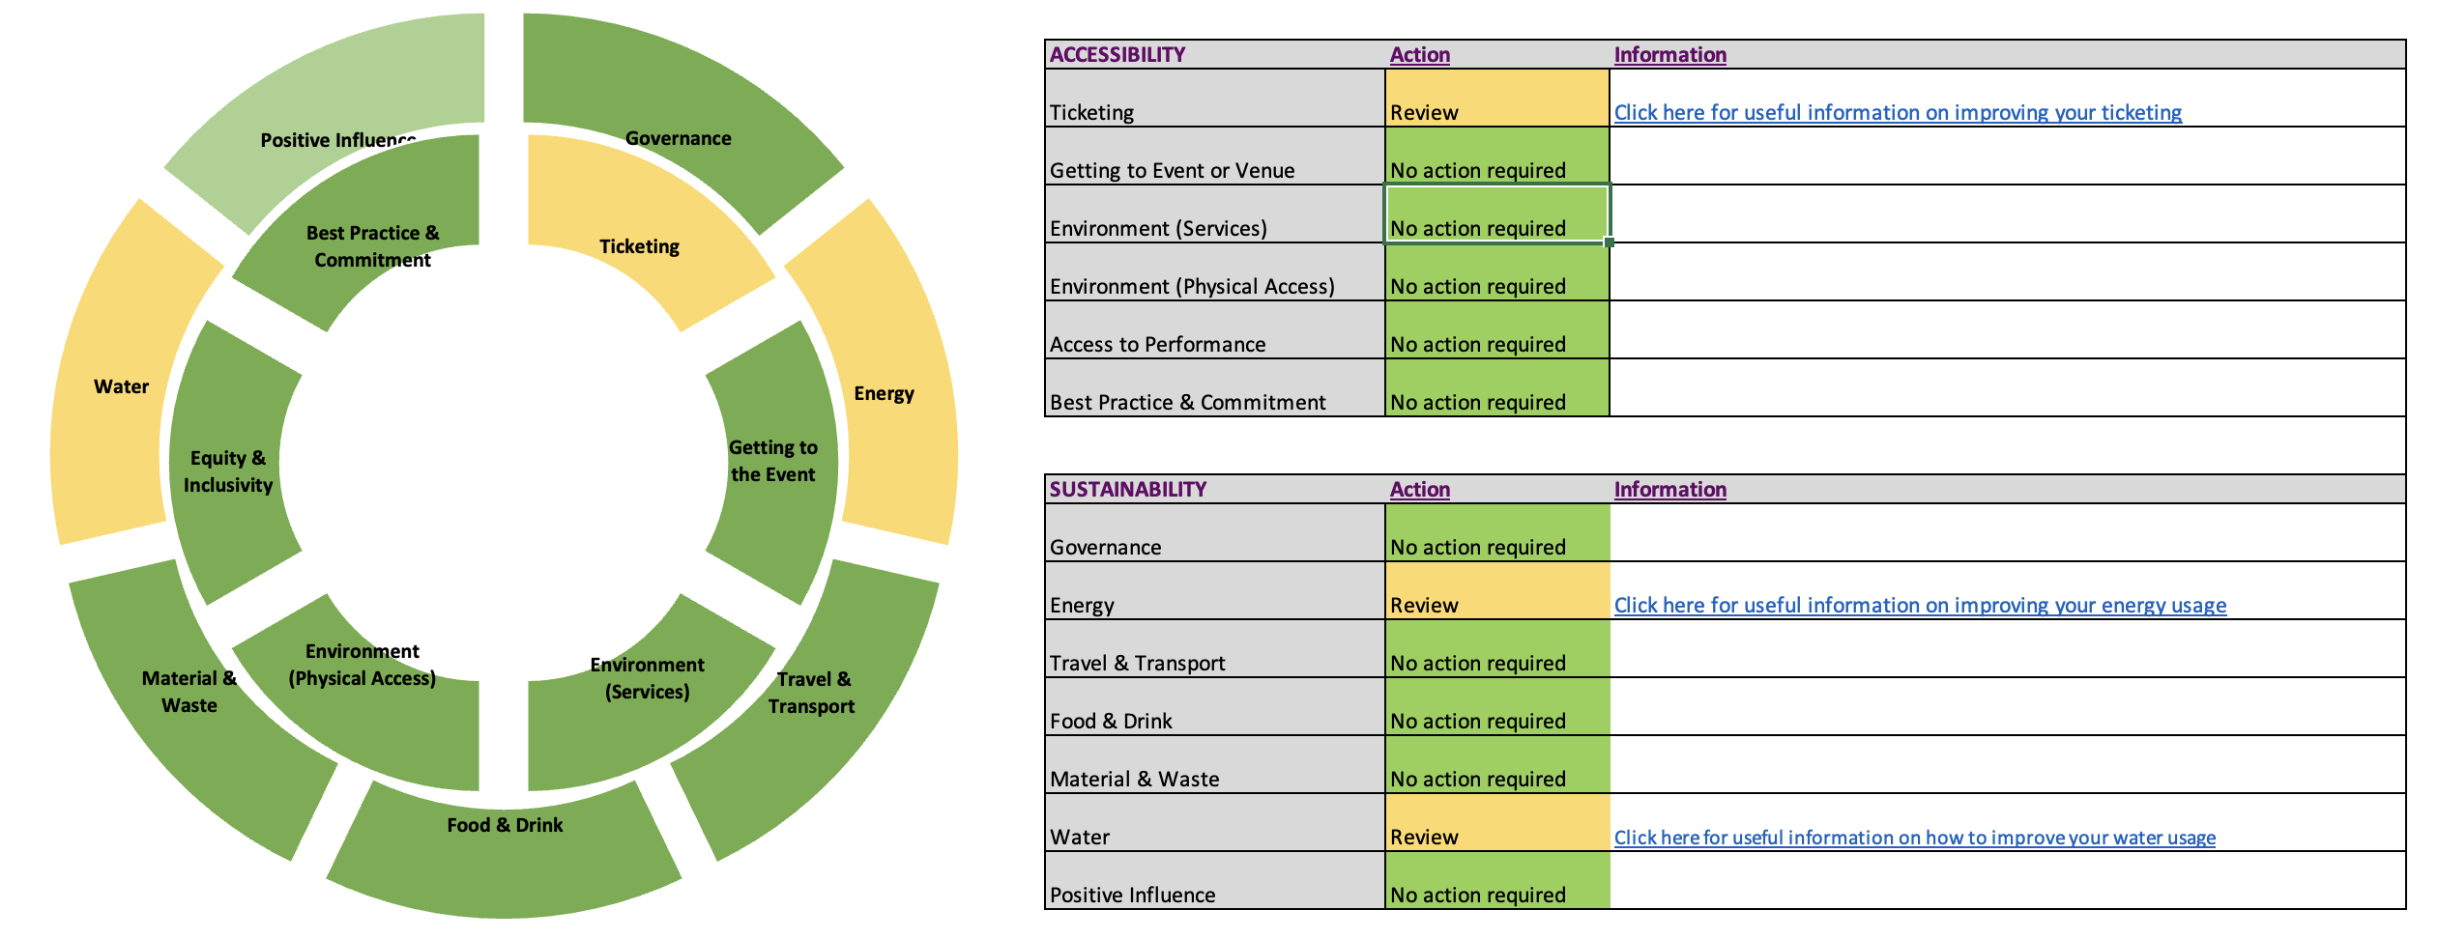
How does DATE work?
The DATE toolkit combines four key elements:
Green Events Code of Practice (Outer ring)
Attitude is Everything Charter (Inner ring)
Project Assessment Tool
“Doughnut” ethos
These work together to create an easy-to-use integrated tool that is:
easy to use for events and local authorities who are not experts on measuring impacts.
within the ability/capacity of even small voluntary run events to use
clear and simple in he picture it provides to those making assessments
Easily integrated in systems and data secure
DATE takes the form of a three-page survey that produces everything needed to assess an events profile against the Green Events Code, as well as providing additional accessibility and social value outputs for local authorities.

Slide 5
Where does DATE work?
DATE can be integrated at any point of the event application process
Event applicant
Local authority event application process
Local Authority
Aggregated analysis
Advisory report to help improve sustainability and accessibility of event; signposting to information and community support
Event reporting incorporating the GEC & AIE frameworks, tailored to each event and authority

Slide 6
Outputs
Policy recommendations
Advisories for event organizers (SVM)
Review funding / budget allocation
Reporting for Events Commissioning / SAG
Aggregated analysis
Identify Local/regional/ national priorities
Dataset for each local authority
Dynamic reporting & modelling; enforcement data
Dataset for sector
Growth Agnostic / Social & environmental value focus
Identification
Analysis
Evaluation

Slide 7
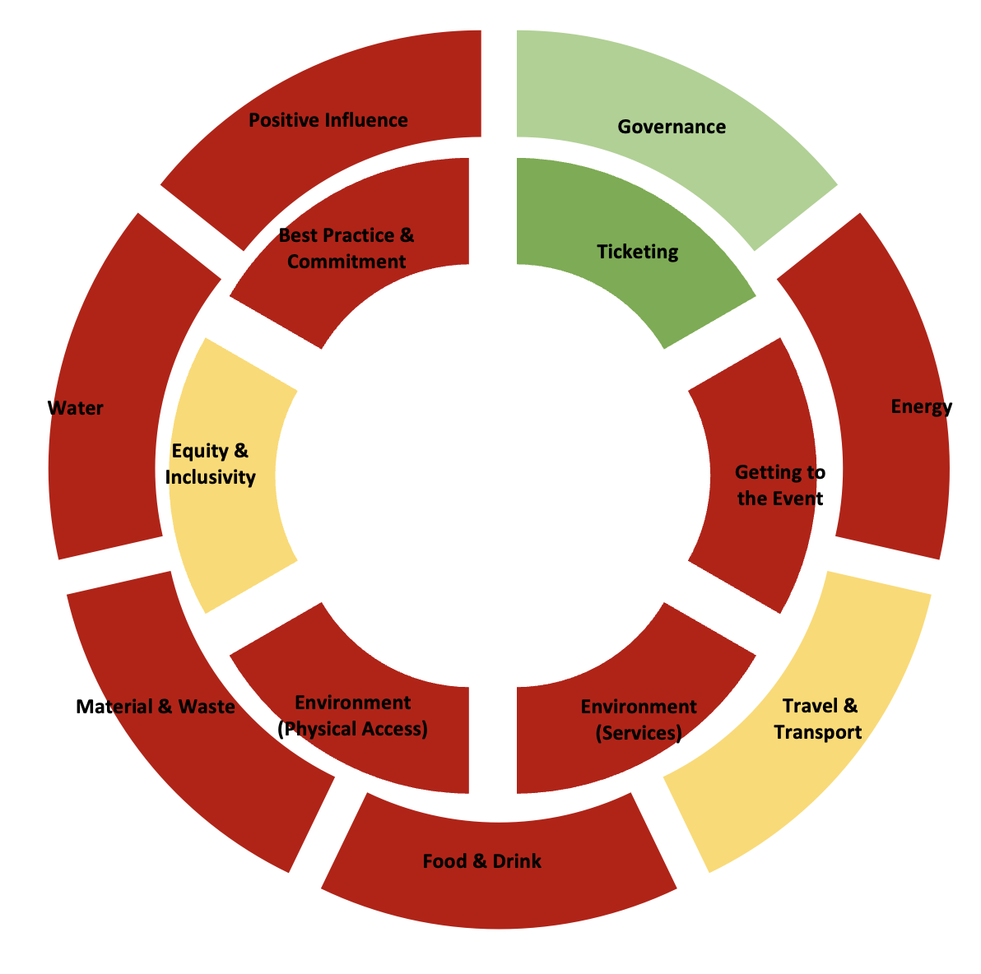
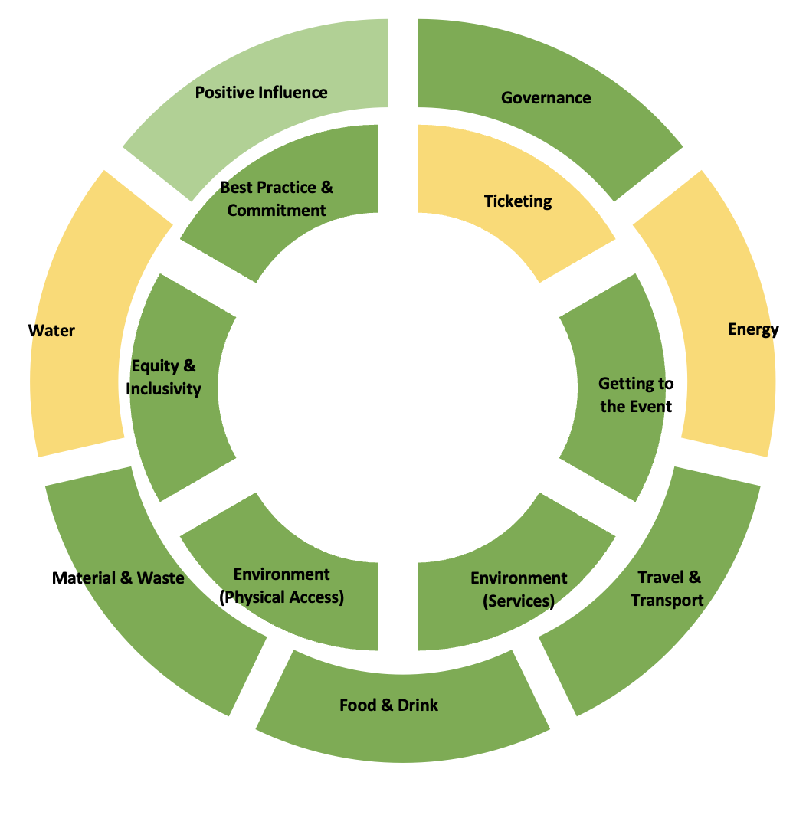
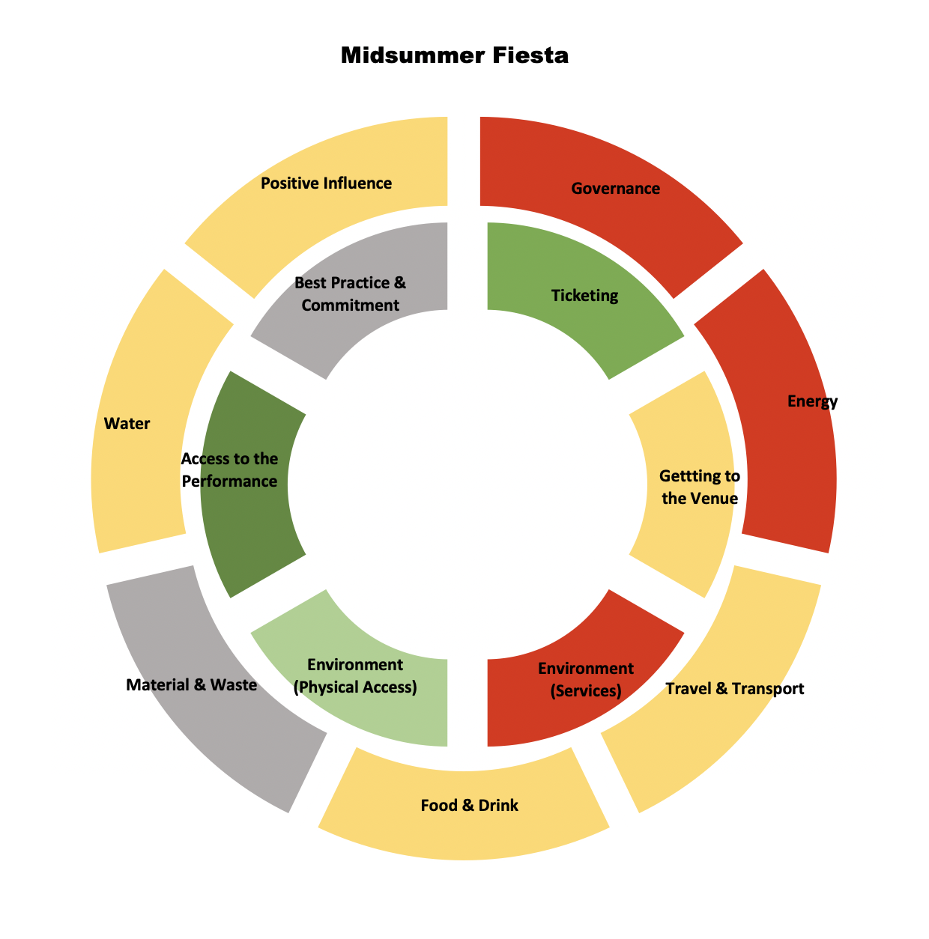
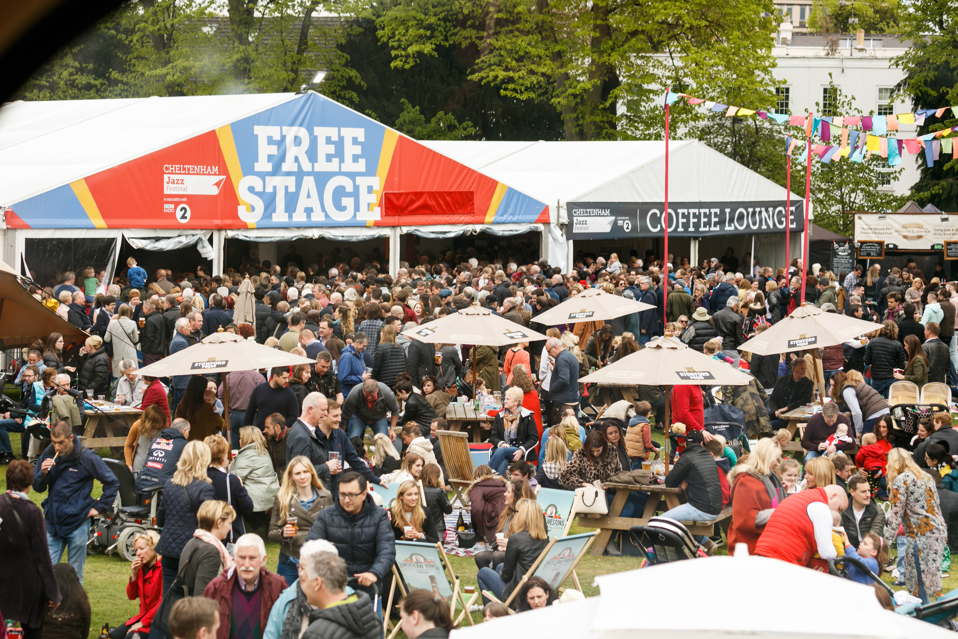
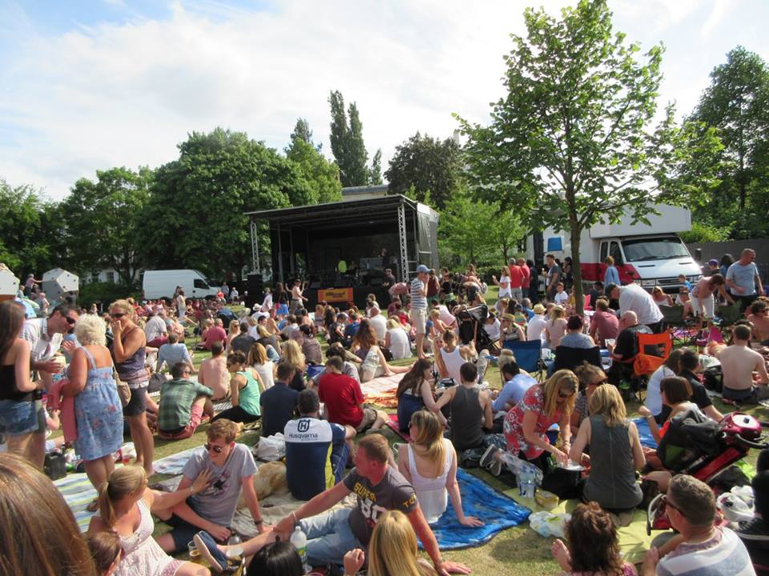
Case Study: Montpellier Park, Cheltenham
Cheltenham Jazz Festival 2022 Cheltenham Jazz Festival 2023
Midsummer Fiesta 2023

Slide 8
What’s next?
GECOP Pilot
Cheltenham Donut Project
Contemporary Issues In Events
Working with Vision2025 & Julie’s Bicycle on ACE funded pilot to trial toolkit nationally in 2024
Working with NHL Stenden and University of Liverpool, and cross sector of local economy to map/audit 138 cultural spaces: venues, museums, theatres, libraries, cinemas, conference spaces, sports, bars, restaurants. Data collection almost complete, analysis beings Dec 2023
Writing a chapter on events licensing frameworks and certification for Goodfellows Publishers, out Winter 2024

Slide 9
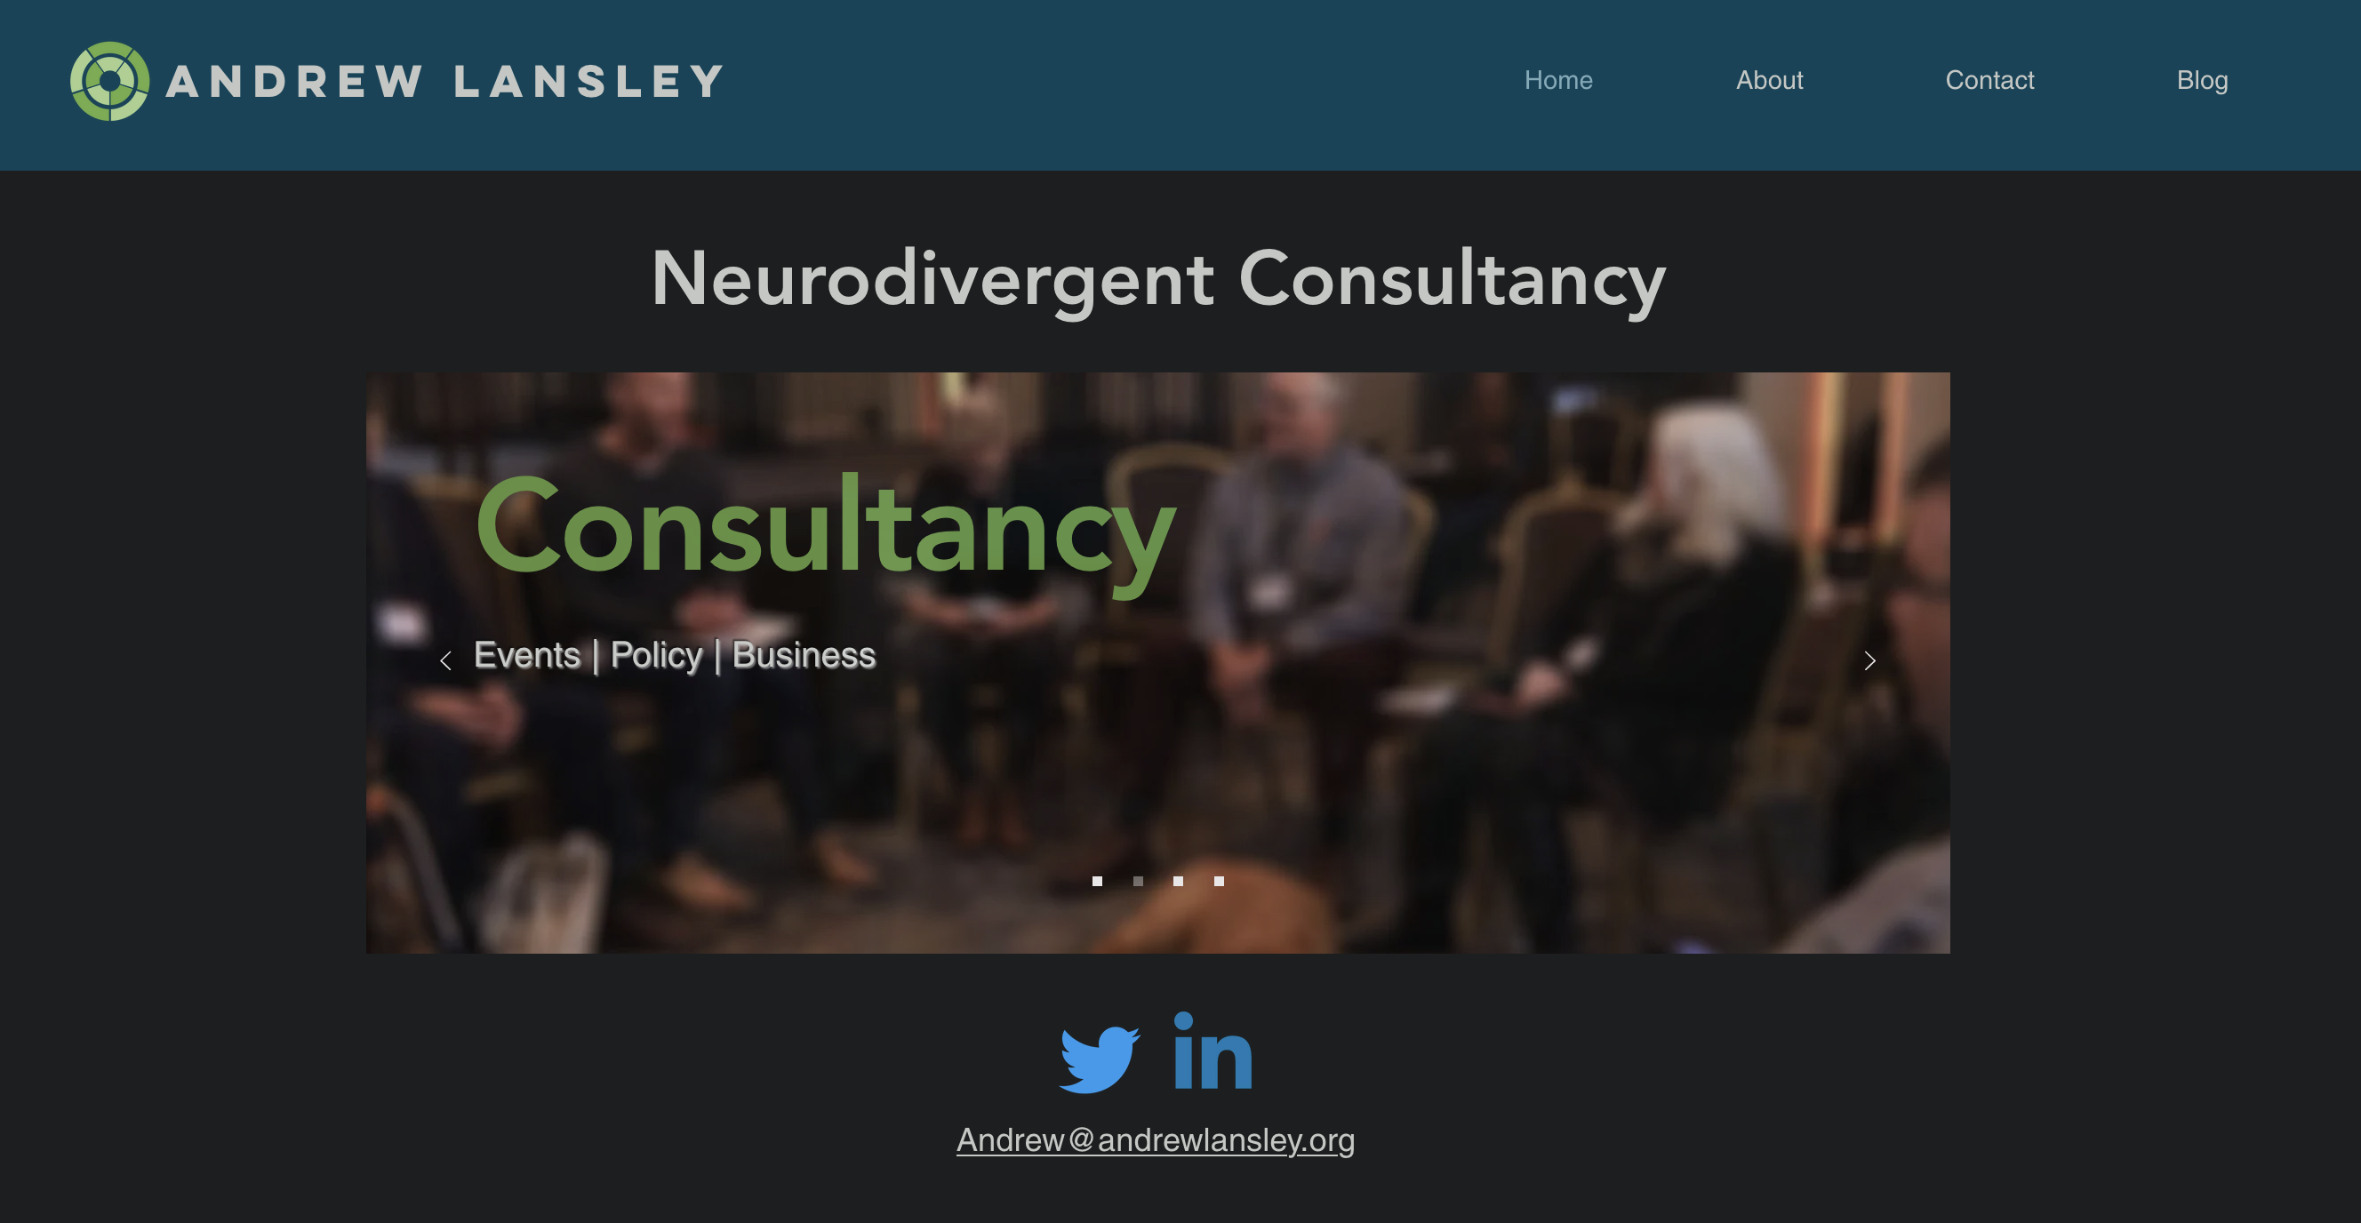
For more information:
www.andrewlansley.org

