Slide 1
Failing Fast
Helping festivals navigate new ways of creative practice,
including MPV solutions and agile working
Sarah Gee and Sonia Stevenson

Slide 2
Who are we
Sonia Stevenson
Head of Music Patron, Sound and Music
Sarah Gee
Chief Executive, Spitalfields Music

Slide 3
How are you feeling? The current festival climate. Challenges and opportunities

Slide 4
What do we mean by failing fast?
Facebook's famous slogan: 'move fast, break things'
Fail fast, succeed faster
Iterating fast failures achieves a desired result faster than perfecting the solution
Ultimately about de-risking
Counter-intuitive to those in performing arts where perfection is the thing we strive for in performance?

Slide 5
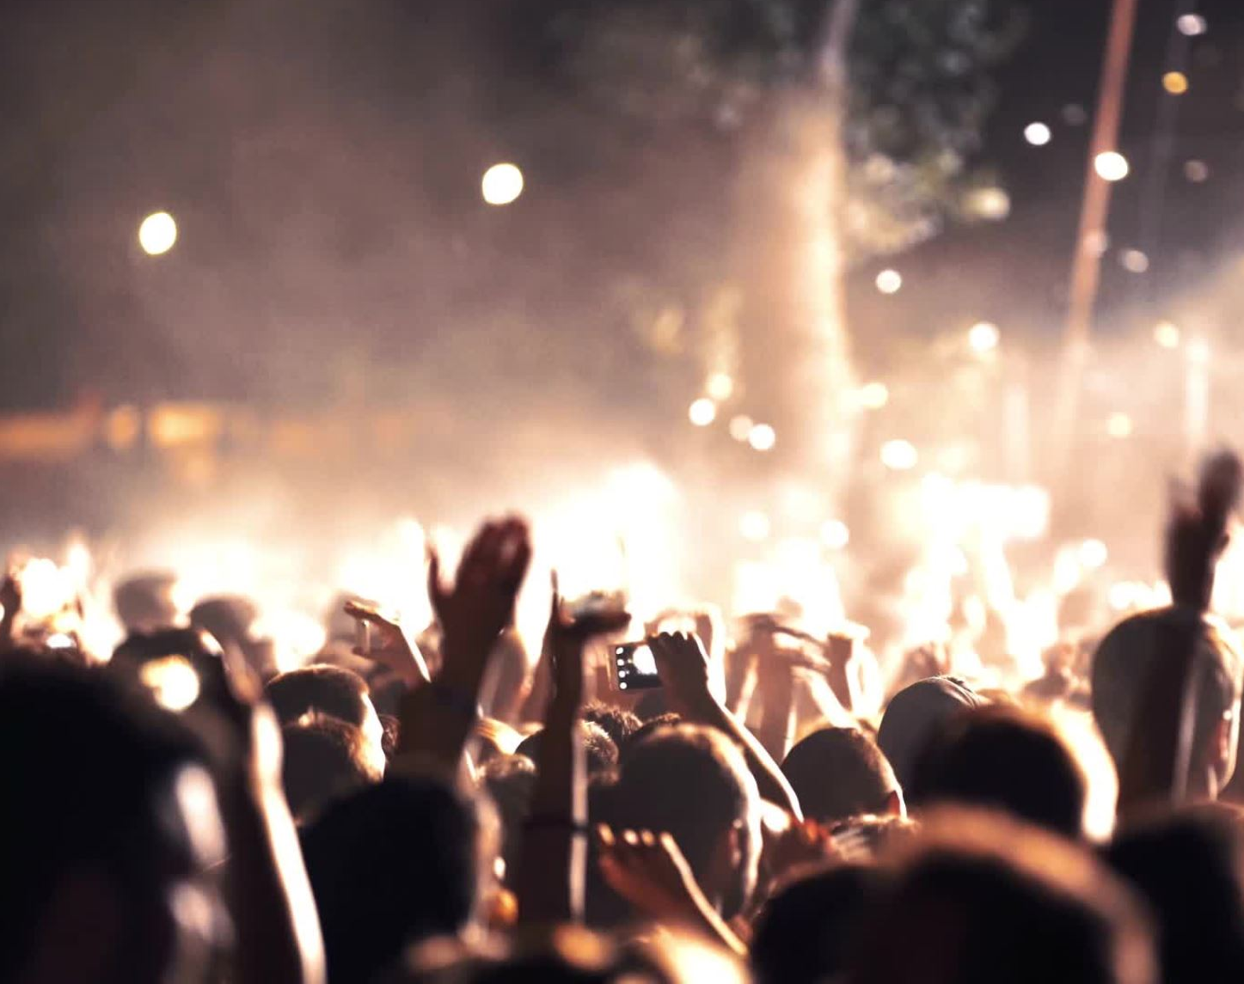
How do you fail fast when you have an annual festival?

Slide 6
How do you do the fast bit? Agile
Work in short cycles
Pause at the end of each cycle to reflect on:
Accomplishments
Learnings
New insights
Next steps
Does all this indicate we should continue in same direction or change course?
Notes:
Who's heard of agile?
Example: patron acquisition. 200 patrons by Xmas. Not pour bucket of water on to concrete, but create specific pipeflow, test and optimise each bit of the flow. Might sound opposite of agile (slow, in-depth), but by going this deep you are able to find the success and failure points quickly and move forward with clarity and confidence rather than guesswork.

Slide 7
What does that mean in practice?
Notes:
Example from MP: we wanted to create website from scratch. Could have done it traditional way (spend month working out all the different bits we need, developer works on it, delivers it after few months, and we go 'but hang on' that's not what we wanted, this bit doesn't work). Instead break it down into sprints that we work on together collaboratively with developer. Meant we went from nothing to website in 2 months. Fail fast example: first alpha site, emailed patrons already signed up 'we've gone live and we're welcoming donations. Didn't work. Some tech thing to do with user registration – fine when we tested it, but not for external users. Quickly fixed in a day. Yes embarrassing, but better this way with small handful of people than on big launch day.

Slide 8
Aim of sprints = MVP
Minimum Viable Product
Notes:
The goal of an MVP is to begin the process of learning, not end it. It's deliberately unpolished, deliberate simple, small-scale or hands on. Its goal is to test your hypotheses. Once you have learnings then you can 'prettify' it or scale it.
A hands-on (concierge) example = moments of joy here at BAFA festival.
Sarah to think of festival MVP example e.g. want to know how a new genre/type of artists might land with festival audience. Do you need to wait for festival to try it? Could you show a video of artist to a focus group, or test engagement with social media ads?
Sarah to ask: Can you run different sprints simultaneously? What's timing of a sprint?

Slide 9
Being agile is also a mindset
How can we do this better, more effectively, more joyfully?
Don't take for granted that things should be done one way only
Clarity – why are we doing this? What's the vision?
Prioritising
Coming together as a team: collaborative solutions, working together on one thing at a time (rituals e.g. stand-up)
Putting the 'user' first (beneficiary: artist, festival goer)
Notes:
Sarah to emphasise the mindset aspect and touch on:
Doing things joyfully
In arts we have a tendency towards perfection and it can hold us back

Slide 10
‘Living start-up is a new way of looking at the development of innovative new products that emphasises the first iteration and customer insight, a huge vision, and great ambition, all at the same time.’

Slide 11
Vision
Strategy
Product (festival output)
Doesn't change
Can change
but not much unless pivot is needed e.g. covid move online
Changes constantly based on optimisation
Notes:
Map analogy – ultimate destination get across this continent = the vision
Strategy = we’re going to do it with this team, over this time scale, we’re going to need to cross grassland, water, desert.
Product (output) ok grassland first – we're going to walk, no that didn’t work needs to be faster, we’re going to cycle. Cycling going well, but now we need more puncture repair kits (didn’t need them for walking so didn’t plan for that)

Slide 12
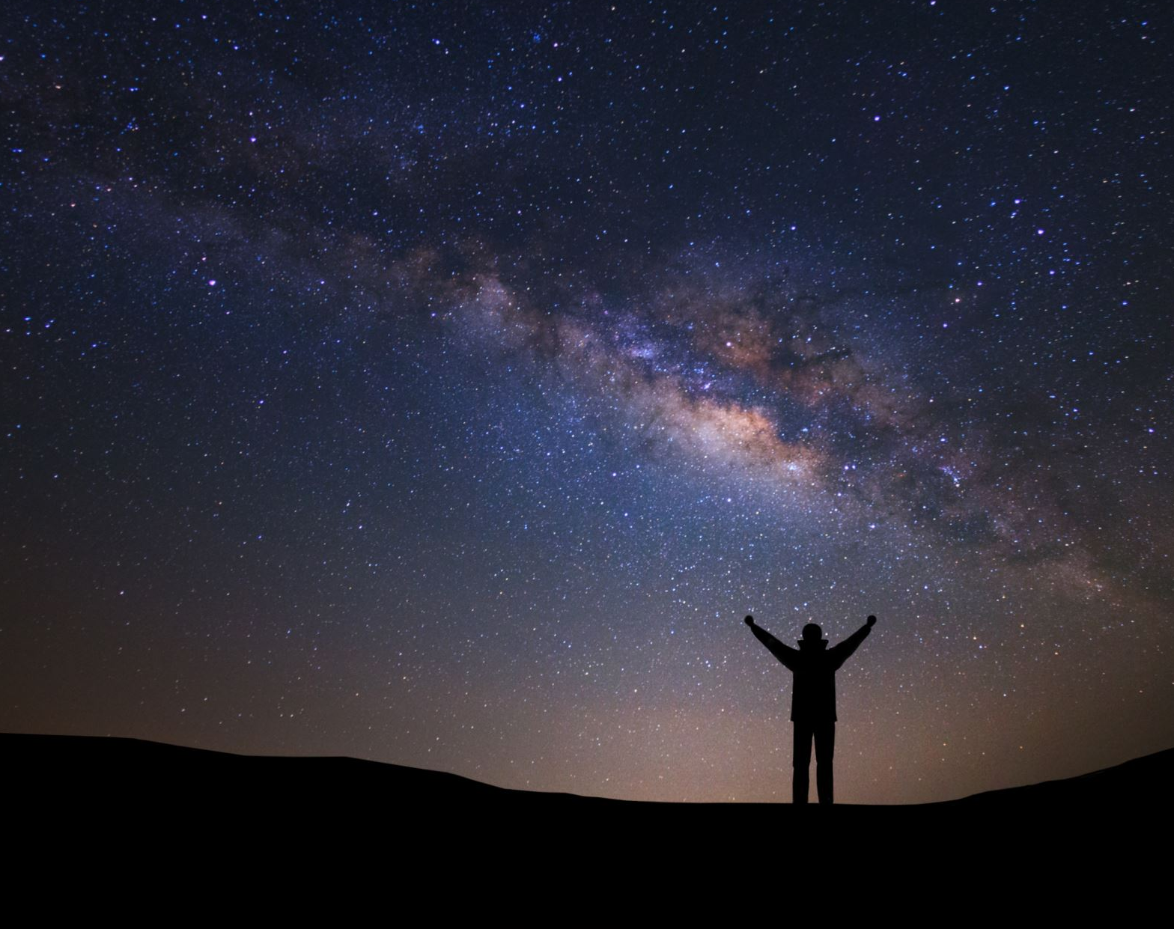
Your north star / Your vision
Imagine you can only put on 3 festival events, what would they be and why?
I want to live in a world where...
Take 4 mins to write them down
Notes:
‘events’ loose term – anything associated with the festival, might be headline event, equally an education workshop, a post-event drink in the bar, even a board meeting. Why is this thing important and essential?
MP's vision: I want to live in a world where composers are valued and can thrive

Slide 13
Your values
What are the values that will remain true regardless of how you realise the vision and who is realising it?
Music Patron's values:
Joy
Authenticity
Trust
Connection
Playful experimentation
Notes:
Starting to turn vision into strategy. Values = Like growing up in a family – all different personalities and different ways of interacting with the world, but same values

Slide 14
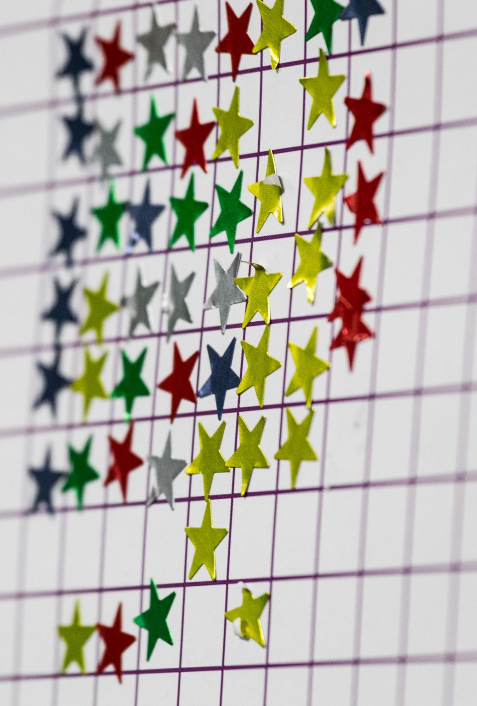
North star metric & goals
North star metric
Number of patrons engaging with content
Tangible goals
5000 patrons by end of 2025 in order to be self-sustaining
100+ composers by end of 2025
Intangible goals
Create a meaningful connection between composers and patrons
3 month goals, 1 year goals, 3 year goals
200 patrons by Christmas 2022

Slide 15
Talk to your users
‘We must learn the customers really want, not what they say they want or what we think they should want.’ (The Lean Startup, Eric Ries)
Which audience opinions should we listen to? What should we prioritise? What’s essential, what’s not? What might please today’s audiences at expense of tomorrows?
Is listening to 'users' controversial for people making festivals? Is there a tension between programming sell-out artists vs feeling like you've 'sold out'?
Notes:
How do you know you're on the right track?
Example: chairman of Lichfield Festival loved Katherine Jenkins, he and I'm sure many of the audience would have loved it if we'd booked her. I had reservations. Quite apart from cost, I don't rate her artistically. Is that me being snobbish? Is the job of a programmer to 'maintain artistic standards' but what even are those standards? Why do they matter?
Nonetheless, we are creating festivals for people (all stakeholders: audience, artists, education beneficiaries etc.) so we should listen to them if we want the festival to succeed. Doesn't mean we have to take on board everything they suggest, but we should understand them.
Lean Startup ‘We adopted the view that our job was to find a synthesis between our vision and what customers would accept; it wasn't to capitulate to what customers thought they wanted or tell customers what they ought to want.’
We'd love to open up debate, but not enough time here.

Slide 16
People lie to you
Mom Test, Rob Fitzpatrick
Notes:
Sarah: radio times example
(masters of scale – airbnb founder) Ask users not what would it take to make this better? But what it take to make everyone you know sign up to this? Or for you to tell everyone you know to sign up? Or what would surprise you?

Slide 17
A mini sprint right here, right now
Plan: what goal are you trying to achieve and why? Define the task. State your hypothesis. Why might it fail/what are the barriers? Rank them.
Design: what will test your hypothesis / address the biggest barriers.
Develop: make the thing itself. Keep it MVP - quick and simple, not perfect.
Test: get feedback on what you've created.
Deploy: make it real, make it live.
Review: really important to reflect together & capture what you learnt.
Notes:
Ask everyone to pick one of these problems:
Loosing older audiences
Venues putting up prices to try and recoup prices lost in pandemic (closing down markets in process)
Pricing of tickets in cost of living crises

Slide 18
Continuing the conversation
sonia.stevenson@soundandmusic.org
@sonia_stevenson (Twitter)
Sonia Stevenson (LinkendIn)
sarah.gee@spitalfieldsmusic.org.uk
@SarahABGee (Twitter)
Sarah Gee (LinkedIn)

Slide 19
Join us on the Music Patron journey
Sign up to mailing list
www.musicpatron.com
Also...
Take a look, let me know your honest thoughts
Sign up as a patron
Help spread the word
Consider hosting a moment of joy

