Slide 1
Philip Walker
Head of Culture
Gloucester City Council
Notes:
Good afternoon,
I will give a quick romp through Gloucester’s festivals and events and illustrate how local authorities can play a role in place-making agenda and in the various ways in which they can support the Festivals and Events sector.
GCC created a 10 year Cultural Strategy in 2016 that was updated in 2021
This strategy set out a number of objectives, one of which was to establish an arms’ length Culture Trust and devolve the strategy development of culture in the city to them.
Soon after, Gloucester Culture Trust came into being in 2018 and has since then done just that, bringing partners together and investment into the city, notably Great Places scheme.
The City Council continues to run its own venues, leaving the Cultural Trust to be able convene partnerships and leverage funds for projects and more.
One of these objectives is to put Gloucester on the Cultural Map – which is clearly an indication that its keen on the Place-Making agenda and understands the role that culture has to play in this.

Slide 2
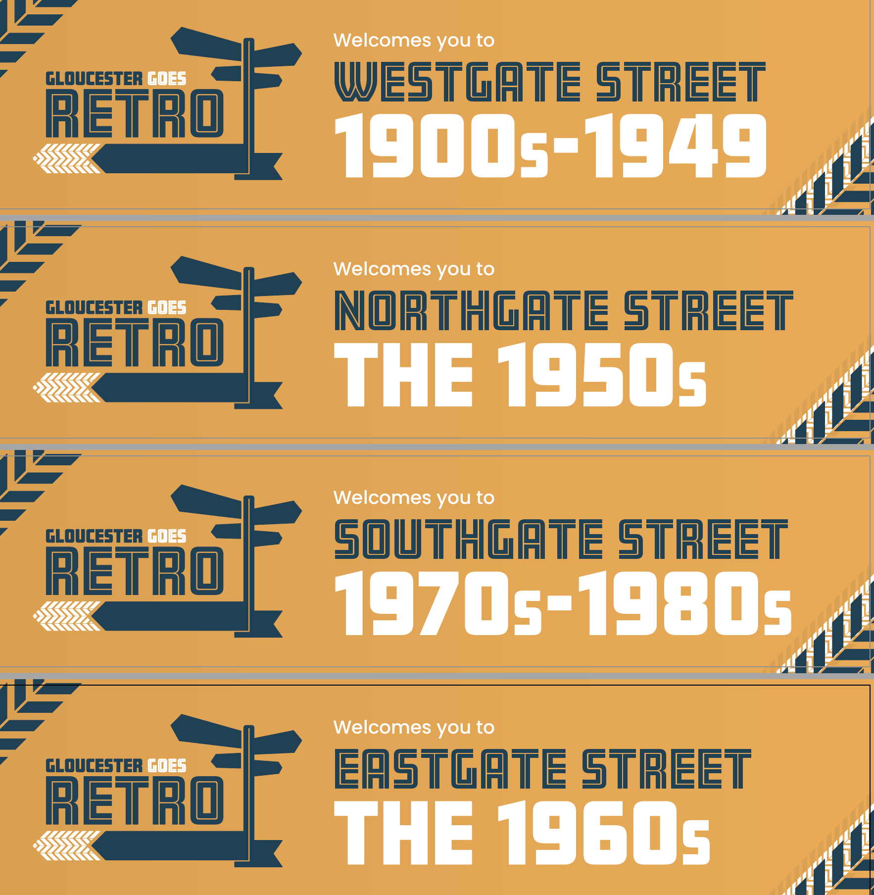
Notes:
Gloucester has an established programme of Festivals and events that all contribute to the Place Making Agenda.
Gloucester Goes Retro – is an annual classic car and vintage festival.
It takes over the city centre and attracts 10s of 1000s of visitors each year. August Bank Holiday weekend each year.
City Council Festival and Events team run the event, with support from Gloucester Business Improvement District (BID)

Slide 3
This Photo by Unknown Author is licensed under CC BY-SA-NC
Notes:
Gloucester Tall Ships Festival is a bi-annual event taking place in May over a Bank Holiday weekend and makes the most of the history of the city as being the UKs most in-land port.
It takes place in the Docks an area transformed from a post-industrial landscape to one of high-quality retail and residential appartments. The Quays is an area of the city that has benefited from regeneration and is now an attractive environment for all kinds of activities.

Slide 4
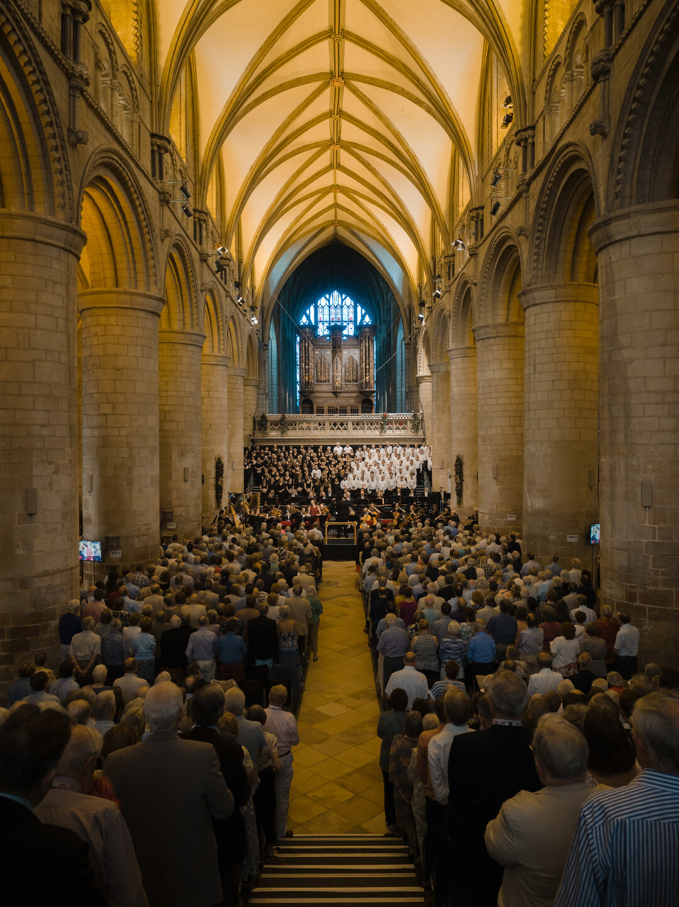
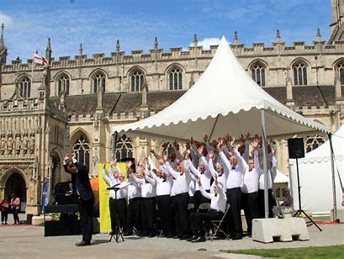
Notes:
3 Choirs Festival is the city’s longest running tri-annual festival – last held in the city in 2019 – next here in summer 2023.
This event brings international audiences and performers and provides a significant boost to the local economy.
In all these instances, the city council either runs the events or provides the funding, brokers relationships and / unlocks spaces for the events to take place.

Slide 5
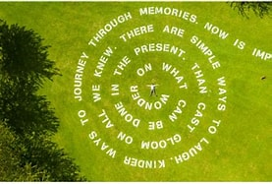
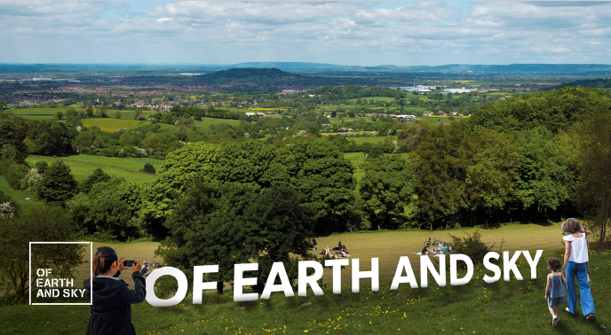
Notes:
Of Earth and Sky – was a multi-site art installation by an artist with a national and international reputation – working with local Gloucester Communities via spoken word and poetry across the open spaces in and around the city – to encourage people to engage with culture during lockdowns in Summer of 2021.
In 2020 the council supported this new commission with funding and underwrote the commission – when funding was still being gathered from sources such as Arts Council, the BID, sponsors and trusts.
Without the council’s support the event would not have been able to go ahead as the timescales for delivery were tight.

Slide 6
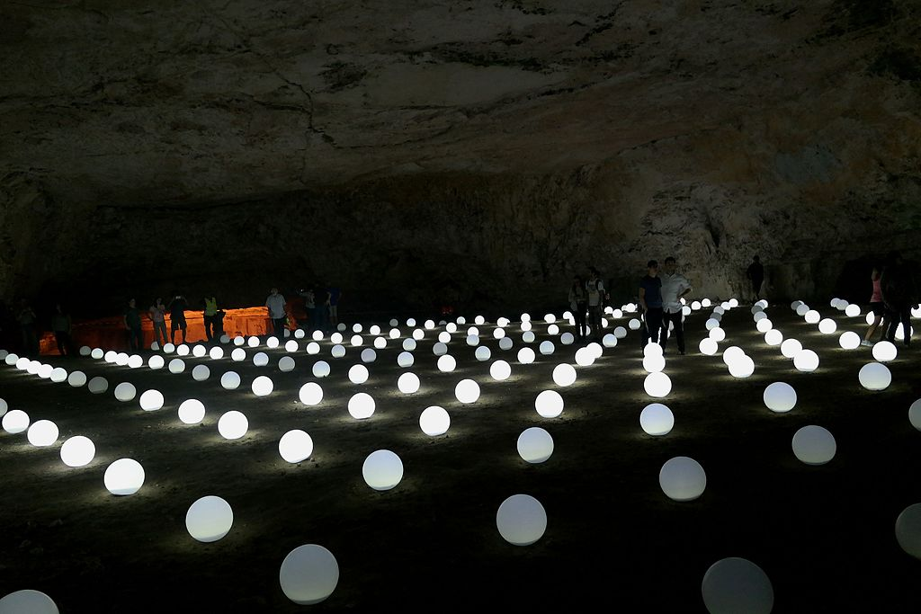
This Photo by Unknown Author is licensed under CC BY-SA
Notes:
A light and sound installation called Globoscope was brought to Gloucester as part of Bright Nights festival in Winter 2021-2.
City Council provided funding to support bringing the work of international artists to the city.
Strike a Light held the partnership with GDIF Greenwich and Docklands International Festival – to get Globoscope to Gloucester – great international artwork
SAL did the community engagement within the local Matson estate – an area of high deprivation levels.
3,000 visitors over one weekend – high winds, cancellation of 1/3 nights
City council owns the land, team of rangers on Robinswood Hill, Festivals and Events team supported the installation, crowd management, logistics, marketing and promotion.

Slide 7
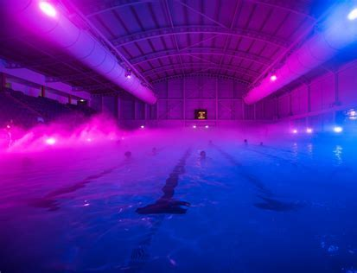
Notes:
Bright Nights – Illuminated Swim – at GL1 – city council owned facilities – partner is Aspire Leisure.
Council led project, new commissions, working with Vashti Waite and Katherine Jewkes – producers to create a city-wide Winter Light Festival.
City Council majority funded £40k, which helped leverage additional £100k of funds.

Slide 8
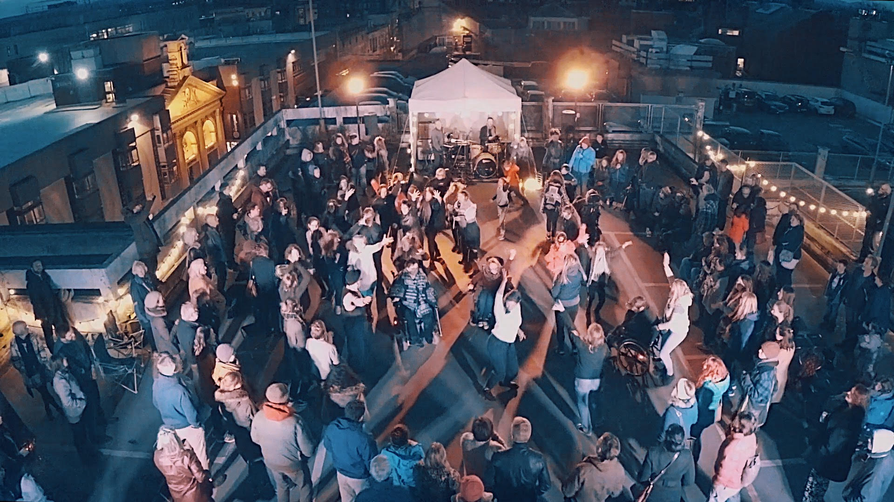
Notes:
Rooftop Festival. In this instance – the council owned city centre carpark rooftops were turned over to Strike a Light and partners to deliver the Rooftop Festival
City Council able to turn over its spaces to others for use. In-kind support as well as technical and Festivals and events support from F&E team and Gloucester Guildhall

Slide 9
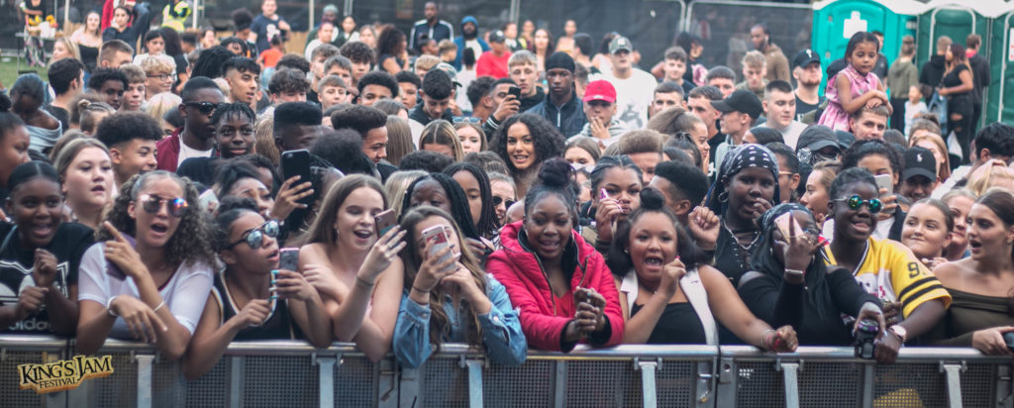
Notes:
Kings Jam – a city-centre event where the city council has provided funding, space and some tech support.
The Music Works, youth music charity run the event and subsidized to engage young people with live performance in their own city.
Both Rooftop and Kings Jam have done lots to engage young people with culture in their city – rather than having to go to Birmingham, Cardiff, Bristol or London.

Slide 10
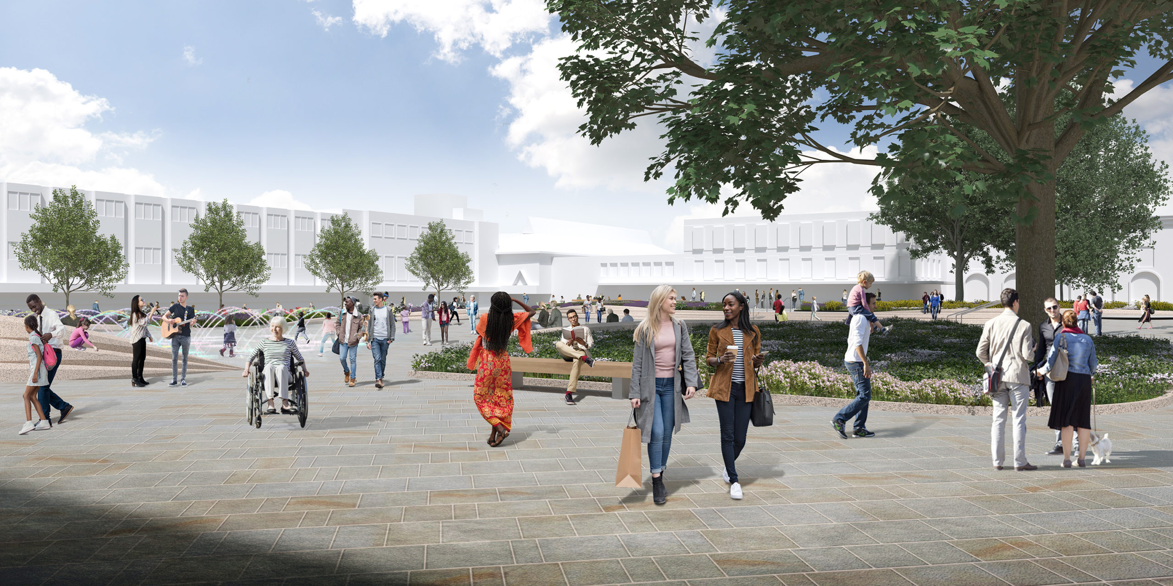
Notes:
Gloucester City – a priority place
The purpose of the Priority Places is an acknowledgement of underinvestment in places such as Gloucester.
Without the external investment from the likes of Arts Council and the Levelling Up Funds from central Gloucester.
Gloucester is in the process of developing a £107m regeneration of its city centre. This is a partnership between the City Council and Reef to develop a substantial portion of the city centre.
The first piece of the puzzle in this journey was the redevelopment of the main city square – Kings Square. The £5m revamp is intended to give Gloucester a ready to go Events space, so its been designed with in-built 3 Phase power and water points flush mounted beneath the Square with pop-up locations to enable flexible use for events, avoiding the need for Generators or long-cable routes and reducing the need for additional infrastructure. The square is level access with vehicular access from all 4 corners and weight-bearing slab to enable heavy vehicle movements.
The fountains and fittings are all flush mounted to ensure the Square is smooth and accessible. Lighting and fountains surround it. City Centre, easily accessible, great location.

Slide 11
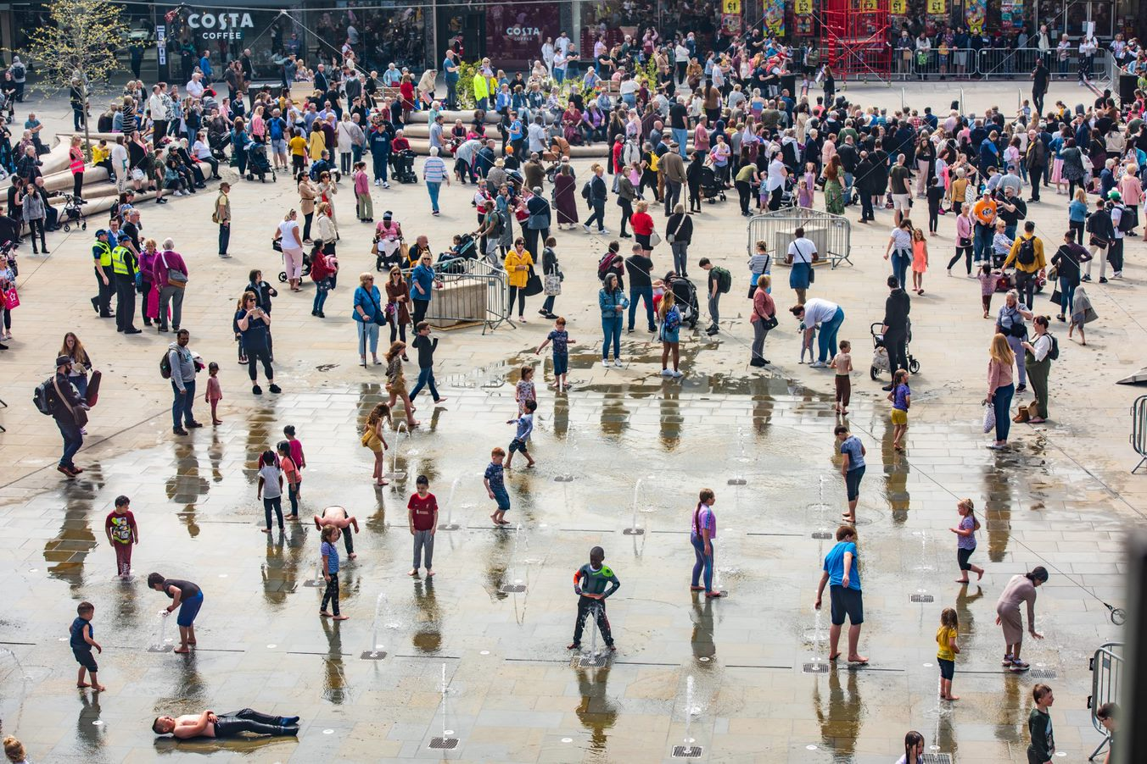
Notes:
As it is now and on the launch event in May 2022

Slide 12
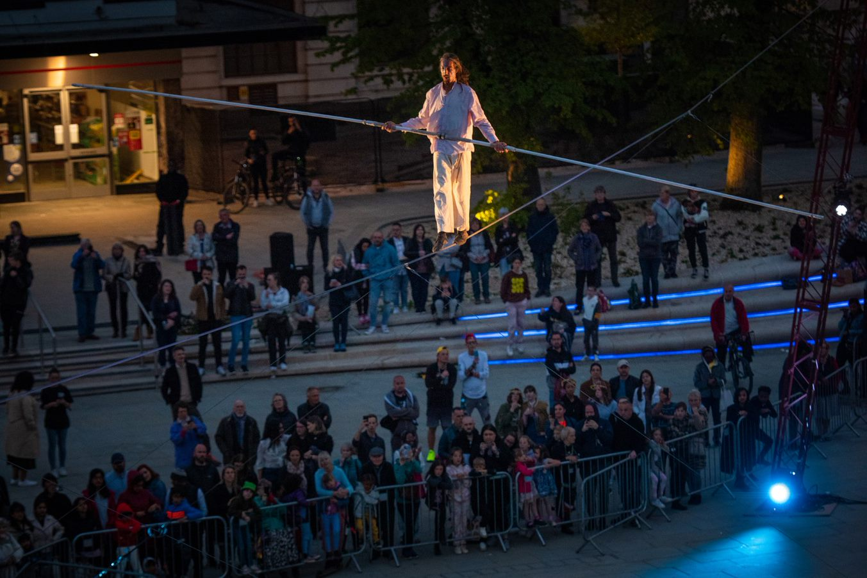
Notes:
Kings Square Launch event – Bulzini high wire artist

Slide 13
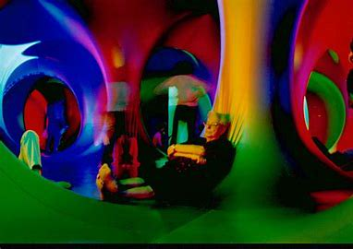
Notes:
Luminarium – Kings Square hosted the Arboria 2 installation by the Architects of Air over 2 weeks in 2022
Heatwave made this very challenging – but high impact for audiences – accessible, different.

Slide 14
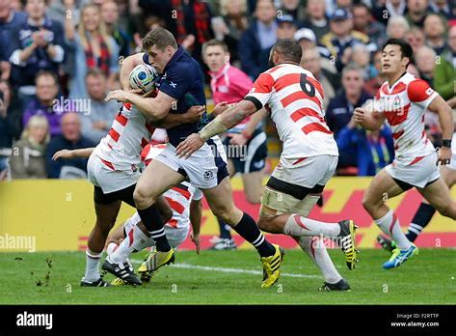
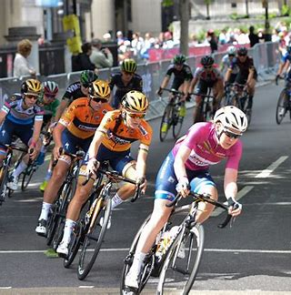
Notes:
Sporting Events also contribute to Gloucester’s identity – which has a proud sporting tradition – notably for Rugby.
In 2015 Gloucester hosted a number of international squads and matches. The city centre and Docks were used as a FanZone, which was programmed with activity to encourage people to stay before and after. A Cultural programme
Women’s Tour of Britain 2022 was held in the city for the first time this year.

Slide 15
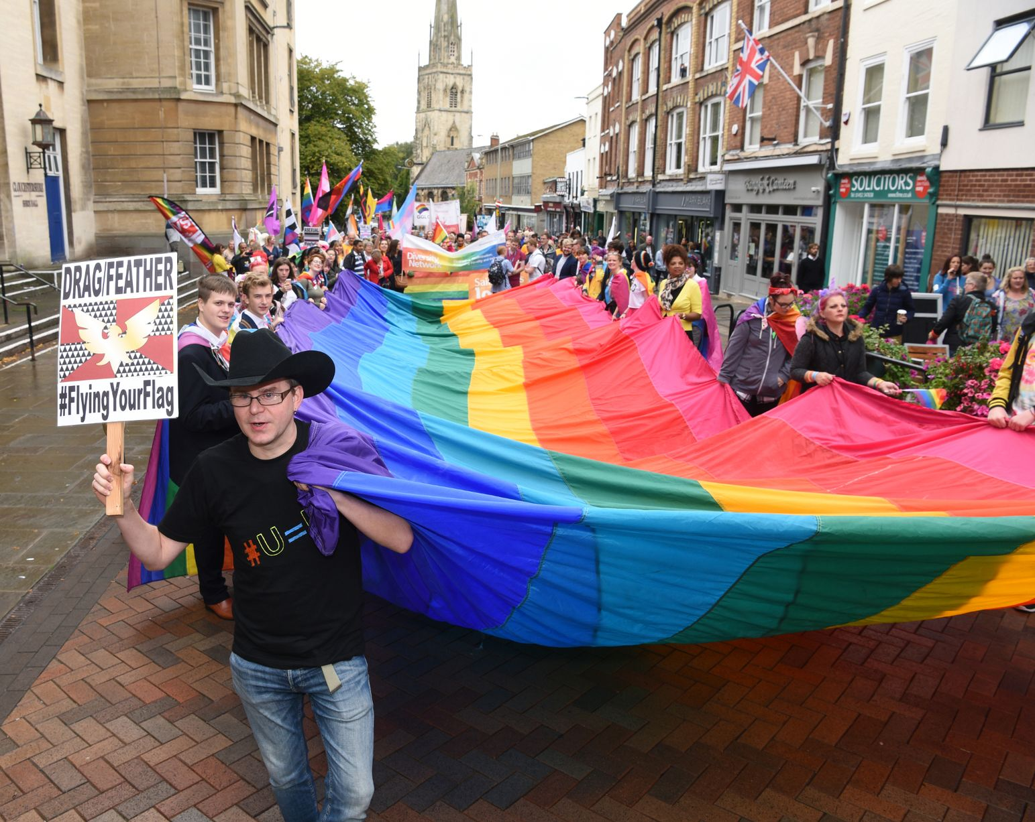
Notes:
Pride in Gloucestershire – hoping to host Europride in 2026 – will be an amazing way to show Gloucester on an international stage.

Slide 16
Notes:
Visit Gloucester – using our role as the city’s DMO – we’re able to amplify and promote Festivals and Events through our channels and capacity within the council.
Additionally, our Cabinet member for Culture and Leisure will champion city activity as do our partners from the Marketing Steering Board that the council convenes to support it and provide challenge.

Slide 17
Notes:
Partnerships
Finally – the key to the success of these place-making events is partnership working – majority of the projects / examples I have given are the result of city-wide partnerships.
You’ll see many of the same organisations cropping up again – Gloucester Culture Trust, Strike a Light, Gloucester Cathedral, Gloucester Guildhall.
In small cities in particular, we cannot work in isolation and as pressures mount over budgets, cost increases and capacity within councils and organisations, now more than ever we need to encourage and support collaborations and partnerships.
Thank you!

