Slide 1
Ellie Petrie
Programme Manager
Literature and Science Festivals
Cheltenham Festivals
Fast Forward: Future Festivals
BAFA Conference for Festivals 2022

Slide 2
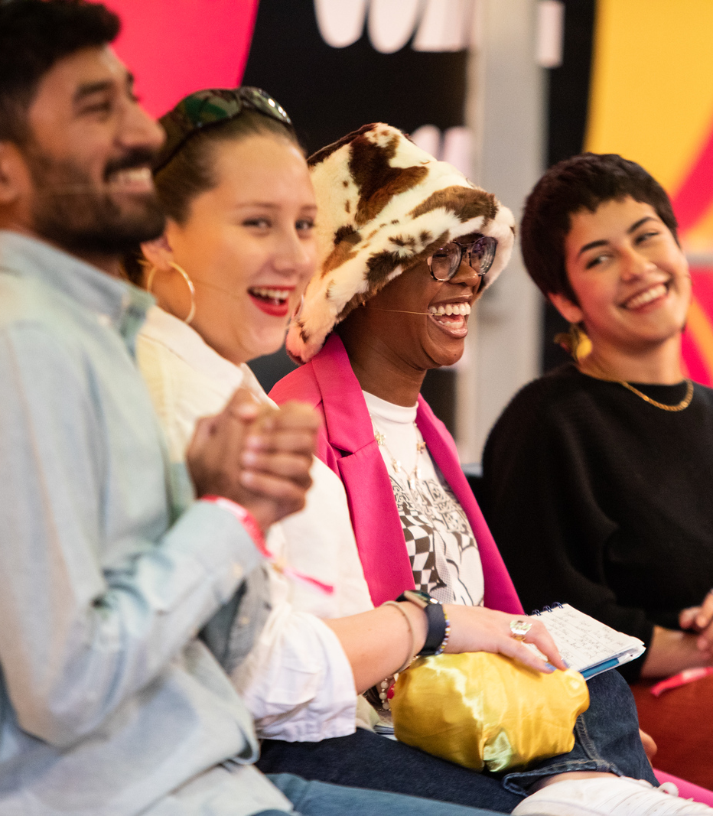
What and Why?
A destination for young people to share and explore ideas and culture, in person and online
A platform to amplify the stories that matter, engage with key local, national and international issues, and connect with others
A distinctive, non-traditional event space and vibrant programme of free, pop-up events in a range of formats
Turning up the volume on local, national and international young voices that are shaping conversations of the future
Image: Still Moving Media

Slide 3
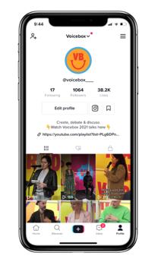
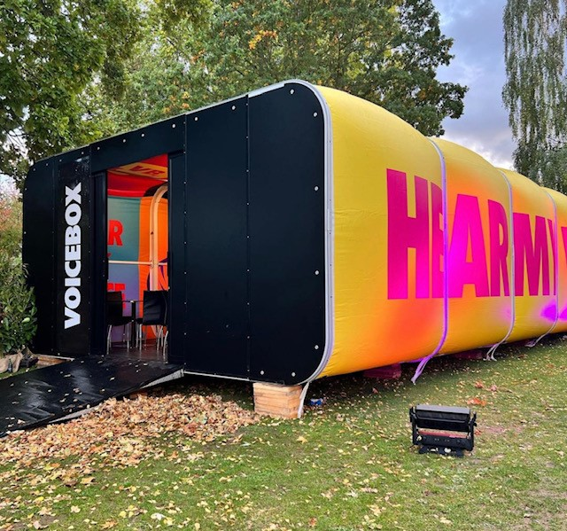
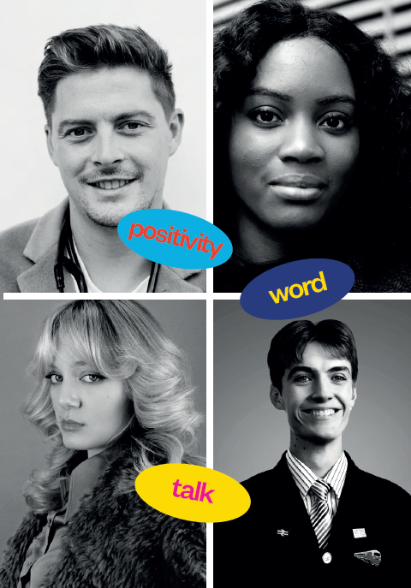
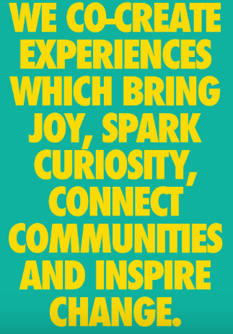
Creating an Identity

Slide 4
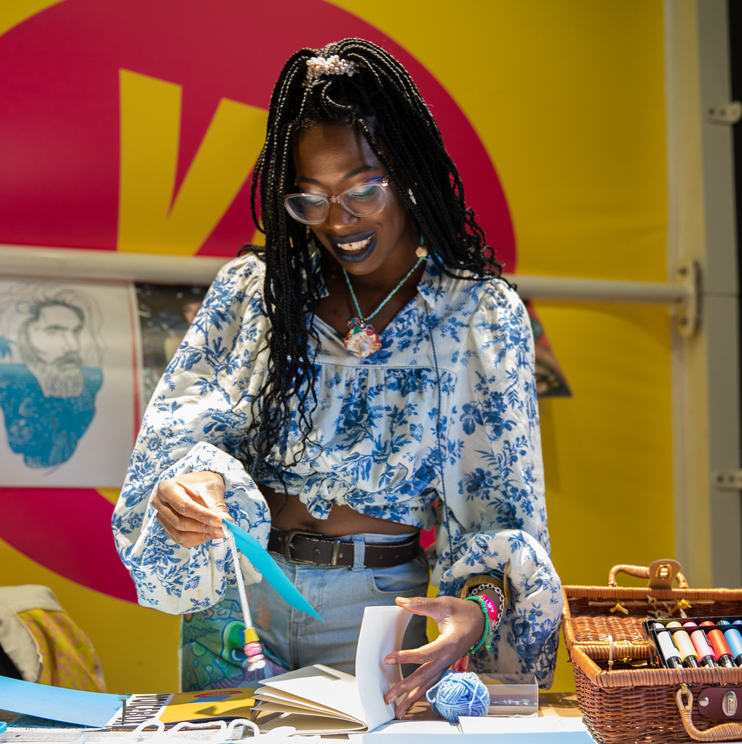
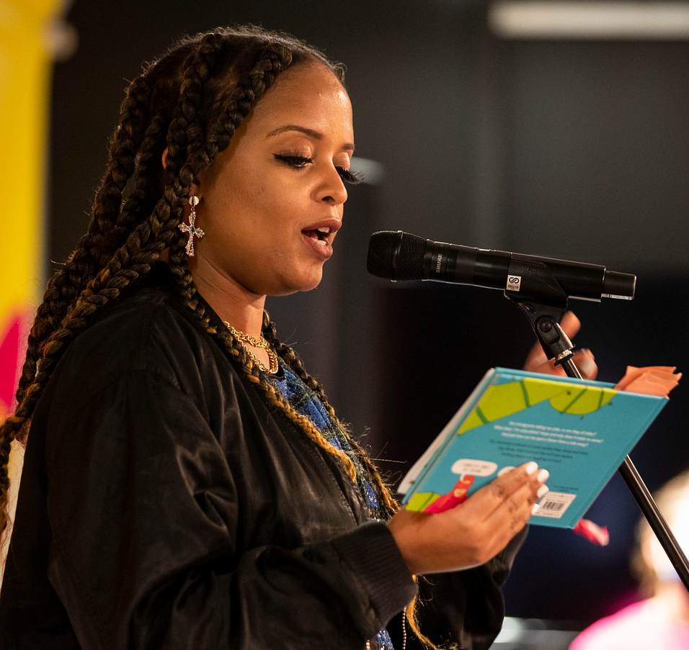
Centring youth voice and young talent
Co-curation
Reflective and relevant programming
Non-traditional formats
Spotlight on year-round activity
Ownership from speakers and audience
Digital content
Programming Approach
Images: Still Moving Media

Slide 5
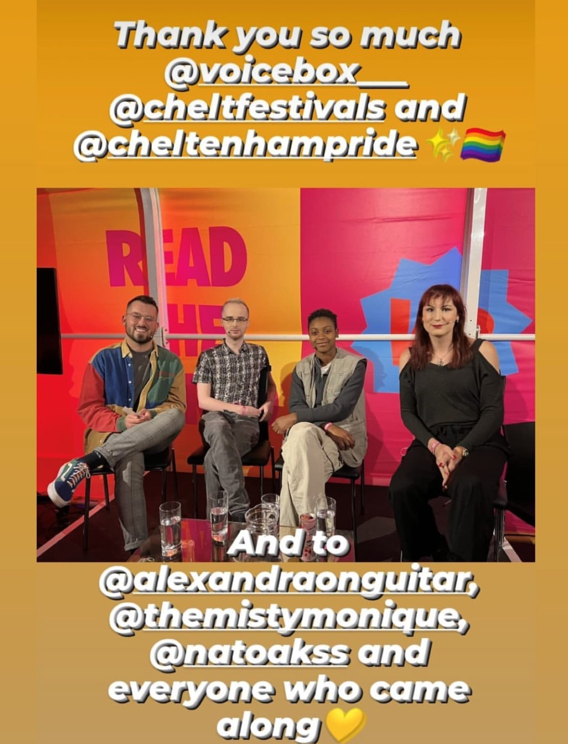
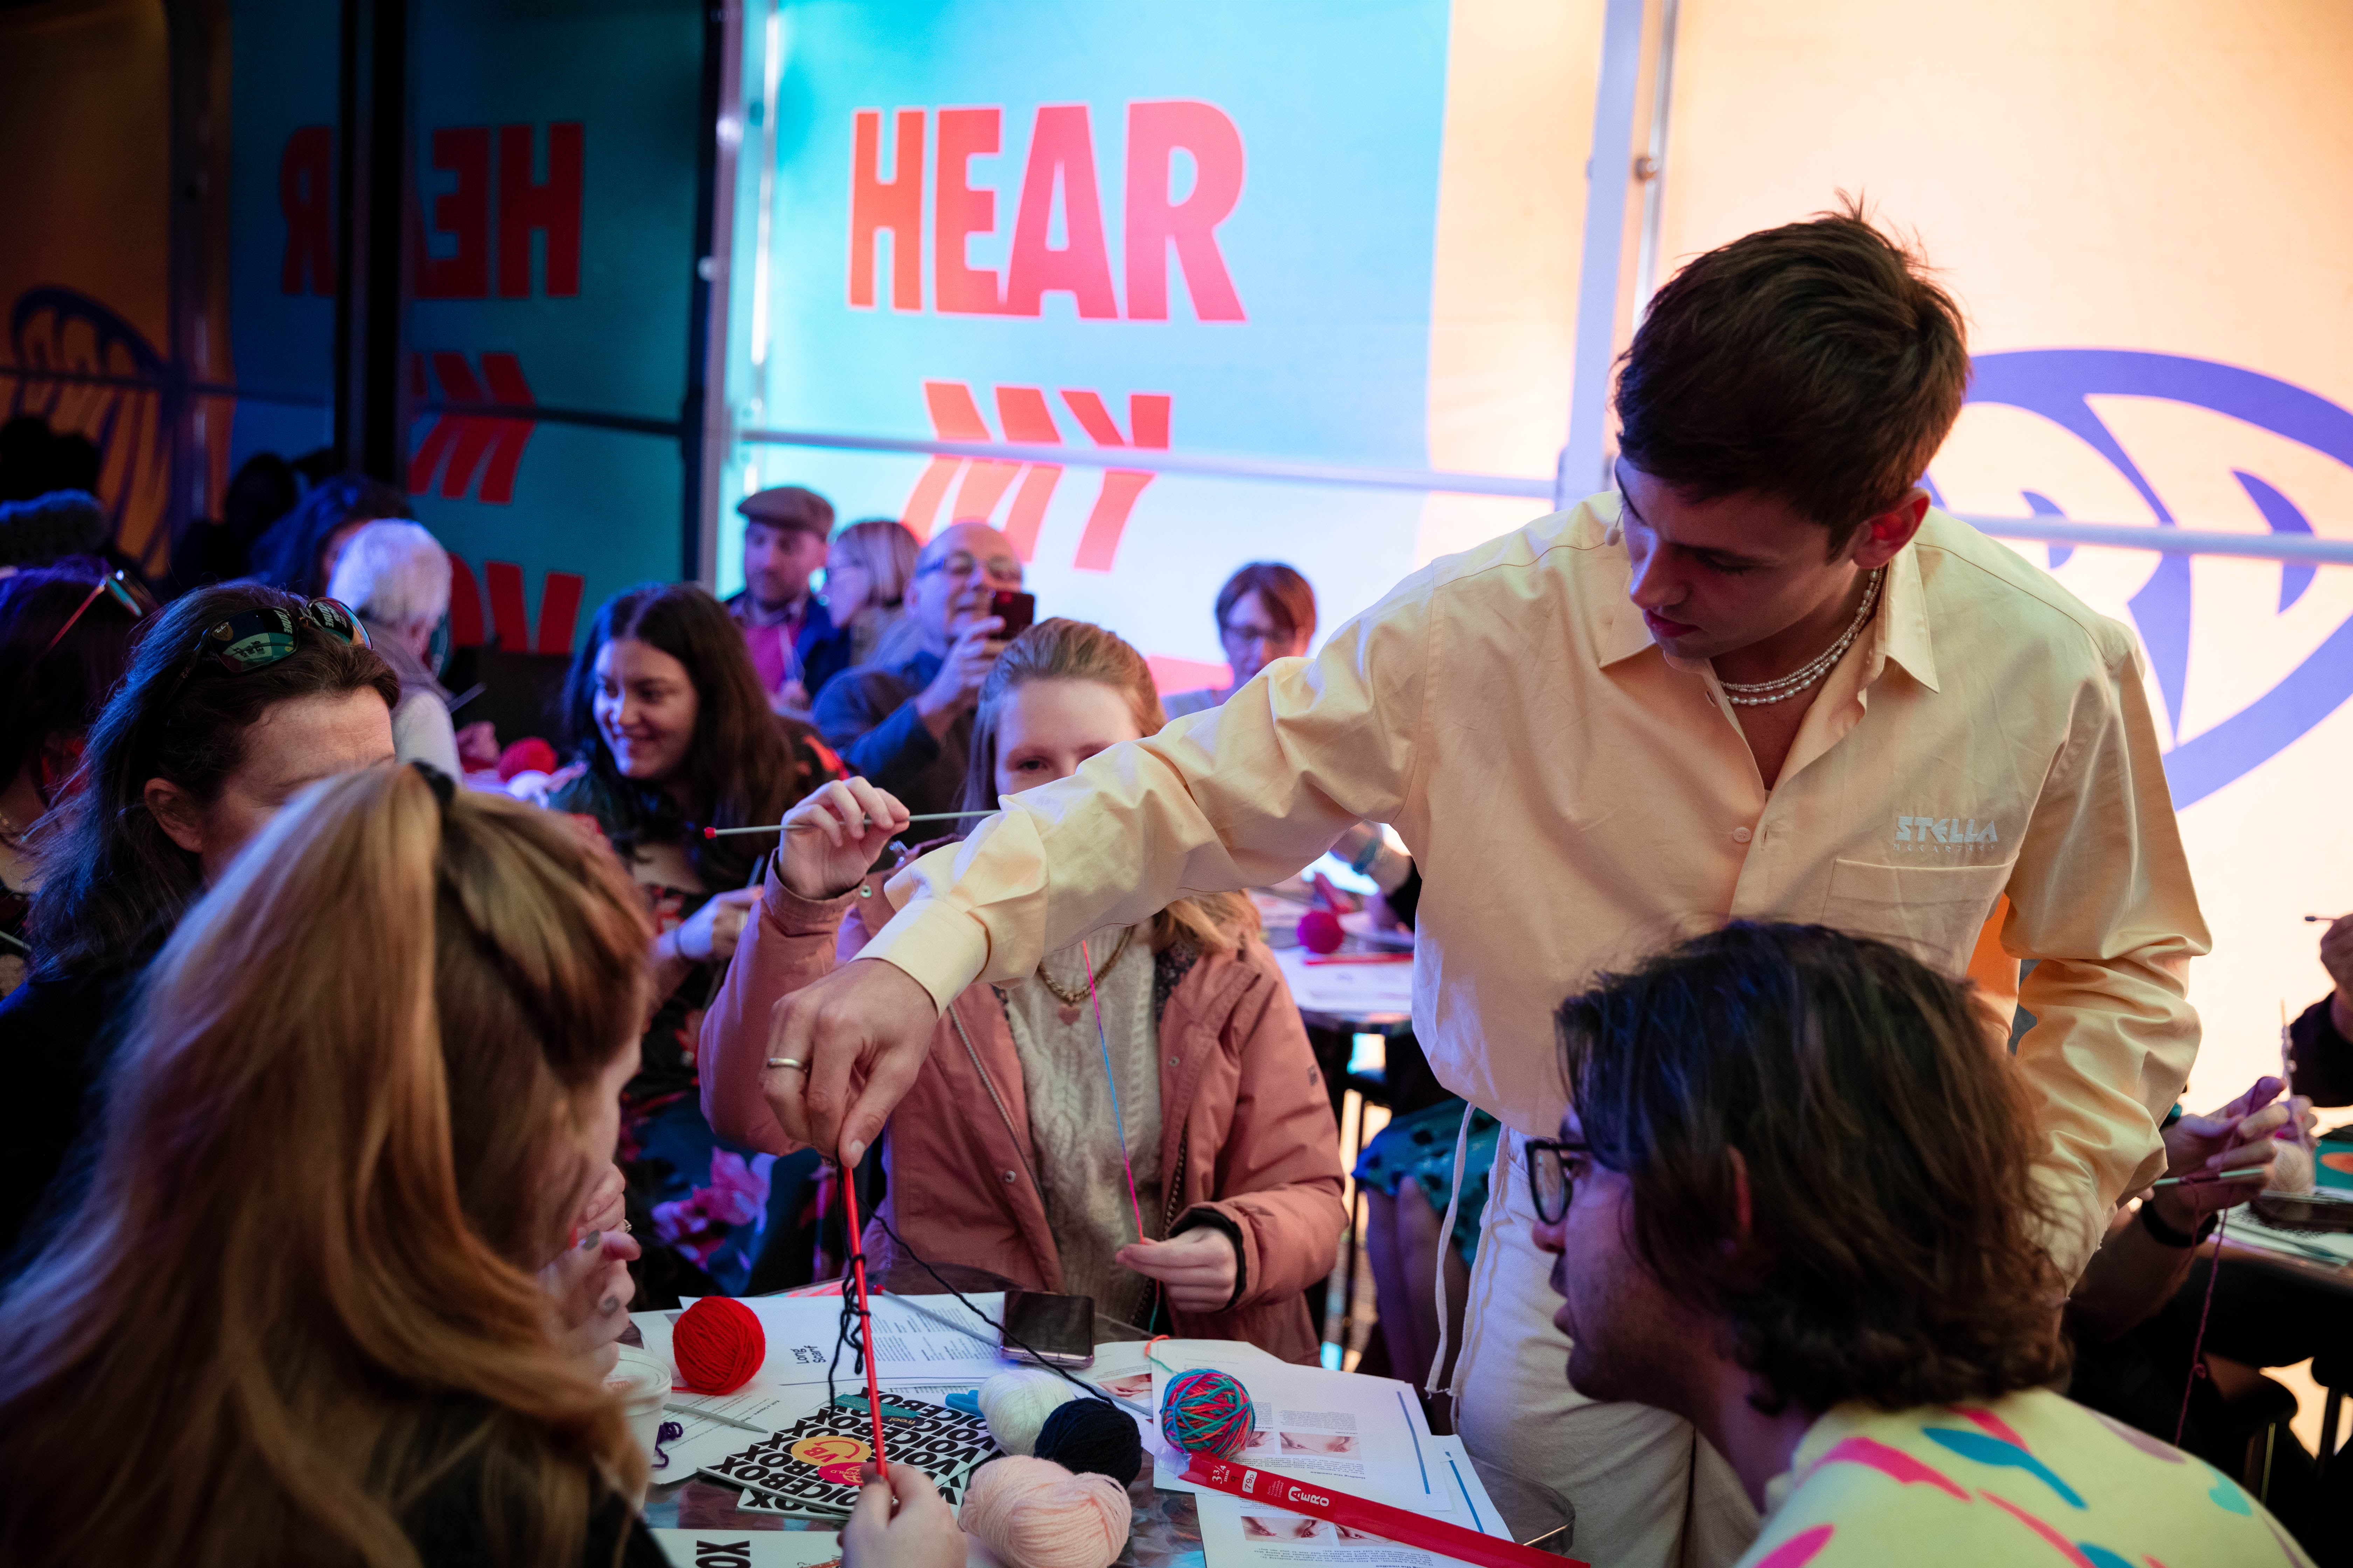
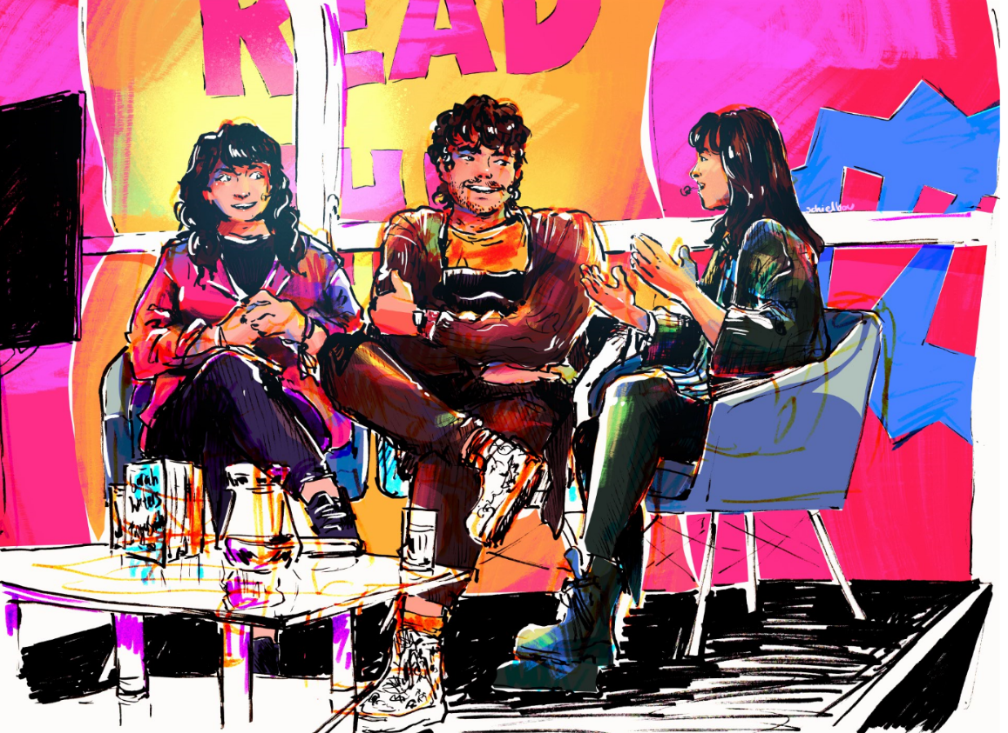
“How raw and real it was”
“Hearing others’ experience of life”
“Fresh perspectives and different topics to usual. Liked the fun feeling it was welcoming”
Building a VOICEBOX Community
“Loved the venue, very unique and intimate and imaginative!”
“The diversity, open-mindedness, educational value and sincerity of the panel and subjects”
“Felt like it was easy to chat to panellists and get advice”
Illustration: Emily Shilton
Tom Daley (Still Moving Media)
Jack Shute Instagram

Slide 6
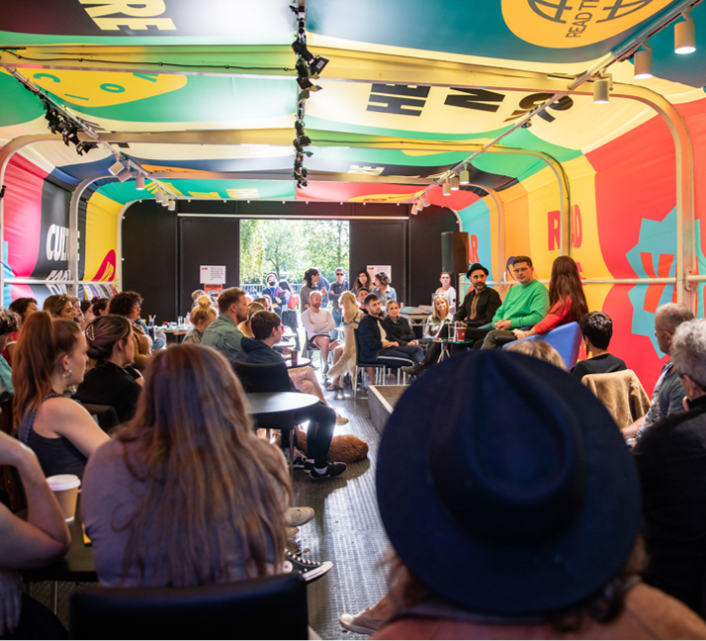
Early Results, VOICEBOX and the Future…
Our VOICEBOX Audience (2022)
16 – 30 Audience: 70%
Ethnically & Culturally Diverse: 24%
Deaf / Disabled: 14%
LGBTQI+: 33%
Community co-curation: 30%
Digital reach: 10.5m
New to Cheltenham Festivals: 36%

