Slide 1
This Is The Place
BAFA Conference for Festivals 2022
Nick Green
Arts Council England November

Slide 2
How Did We Get Here
Three-pronged approach to working in place
A universal offer which is accessible to all parts of the country
Work in places where joint investment in culture and opportunity to work with our partners and other arms length bodies is relatively high
Priority places where cultural engagement and current investment are low, and, as a result, opportunities for creative and cultural engagement are underdeveloped
#culturematters

Slide 3
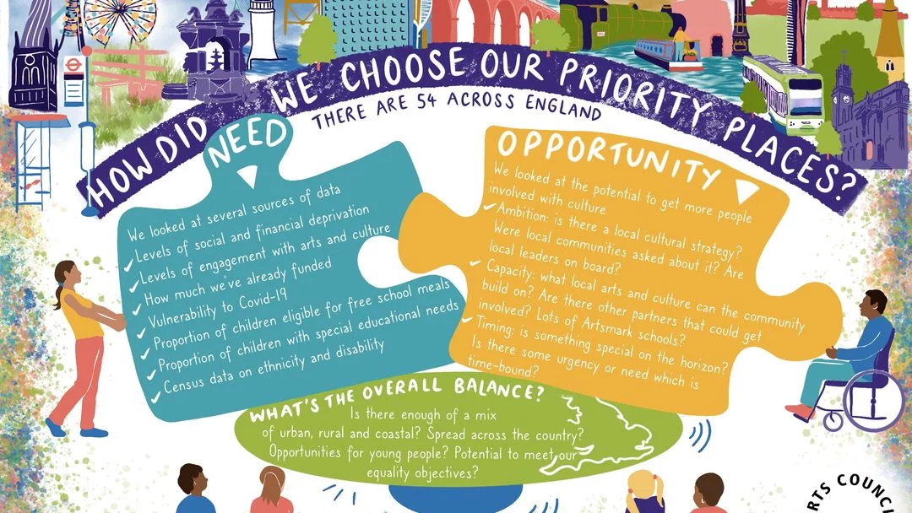

Slide 4
Establishing need
 | Need | Opportunity | Balancing
ACE investment | x
Engagement | x
Pandemic recovery – economic, social and health and wellbeing | x
Levelling up agenda | x
Places that work in partnership |  | x
Children & young people | x | x | x
Respond to moments |  | x
Equitable distribution | x |  | x
Relevant cultural sector | x |  | x
Inclusive cultural orgs |  | x
Type of place inc rural |  |  | x
#culturematters

Slide 5
Balancing
Geographical spread Type of place Potential impact on children and young people Diversity - Delivery Plan Equality Objectives
#culturematters
Notes:
The need/opportunity matrix will identify more places than could become priorities. These will then be subject to balancing.

Slide 7
What does being a priority place mean?
Increased investment and staff time
Increased engagement with culture
Increased social, health, and economic impacts
Remain a priority place for at least the three years of the delivery plan 2021-24
#culturematters

Slide 8
How Did We Get Here
LUCPs
ACE worked with the DCMS to identify 109 local authority areas, all outside of Greater London, which will be the focus for additional Arts Council England engagement and investment.
The 109 Levelling Up for Culture Places include: A further 56 local authority areas outside of London that have the highest need
#culturematters

Slide 9
How Did We Get Here
LUCPs
In its Levelling Up White Paper, the government commits to:
“Identifying over 100 levelling up priority places outside of London that will be the focus for additional Arts Council England engagement and investment.”
£43.5 million additional investment to benefit creativity and culture outside of London, and where possible to benefit the 109 LUCPs.
#culturematters

Slide 10
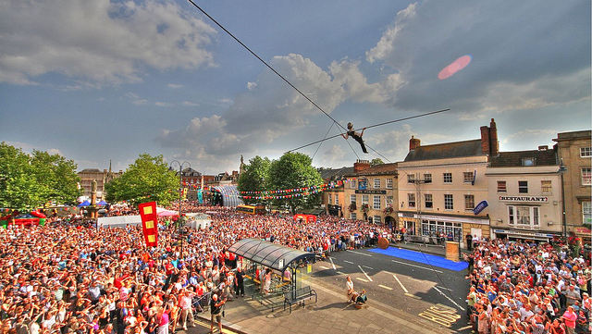
This is The Place
Devizes Festival – Bullzini Family
BAFA Conference for Festivals 2022
Nick Green – Arts Council England
November 2022

Slide 11
Why is this the place?
Changes in behaviour: the pandemic and cost of living
Attending an outdoor festival, carnival or street arts tended to be done locally 17% of all respondents are looking to do this activity closer to home in future, compared to before the pandemic
Overall, performance audiences expected to be attending live performances less than they did pre-pandemic but slightly closer to home
Audience Agency: Key Findings from the Cultural Participation Monitor
#culturematters

Slide 12
Why is this the place?
Environmental Responsibility
Fully addressing the climate crisis will mean:
Addressing impact including artist, production and audience travel
Local production and resourcing
Licensing conditions
#culturematters

Slide 13
Why is this the place?
Inclusion and Relevance
Improving equality, diversity and inclusion across the arts is key to releasing the true potential of our nation’s artistic and cultural talent, and it starts with entry level roles. Only a more representative sector at all levels will ensure that in future, the art that gets made is not just outstanding in form and content, but relevant to the widest possible audiences.
Jerwood bursaries
#culturematters

Slide 14
Why is this the place?
Let’s Create
Local opportunity to create and participate in culture is what people want
we aim to recognise and champion the creative activities and cultural experiences of every person in every town, village and city in this country, and to ensure that, over the next 10 years, we support more people to express and develop their creativity and create more opportunities for them to enjoy the widest possible range of culture.
#culturematters

Slide 15
Where are we now?
NPO 2023-26
National Lottery Project Grants
Investing in new NPO festivals in LUCPs:
Festival of Making, Blackburn
Festival of Thrift, Redcar
Ventnor Exchange – Isle Of Wight
Total £39,2m p.a.
Ongoing support through National Lottery Project Grants
#culturematters
Notes:
NPOs 2023-6: Blackpool Illuminations, Art Asia Trust Limited Artichoke Trust Artsreach BCP Council Blackpool Illuminations Brighton Dome & Festival Limited Certain Blacks Cheltenham Festivals Creative Folkestone Durham County Council Festival of Making CIC Festival of Thrift First Light Festival CIC Freedom Festival Arts Trust Greenwich+Docklands Festivals Magna Vitae Metal Culture Ltd MIF Milap Festival Trust Norfolk and Norwich Festival Trust SICK! Productions SPILL Festival Limited Stockton International Riverside Festival The Seachange Trust Ventnor Exchange Without Walls

Slide 16

Why is this the place?
Create the festival - make the place
#culturematters

