Slide 1
Brexit: UK nationals in the EU Options for artists, actors, performers and models
Fragomen presentation for Creative Industries Federation
May 2021

Slide 2
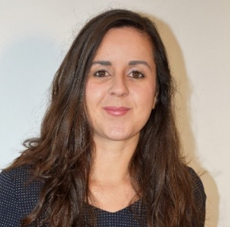
WITH YOU TODAY
KASIA PINSKA
ANDREW BARNETT
TIPHAINE MOREAU
PATRICIA GARCIA
LUIGI GRECOLA
Director
Fragomen
Europe
Senior Manager
Fragomen
Europe
Manager
Fragomen
France
Supervisor
Fragomen
Spain
Supervisor
Fragomen
Italy

Slide 3
BREXIT: UK NATIONALS IN THE EU*
30 JUNE 2021
UK nationals working in the EU before 31 Dec 2020
Must secure Article 50 Permit or Frontier Worker Permit (deadlines may apply, varying by country)
Article 50 Permit should be used as Right to Work evidence; in some jurisdictions a grace period applies in which other documents can be used
UK working in the EU (1 Jan 2021 onwards)
Immigration schemes for non-EU citizens: Member State rules and conditions of employment will determine work authorisation type
Employers must consider timelines, costs, compliance
Right to Work evidenced by work permit/visa/residence permit per Member State requirements
Workforce planning possible if work in more than one EU country is envisaged
UK travellers – business and personal travel
Activities must be screened in each Member State
No visa required but strict allowance of 90 days within any 180-day period within the Schengen zone; consequences for non-compliance
Possible work permit exemptions; broader possible exemptions under Trade & Cooperation Agreement
*Excluding Ireland

Slide 4
EUROPE AND SCHENGEN
EU Schengen Countries
Non-EU Schengen Countries
Non-Schengen EU Countries

Slide 5
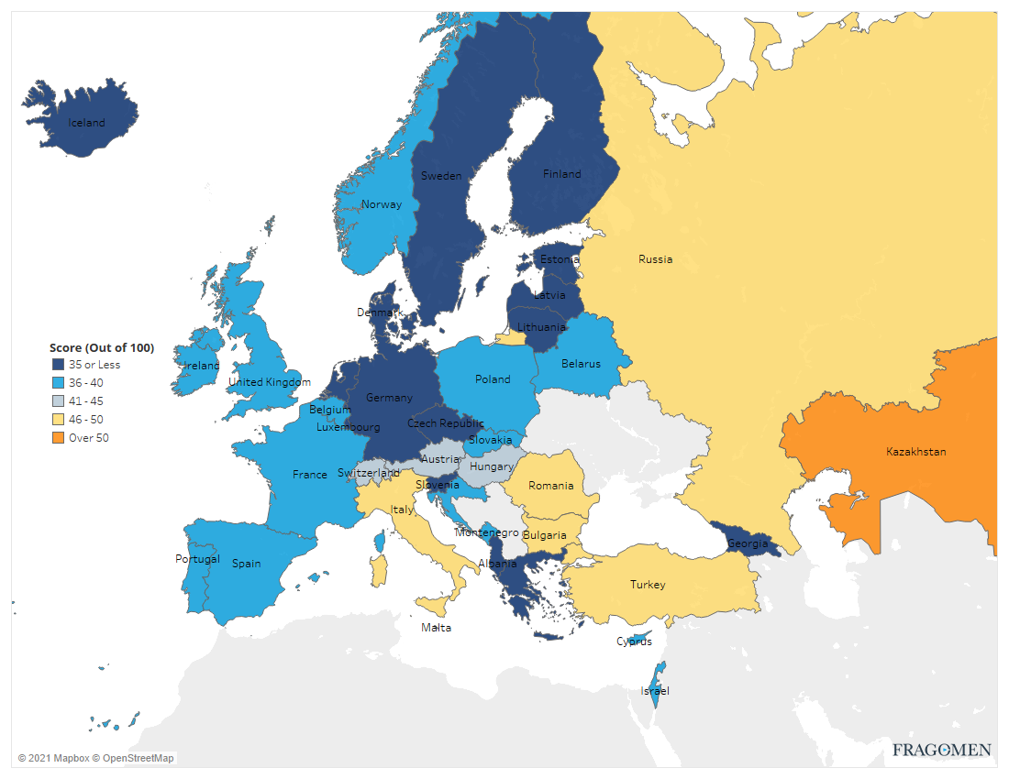
HEAT MAP OF EUROPEAN RESTRICTIVE PRACTICES
This map gives you a bird’s eye view of immigration rules using a scoring system of the extent to which countries restrict a company’s ability to transfer or hire a foreign national to work temporarily based on several factors. The higher the score, the more restrictive.
Factors include:
eligibility requirements on the company and the foreign national
limitations on the types of employment positions
the degree of certainty that authorisation will be approved
government processing time and fees
the complexity of the process
hidden costs or risks
the level of corruption
.

Slide 6
A NOTE ON THE UK-EU TRADE & COOPERATION AGREEMENT
The TCA permits a broader list of activities under business visit status… but does it help you?
Short-term business visitors (up to 90 days in any six-month period)
Meetings and consultations
Trade fairs and exhibitions
After-sales/after-lease installation, repair or maintenance service
Commercial transactions
No direct sale to the public
No remuneration from the EU country
Not supplying services under a contract between a UK person/company and a consumer in the EU country
Patricia.Garcia@Fragomen.com
+ 44 (0)20 7090 9353

Slide 7
SPOTLIGHT ON SPAIN
ARTISTS
Artists Visa with work authorisation exception
Company based in UK/Spain
Definition of artist
No more than 5 consecutive days or 20 cumulative days
Options for short and long term
Schengen allowance consumption
Options for employed and self-employed contractors
Authorisation - artists of international prestige
Company based in Spain
Artists of International prestige
Approval from the Ministry/official department needed
Only for employed
Visa required
OTHER
Work permit (National ICT)
Supporting an artist of international
prestige

Slide 8
FOCUS ON FRANCE
Artists (singers, actors, film/production crew)
Short-term (up to 90 days) - corporate sponsorship and self-employed
Long-term (more than 90 days) - corporate sponsorship and self-employed:
Models
Temporary Worker
UK Modelling agencies can no longer obtain a Model Agency Licence which is accessible to EU countries exclusively. As a result, short or long term assignments are no longer available for models hired by a UK modelling agency

Slide 9
INSIGHT INTO ITALY
Artists (singers, models, actors, film/production crew):
Employed by the UK entity
Work authorisation and visa required
No difference between short (less than 90 days) and long terms
Local Italian entity to sponsor the work permit
Processing times (2 months from documents submission)
Self-employed
Self-employment work permit and visa required
No difference between short (less than 90 days) and long terms
Strict interpretation of self-employed artists by authorities
Processing times (2 months from document submission)

Slide 10
Panel Discussion

Slide 11
Scenario:
A company of dance performers spending two weeks carrying out paid engagements and taking a crew/entourage with them

Slide 12
Scenario:
A visual effects specialist working for a UK company and spending 1 month carrying out paid work on the post-production of a film and taking equipment with them

Slide 13
Scenario:
A freelance touring musician taking up a series of paid engagements over one week in one country followed by another week of paid engagements

Slide 14
UK who resided in Europe before December 31, 2020
Regularise status in EU country of residence – deadlines may apply
As from January 1, 2021
Travel time to Europe will be limited to 90 days within 180 days
Travel between European countries will be limited
Activities may require authorisations to perform work – check exemptions where available
Obtaining permits or visas in Europe might be time-consuming, requires planning
Remember

Slide 15
THANK YOU!
Contact us for more info:
KASIA PINSKA
KPinska@Fragomen.com +44 (0) 20 7090 9204
ANDREW BARNETT
Andrew.Barnett@Fragomen.com
+ 44 (0)20 7090 9145
TIPHAINE MOREAU
TMoreau@Fragomen.com
+33 1 86 65 70 40
PATRICIA GARCIA
Patricia.Garcia@Fragomen.com
+ 44 (0)20 7090 9353
LUIGI GRECOLA
LuigiGrecola@Fragomen.com
+ 44 (0)20 7090 9391

